Slide 1
Investment Management and Asset Performance in the State Services: Update
Presentation to Investment & Asset Management workshop
Victoria University Campus, 11 November 2015
Notes:
Good morning, thank you Michael David and Sharon Cottrell for inviting us to come to this workshop. Its a pleasure to be here.
I’ve come along this morning to let you know what’s going on in central government in what we now call the investment management and asset performance space.
This is the domain of capital investments but it includes “Cloud-based” services as well as rents. Its what we used to call CAM
I hope what I cover today will stimulate discussion in the workshop and in other forums as you and the TEC consider what may be appropriate for your sector in the future.

Slide 2
Outline of presentation
Coverage | Page
Investment Management System | 3
Change programme 2015-17 | 4
Developments since July 2015 | 6
Investor Confidence Rating ( ICR) | 7
Long term Investment Plans | 10
Update on BBC changes | 12

Slide 3
Investment Management System
Notes:
Once upon a time (back in 2010) we described the capital asset management system in terms of the processes we had in place to reveal intentions, develop business cases, monitor project performance and measure and enhance agency asset management capability.
What this diagram shows is that our thinking has evolved in several important ways:
There is a portfolio perspective – a more deliberate focus on selecting the investments that will deliver what government wants
There is a value (rather than financially constrained) perspective – the new paradigm seeks best value within acceptable risk parameters
There is a more systematic use of performance information over the life of the investment, rather than a focus on the investment decision alone, and
There are system objectives and roles for key actors.
System objectives
Investment choices and decisions need to be informed by disciplined processes across the system and at agency level in order to:
14.1optimise value generated from new and existing investments;
14.2 increase the efficiency and effectiveness of the investment management system; and
14.3 enable investments to achieve their specific investment objectives.
To that end, the system must:
15.1enable Cabinet and agencies to prioritise and coordinate significant investments according to government and State services long term priorities;
15.2establish, disclose and then deliver the agreed value from particular investments;
15.3promote good stewardship of Crown resources;
15.4enable Ministers, agencies, and the corporate centre to exercise their required roles in a flexible and efficient manner; and
15.5make systematic use of performance information in corporate centre and agency investment management and decision-making processes.

Slide 4
Change Programme 2015-17
Improved leadership and co-ordination
Eg Investment Ministers,
Extending the coverage to selected Crown companies
More flexible business case frameworks
Moving to a more integrated and flexible assurance system
Giving greater prominence to long-term investment
Introducing a strategic stage gate (SAR or strategic assessment review)
Including functional leaders roles and services
Implementing portfolio management
Reporting on asset and investment performance (benefits, delivery)
Introducing capability and performance assessments
Introducing an investor confidence rating (ICR)
Notes:
I’m going to spend most of my time this morning on these shaded items whaich are part of an overall programme to change the way central government makes capital investment decisions and delivers results.

Slide 5
Focus on 24 Investment-intensive agencies
Tranche 1 (2015) | Tranche 2 (Feb-June 2016) | Tranche 3 (August – December 2016)
ACC Corrections Education IRD NZDF NZTA | Auckland DHB Northland DHB Counties-Manukau DHB Waitemata DHB Canterbury DHB | Conservation Customs Housing NZ Internal Affairs Justice MBIE MFAT MSD Police MoH Waikato DHB Capital and Coast DHB Southern DHB

Slide 6
Recent developments (since July 2015)
New expectations published on-line via new Cabinet Office circular CO(15)5 which:
  Defines what’s in scope of the investment management system
  Sets out objectives of the investment management system
  Explains the roles of parties in the system especially the role of Investment Ministers and the Corporate Centre
  Introduces new incentives regime “Investor Confidence Rating”
  Places greater focus on long term investment plans as key aspect of the system
  Confirms the requirements for business cases, project assurance and benefits reporting
New Treasury investment management website: http://www.treasury.govt.nz/statesector/investmentmanagement
Rolling out ICR across 6 tranche 1 agencies
Notes:
See presentation from May

Slide 7
Investor Confidence Rating
ICR being rolled out in 3 tranches over 18 months.
ICR is a Cabinet-approved rating of an agency based on mix of 4 lead (e.g. maturity, quality of long term plans) and 4 lag indicators (e.g. asset or project performance).
  An expression of confidence that investors (e.g. the relevant portfolio Minister, or Investment Ministers) should have in government agencies to manage asset portfolios well and successfully deliver promised benefits from investments.
ICR may directly impact the level of delegated authority, scrutiny and support an agency has over investments.
Focus for performance improvement

Slide 8
The elements of the ICR

Slide 9
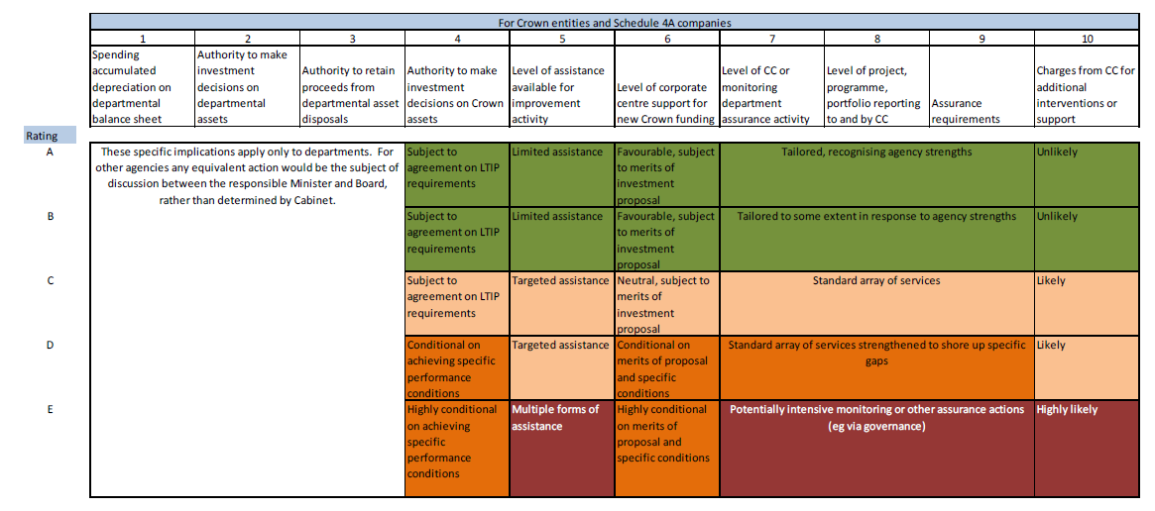
Potential implications from ICR
Will vary according to investment context in each agency but potentially there will be ...
More autonomy than present for some agencies, and
Less autonomy than present for others

Slide 10
Long-term Investment Plans
  Describe the investment journey over at least 10 years for an investment-intensive agency
  The LTIP reveals what will be invested in and how investment will occur in order to support delivery of the agency or sector strategic intentions.
  The LTIP should be one element of the agency’s overall planning, management and reporting activity.
  The quality of the LTIP matters: it affects the agency ICR, informs all-of-government portfolio management choices.
Notes:
We’re giving new life to an idea that has been around formally since 2010 but doing it in a way that makes it relevant to the investment management system.
In the intervening period we got fixated on departmental 4 year plans (which in truth have been of limited value due to the near term focus).
The LTIP has similar information requirements to what we used to call capital intentions reports. What has changed since 2010 is the demand from Investment Ministers in particular for better information on the current and expected performance of asset portfolios as well as the performance of individual investments. Also the SSA changes in 2013 heightened the need for departmental CEs to demonstrate good stewardship of government assets. Plus the corporate centre (including GCIO) is much more interested in performance of these things. And finally, importnatly, the quality of the LTIP will affect an agency’s ICR.

Slide 11
Context for Long Term Investment Plans
Notes:
The LTIP should be one element of the agency’s overall planning, management and reporting activity.
The LTIP should clearly align and integrate with agency or sector strategic processes such as:
strategic thinking and strategic intentions (eg, Statement of Intent)
medium term planning (eg, a department’s Four-year Plan)
annual business planning, and
functional planning (eg, asset management planning)
This slide illustrates how strategic intentions inform and are informed by a range of typical planning outputs. Planning outputs will be tailored to different audiences, purposes and planning horizons. They can include functional plans such as ICT, asset management, property or workforce, and Better Business Cases for programmes and projects relating to investments in the LTIP.

Slide 12
Better Business Cases - Update
BBC has been in place since 2010 to enable smart investment decisions for public value
BBC is based on the 5 Case model:
    Strategic case
    Economic case
    Commercial case
    Financial case
    Management case
Review undertaken earlier this year including expert evaluation, Gateway lessons learned and user feedback
New features effective 30 September 2015

Slide 13
BBC – Insights from various sources
Expert evaluation
Significant improvement in quality of business cases since 2013: Overall level of business case maturity is moderate
Business cases being applied well to projects but more emphasis needed on programmes
Users
Concerned about fit with policy decisions, annual budget process
  Gateway Lessons Learned report
  Still significant uncertainty about: the application of the business case framework to programmes; how the process, information can be scaled to the investment context

Slide 14
BBC – New emphasis, features
Encourage agencies to use Endorsed BBC Experts
Launch Clinics for Investment Intensive Agencies
Start publishing BBC case studies
Encourage agencies to make use of training
Enhance the BBC Reviewers Course for the Corporate Centre
Introduce Investment Management Course and Executive sessions
Release revised guidance

Slide 15
BBC – Latest guidance
http://www.treasury.govt.nz/statesector/investmentmanagement/plan/bbc
Clarifies:
what’s expected and the suggested evidence
the relationship with strategy and policy
fit with decisions in annual budget process
Introduces:
principles-based approach to use of methods and tools
different ways of designing and delivering ICT projects
recent changes to the Government Procurements Branch’s guidance, early market engagement
Replaces:
multiple scoping documents into one point of entry document

