Slide 1
Regional Skills Leadership Groups (RSLGs) – Delivering the Vision
RoVE Virtual Hui
APRIL 2022

Slide 2
Collaboration – key to realising RSLG success
Regional Skills Leadership Groups (RSLGs) identify and support better ways of meeting future skills and workforce needs in our regions and cities.​
In a RoVE context this means a system that is collaborative, flexible, innovative and sustainable for all regions and communities, with provision that responds to regional skills needs.
This sort of change ‘wont happen overnight, but it will happen’, but relies on collaboration at a local, regional and national level.

Slide 3
Canterbury: WDC and national alignment
The Canterbury RSLG has identified the Manufacturing sector as a priority workforce and skills focus area.
Drawing on initial RSLG theming late last year, Hanga-Aro-Rau have met with the RSLG secretariat around areas of collaboration.
In addition to engaging with RoVE and tertiary education partners, the RSLG is engaging with the Advanced Manufacturing Industry Transformation Plan to identify areas of alignment, including engagement and consultation.

Slide 4
Marlborough: regional engagement
The aged residential care sector has been identified by the Marlborough RSLG as having potential underemployment as well as a growing demand for labour.
In mid-2021 the Marlborough RSLG held a workshop with all the key players within the sector to work through issues faced locally and develop solutions to address these issues. This was the first time all key players had been in the same room together.

Slide 5
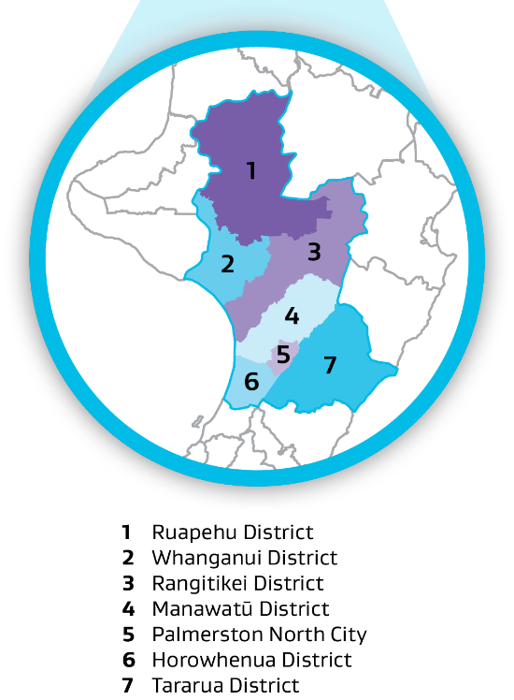
Manawatū-Whanganui: the sub-regional voice
The Manawatū-Whanganui RSLG has been working hard to ensure that all communities, no matter how large or small are heard. This includes:
Ensuring that all RSLG members have a good understanding of all communities in the region
Actively encouraging and facilitating the sharing of best proactive
Having ‘down the metal road’ case studies in their regional workforce plan

Slide 6
Closing the loop – how collaboration fits with the vision
These examples of collaboration reflect the journey that we are on towards building workforce planning capability within our regions, and this will take time.
RSLGs, through the likes of their Regional Workforce Plans, support and facilitate labour market dialogue within their regions.
In supporting businesses, workers and communities to identify and act upon local opportunities, RSLGs can build a reputation as the “go-to” place for regional labour market insight.
In turn, this will help expand the ongoing collaboration and ultimately support enduring skills and labour solutions that are tailored to our regions.

Slide 7
Ngā mihi nui kia koutou
Questions?
Contact us RSLG@mbie.govt.nz

