Slide 1

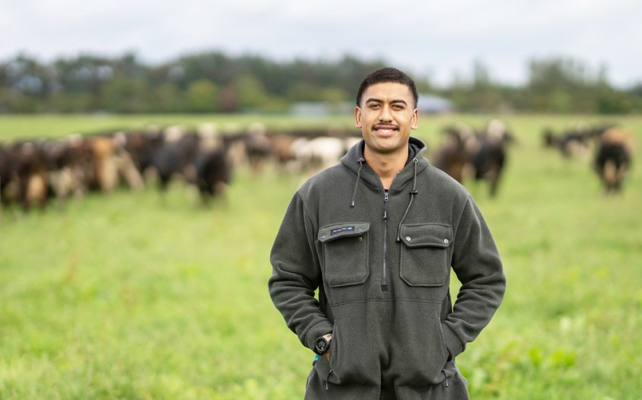





Slide 2


Commitment With Aspiration
Driven by the RoVE, FFCoVE is an initiative of the Food and Fibre Centre of Vocational Excellence Society Incorporated. The society is a combination of industry peak bodies, employers and training providers from across the food and fibre sector. The FFCoVE is committed to investing in excellence in vocational education and training for the food and fibre sector so that:
Learners have access to and can experience exciting, varied and fulfilling opportunities
Employers engage as trainers/learners and develop motivated and ambitious employees
Higher numbers and a more diverse talent pool of learners are attracted and retained
We see the needs of Māori and Pasifika employers and ākonga being met
FFCoVE complements the strategies of Fit for a Better World along with the Food & Fibre and Forestry Skills Action Plans
As investment agents we understand what the market and consumers require for success

Slide 3
Food and Fibre Cove Core Values
Courageous –Māia: We will challenge ideas, systems, models and practises and pursue a path of positive disruption, all the time seeking Vocational Education and Training excellence
Innovation -Auaha: We consider possibilities and encourage new ideas, seize relevant opportunities, learn from challenges, and build on our successes
Integrity -Pono: We will be transparent, responsible, honest and accountable, listening with intent and taking relevant action
Synergistic -Whanaungatanga: Valuing our relationships, we will work with others through productive and co-design partnerships by sharing knowledge and expertise to contribute towards common goals common goals.

Slide 4
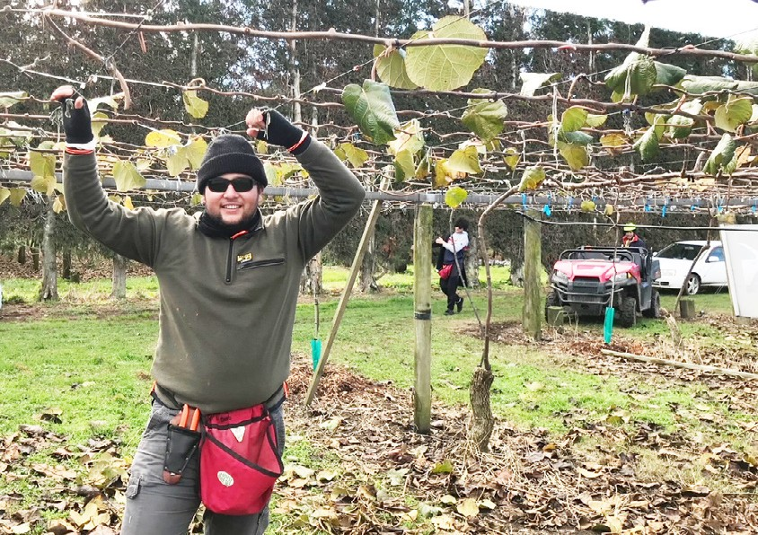

We have an important role to deliver quality outcomes for
New Zealanders

Slide 5
Learner Focused, Industry Led,
Government Enabled
The Food and Fibre CoVE will ensure an enduring focus on educational excellence in the Food and Fibre Sector for learners and their whānau
The Food and Fibre CoVE will ensure an enduring focus on educational excellence for industry and employers, and the current and future workforce
The Food and Fibre CoVE will ensure an enduring focus on Government expectations and complementary policy work

Slide 6
Learner Focused
Industry-led, Government-enabled
Muka Tangata
FFCLG
Food & Fibre Capability Forum
Board
PICA
FFCoVE Society
TEC
FFCoVE
General Manager
Te Pūkenga
FFCoVE host
Technical Reference Group
Portfolio Manager
Operations Administration Coordinator
OTHER STAKEHOLDERS
PTES Other CoVE's
Project teams
OTHER GOVERNMENT AGENCIES
RSLG MOE
KEY:
Industry/ peak bodies
NZQA
MPI
Core structure Key partners Other influencers
Employers

Slide 7

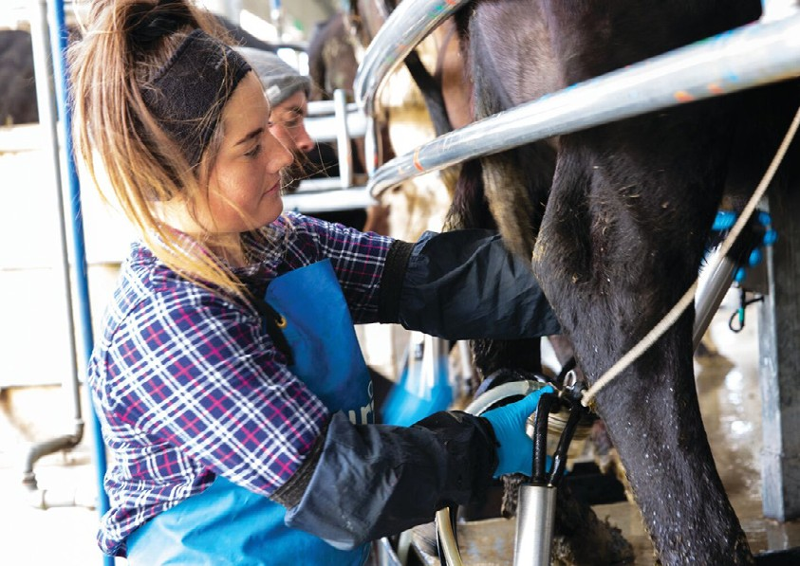
Building a talented team is important for the success and longevity of our business

Slide 8


THE FFCOVE TEST
THE FFCOVE PROJECT EVALUATION & APPROVAL PROCESS
THE GAME PLAN
Project Concept I/we have an idea for a project
THE PROJECT DELIVERS ON THE COVE’S TERMS OF REFERENCE?
Adopt or adapt as required (process ends)
Is there an existing product to adopt or adapt?
Learner outcomes
Industry outcomes
Education outcomes
YES
NO
THE PROJECT DELIVERS ON 1 OR MORE OF THE COVE’S FOCUS AREAS & THEMES?
(rework and resubmit or cancel)
Vocational excellence
Attraction and retention
Innovation
Draft Project Definition
This is what I/we think the
NO
project would achieve
Does the Draft Project Definition meet the FFCoVe Test?
THE PROJECT CREATES POSITIVE IMPACTS IN EACH TARGET GROUP?
Impact on Learners
Final (collaborative) Project Definition Amalgamation of like initiatives, expanded requirements to meet a wider (but related) need etc.
YES
Increases enrolments and higher achievements
Provides more effective pathways
Improves Māori outcomes
Equalises opportunities (gender, ethnicity, etc.)
Reduces location dependence
Reduces learning challenges
Improves hauora/resilience
Creates easier, quicker transitions
Provides a better knowledge and skills mix
Improves curriculum/courses/qualifications
Enhances career stage/lifelong (up-skilling and re-skilling)
(rework and resubmit or cancel)
NO
Business Case Defines what needs to be delivered to generate the benefits required, in what time
Does the revised Project Definition meet the FFCoVE Test?
YES
Impact on Industry
and at what cost
Did the Board approve the Business Case?
Supports employers as learners
Increases productivity
Optimises system settings
Improves sustainability
Targets Māori expectations
Improves skills supply
Increases investment/funding
Improves employer/leadership outcomes
Prototype We’re uncertain about the solution so need
to trial different approaches to get the right outcome (including a managed impact)
Pilot
We know what the solution is but are uncertain about the impact so need to test it in a more controlled environment before
rolling it out sector-wide
YES
NO
Impact on Education
Action as directed:
Return for amendment
Hold pending resubmission (when funding is available, when other scope can be added etc.)
No further action required (process ends)
Improves flexibility, agility, relevance
Enhances workplace-focused learning
Increases demand
Delivers work-ready graduates
Increases employer and learner satisfaction
Full Project
We need to develop the solution from scratch and test it for sector-wide implementation

Slide 9
Portfolio of Projects to Date
Completed Projects:
Data Management System and Knowledgebase https://foodandfibrecove.nz/knowledgebase/ffcove-kb/
Evaluation Framework
Taking Stock
Technology Enabled learning Website
Current Projects:
Tupu Case Study
Te Ao Maori Integration into Level 3 Maori Cadetship
Year 7 and 8 STEM Programme
Systems Approach to Micro-Credentials
Work Integrated Learning pilots
Training in the Shearing and Wool Industry
Farm For life Case Study
Food and Fibre Degree-level Apprenticeship
Residential and Group Training Research Project
Under Development:
Attraction and Retention Research Programme
Food and Fibre Sector Leadership Framework
Food and Fibre Training and Career Framework

Slide 10
Taking Stock
Initiated by FFCoVE Lead By Scarlatti
The Taking Stock project is started in July 2021 and was completed at the end of February 2022. Its objectives and the resulting outputs were;
A literature review that established an authoritative view of best practice vocational education and training delivery against which the current state could can be compared
A set of rubrics against which the sector can measure what is acceptable, good or excellent in vocational education and training
Through surveys and interviews across a wide range of vocational education and training providers, food and fibre sector employers, peak bodies and learners developed a report on what is working well and what good practice looks like

Slide 11
Tupu Case Study
Initiated by Te Hiku Development Trust Lead by Te Hiku Development Trust
The Te Hiku Iwi Development Trust (Kaitaia, Northland) recently commissioned an innovative ‘learn as you earn’ programme (the Tupu programme) to trial a new way of transitioning out of work rangatahi into meaningful work. It was obvious that, even after just a few months, some impressive results were being achieved with very positive outcomes for both worker-leaners and employers in an environment where neither group had been particularly well served in the past. It was agreed that;
Empirical data should be captured on what was different about the Tupu programme and why those changes were working for Tupu where other programmes across New Zealand had not been as successful
A report be developed to ensure all learnings be made available to future initiatives, providers and Government agencies alike
Funded by the FFCoVE, the Trust has engaged a research company which is working toward a final report toward the middle of 2022

Slide 12
Residential and Group Training
Research Project
Initiated by FFCoVE Led by Skills Consulting
Based on initial exploration, there appears to be potential for an updated or modernised version of residential training within the FF Sector. Similarly, Group Training would seem to offer a range of advantages that make it an attractive option for the food and fibre sector. This project will explore the potential for a Group Training Scheme to be established, on its own, or as an element of a wider training model.
The primary objectives of the research are:
To capture and consider national and international best evidence on both residential and group training, and test these for applicability in the Food and Fibre sector.
To assemble the necessary information and inputs to design a new training model or service innovation within the Food and Fibre sector.
To test the proposed model against relevant policy settings and good practices to ensure system deliverability and industry credibility.
To consider how the new training model can expand or augment current formal VET delivery, to attract more learners and employers through the availability of a new and fit-for-purpose training option for the sector.

Slide 13
Food and Fibre Leadership
Framework Project
Initiated by Rural Leaders
This project proposes to design and drive the adoption a food and fibre leadership training framework with supporting system(s). it will provide a set of success criteria that other projects would use in order to meet the current and future leadership needs of New Zealand’s food and fibre sector.
Initial consultations have revealed a demand for a high-performance leadership system, underpinned by an academically credentialed framework at every level that will lift the performance and profitability of food and fibre businesses across the sector.
Left unchecked, the sector will end up with a plethora of disconnected leadership programmes that are not credentialed vocationally or academically, lack logical progression, and suffer from a variety of pedagogical value. Therefore, this project is designed to have impact across the food and fibre sector.
Once instituted, the food and fibre leadership framework and enabling systems will form the backbone of the wider high-performance food and fibre model. It will take industry entrants and volunteers and build their competency and confidence through different transition levels so that they can evolve their capabilities in-line with increasingly complex roles and responsibilities.
The impact of this is a Sector that values its people, a Sector in which people achieve their potential and a Sector that can leverage its opportunities in a VUCA (Volatility, Uncertainty, Complexity and Ambiguity)
era of accelerating change.

Slide 14
Proposed Collaboration with ConCoVE
We recognise the, by design, close similarities in each others Kaupapa
We had agreed from the outset to collaborate and our relationship continues to develop
We share intelligence and insights on each others projects
Staff from either CoVE can, where applicable, sit on the other CoVEs project steering or reference groups
We have discussed the possibility of two joint programmes of work:
Productivity, which will include both leadership, disruptive technology and diversity
Sustainability or “a Landscape for living” both CoVEs recognise the importance of ensuring all future training for industry no matter the level, needs to ensure both the building in a focus of the importance of environmental sustainability as well as the technical knowledge and skills to realise that focus

Slide 15
In Conclusion
The Food and Fibre Cove in its pursuit of the encouragement and continued development of vocational excellence, unashamedly focuses on the learner placing them at the center of all of its activity
The Food and Fibre CoVE as its name suggests takes its lead from its industry constituency and strives, with its constituency and all VET related partners, to ensure that the Food and Fibre Sector has the skilled talent that it needs to thrive and grow into the future
The Food and Fibre CoVE is fully committed to the ongoing success of the wider Vocational Education and Training Sector and to Aotearoa Inc as a whole. All Food and Fibre Cove outputs will be readily available for use by whom ever wishes to use them

