Slide 1
Asset management and long-term planning
Learning from audit findings
2015 to 2017

Slide 2
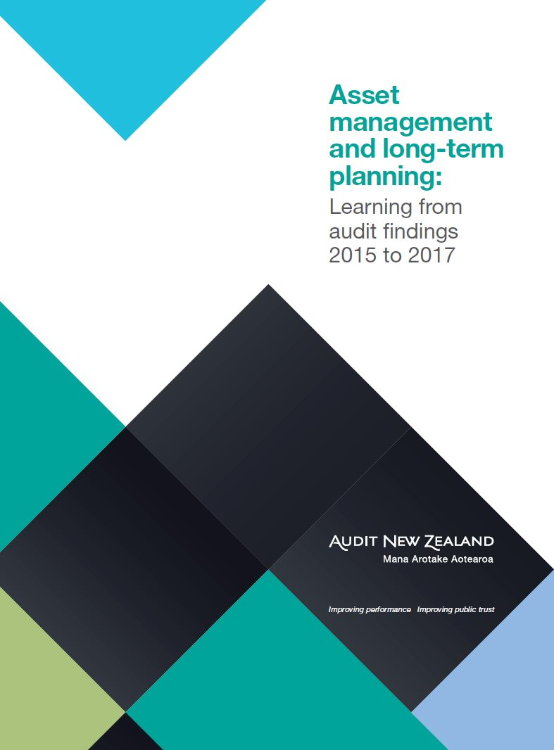
Asset management and long-term planning
Notes:
I am here to talk about our latest publication:
Asset management and long-term planning: Learning from audit findings 2015 to 2017
This publication is intended to be a resource for public sector organisations that manage significant infrastructure networks
And those whose services rely on assets for their delivery.
It is aimed principally at:
asset managers - responsible for managing asset-related functions or contributing to planning – the asset management team if you like; as well as
Senior managers and governing bodies that have responsibility for making strategic and asset-related decisions.
It builds on our similar publication of April 2010, Asset management for public entities.
Both are a combination of thoughts from our audit findings, reflections on good practice, and some highlights of notable practice from across the sector.
In 2010 we said that good asset management is an integral part of an organisation’s service and financial planning. That is even more true as our population increases and makes more demands on public services.
Through this publication we are making the most of our unique view across the public sector. We want to raise the profile of asset management, and support the practitioners working in it. We want to foster continued improvement across the public sector by sharing our views and examples.
We pose 10 questions that we think governing bodies and senior management need to know the answers to.
We are confident that the information in this publication will add value and encourage sharing of good practice examples and lessons learned, between asset managers and across public sector organisations.
We quote examples from 15 entities in this publication. I want to thank the public sector organisations who agreed to be featured. Their willingness to be open and transparent contributes to the effectiveness and efficiency of the public sector.
We are not saying that these organisations are perfect. Nor that we have all the answers. We are merely
pointing to some examples that we think are interesting; and
encouraging the public sector to share the skills, knowledge and experience that we see across the country.

Slide 3
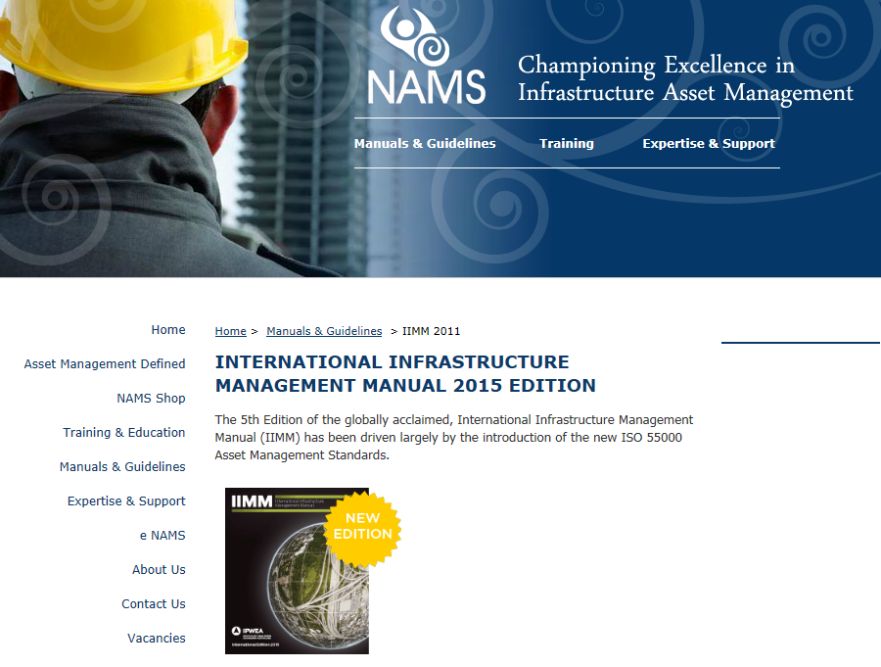
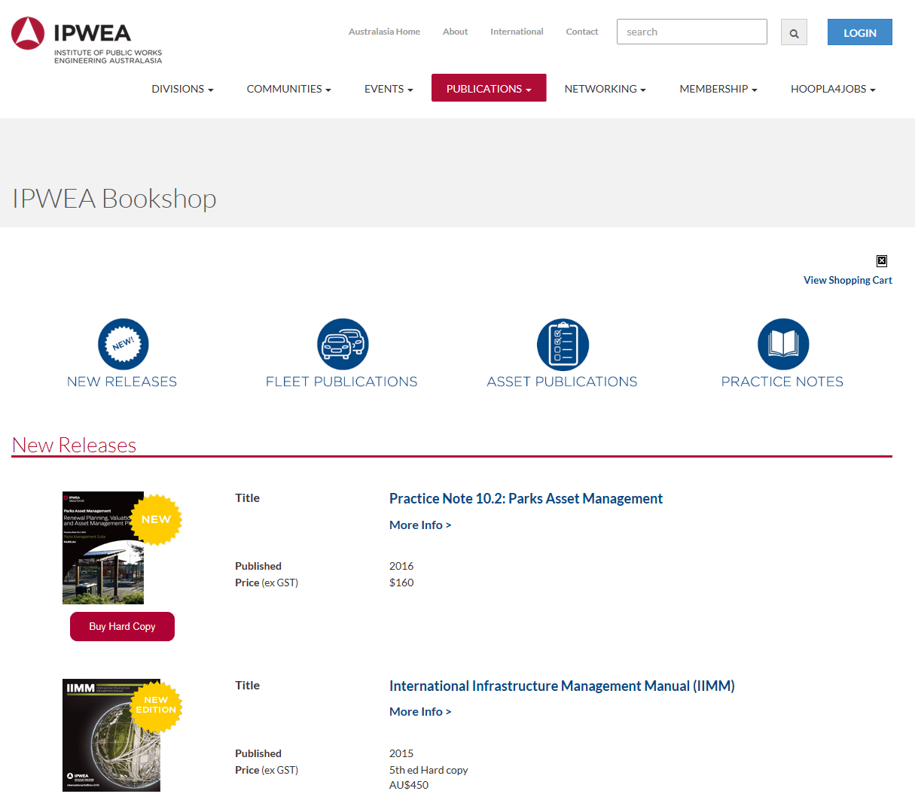
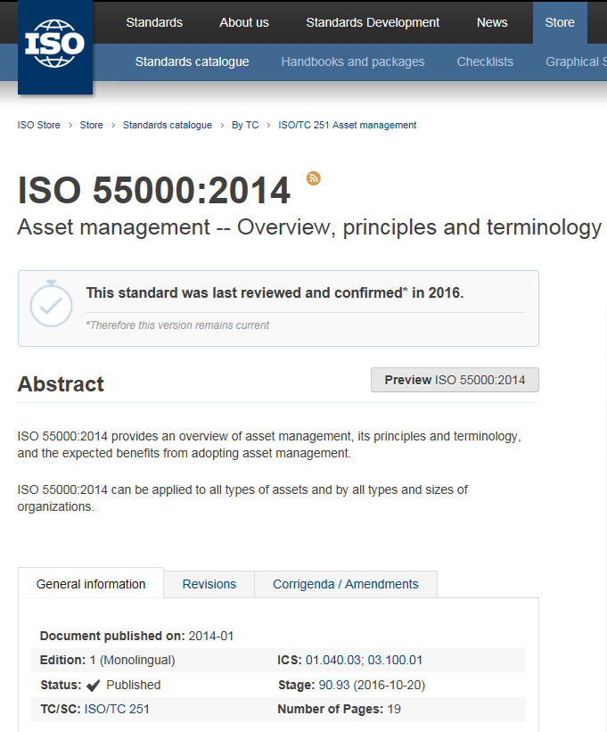
Good practice
www.nams.org.nz
www.ipwea.org
www.iso.org
Notes:
Asset management benefits from good quality, and up-to-date standards and guidance. The International Standard ISO 55000 was introduced in 2014, followed by an updated International Infrastructure Management Manual (IIMM) in 2015.
Our observations are informed by these standards and guidance. We support and encourage their use.

Slide 4
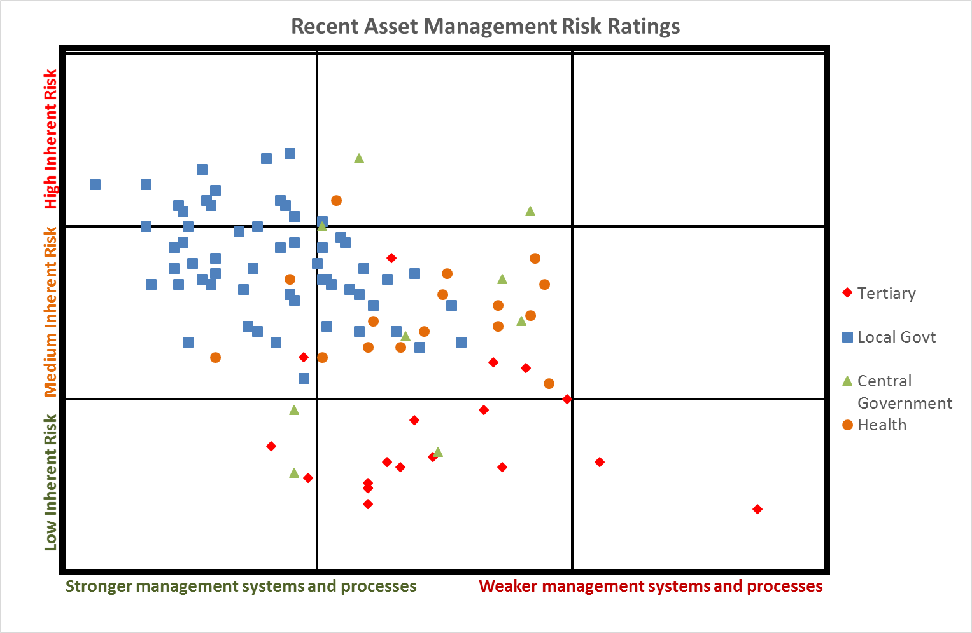
Assessing risk and opportunities for improvement
Notes:
Our audit work is directed by our assessment of risk. So how do we think about risk and why does it matter to you?
When we assess risk, we consider two angles:
Firstly - environmental risk influenced by the type of activities being undertaken, complexity, instability, change, the criticality of services, interdependencies, and reliance on third parties. Size, strategic direction and organisational structure are also important. There is often limited scope to reduce this inherent risk short of ceasing to deliver some services. That is not usually an option for the public sector.
We also think about risk related to the effective application of good practice management systems and processes. This type of risk is more controllable with proper investment in systems and processes.
We assessed asset management risk across the public sector and graphed the results on a 3x3 heat map. This helps show the relationship between inherent and management process risks. We use a simple high, medium, low scale.
Stronger systems and processes reduce management risk.
We expect organisations with high levels of inherent risk to have stronger management systems, processes, and controls
and more sophisticated management approaches to deal with the importance and complexity of their assets.
Conversely, for organisations with lower inherent risk, less complex approaches may be appropriate.
The key point is that the management approach needs to match the complexity and importance of the task.

Slide 5
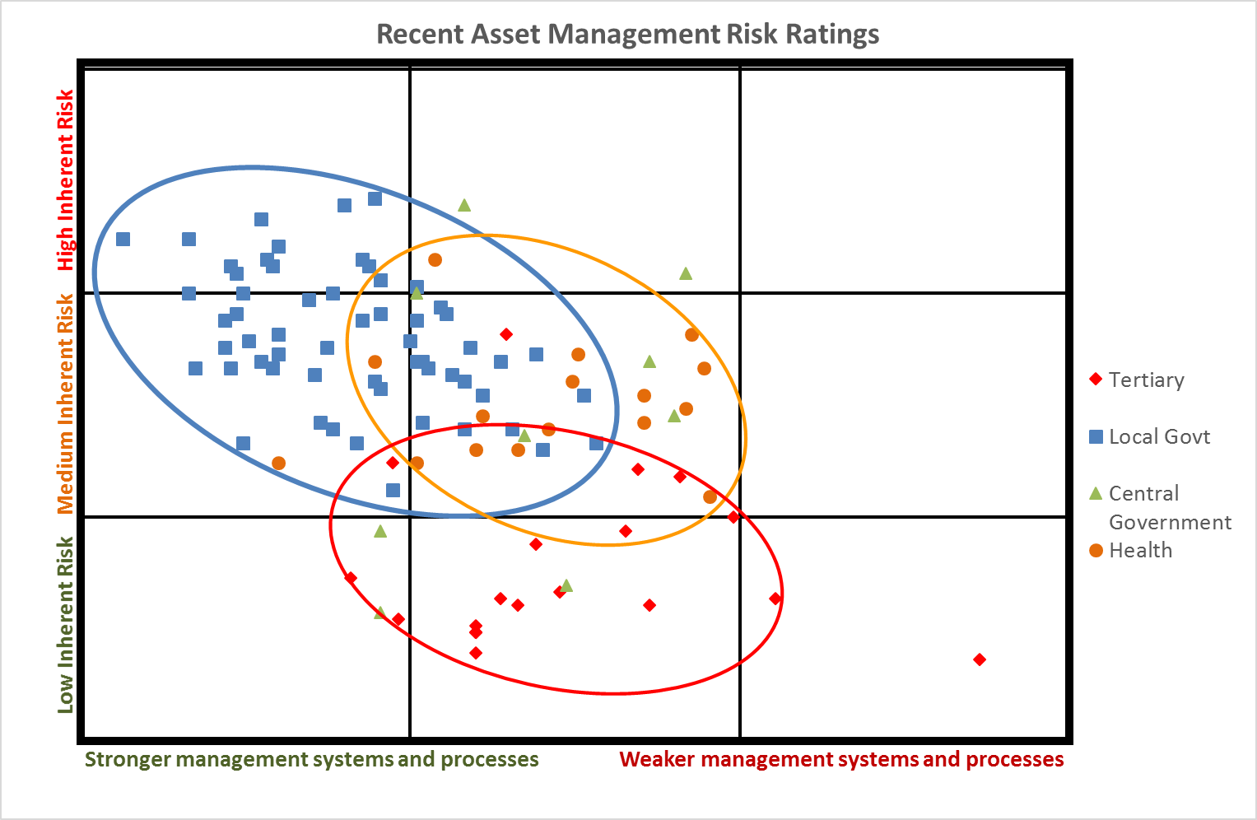
Assessing risk and opportunities for improvement
Notes:
Pull out three sectors – explain meaning of the shapes, clustering and orientation of the ellipses

Slide 6
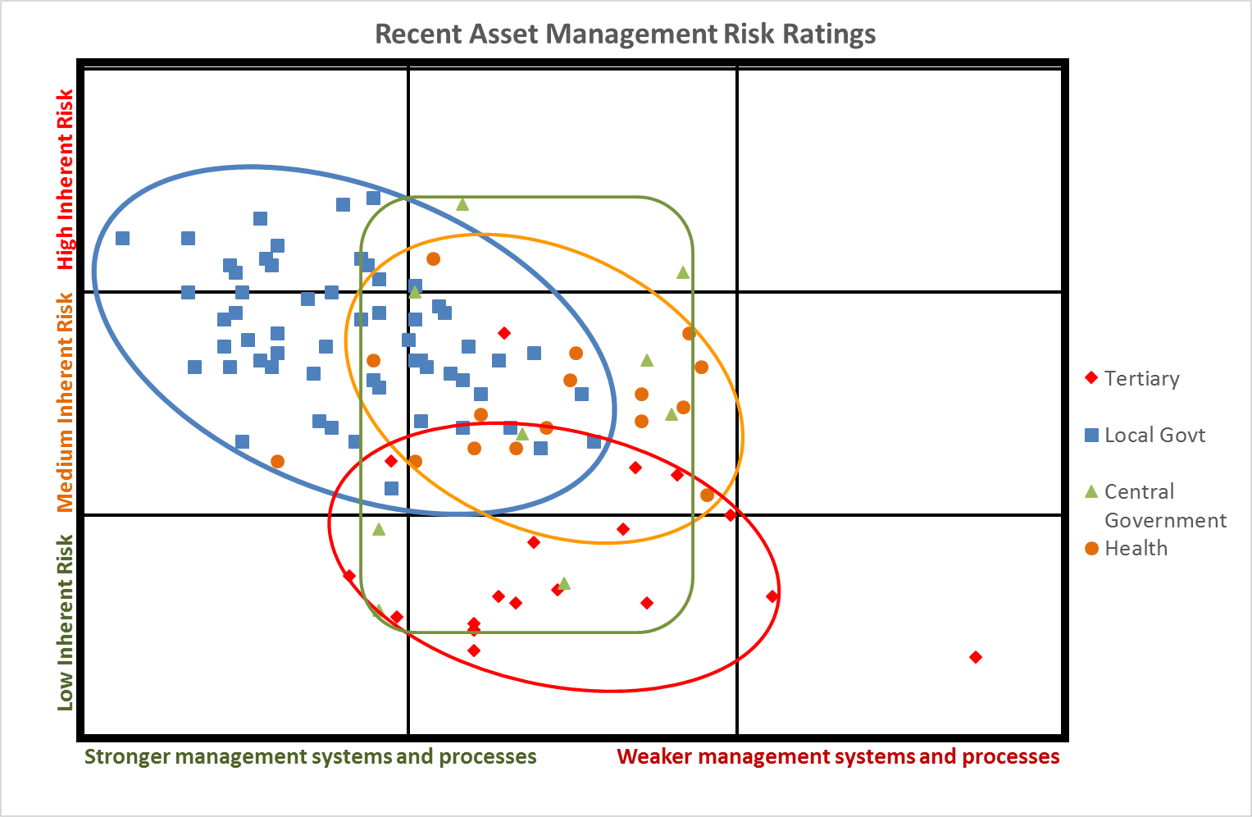
Assessing risk and opportunities for improvement
Notes:
Now added CG – don’t see the same pattern

Slide 7
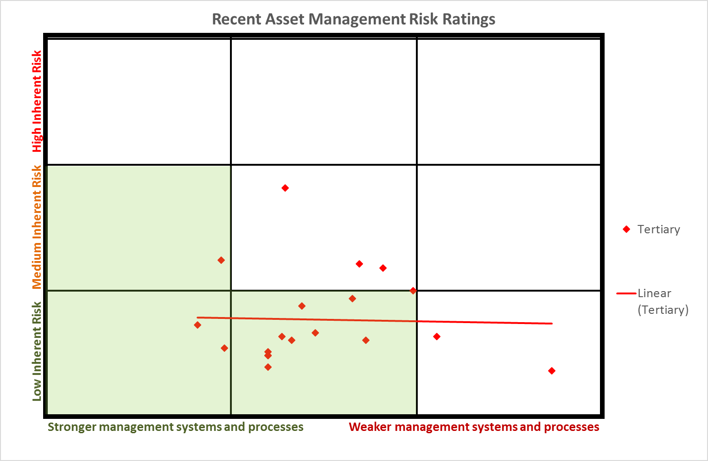
Assessing risk and opportunities for improvement
Notes:
Discuss long flat trend line
Point out the apparent cluster heading in the wrong direction?

Slide 8
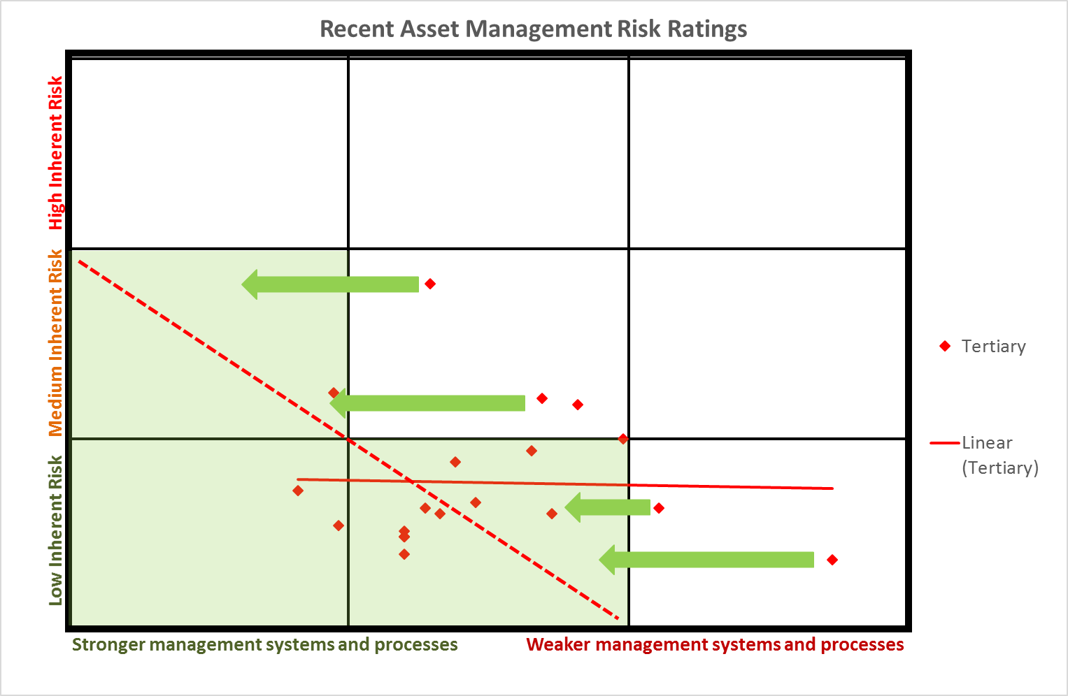
Assessing risk and opportunities for improvement
Notes:
Emphasise the movement we hope to see over time

Slide 9
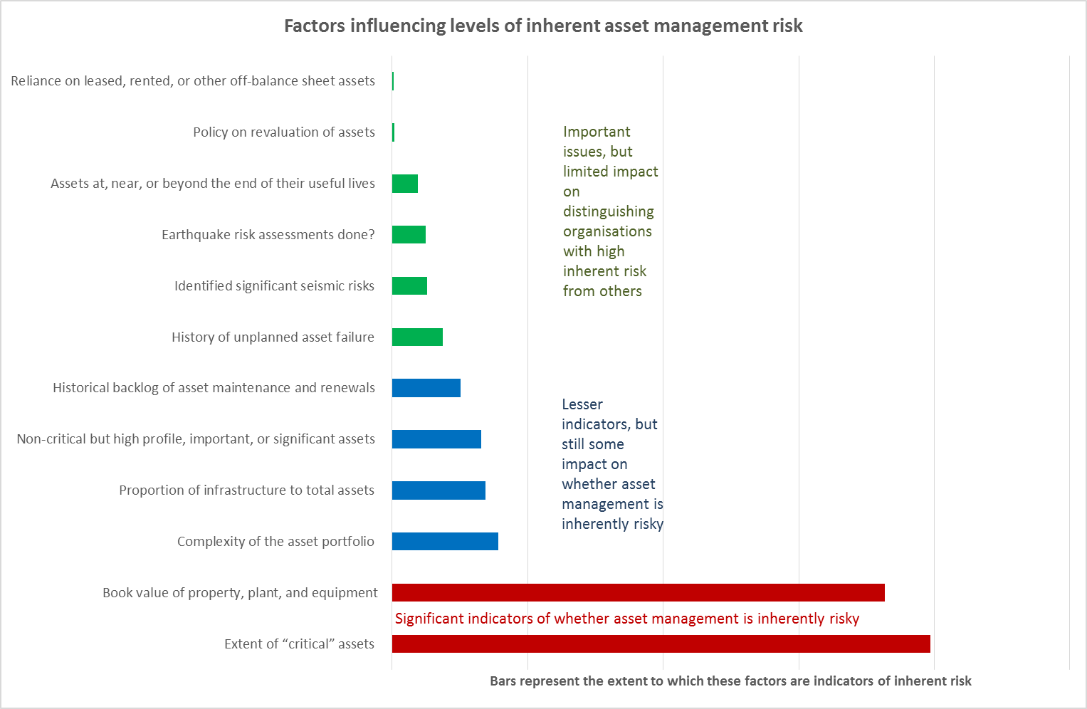
Inherent risk
Notes:
Now for more detail on how we derive the ratings
This is the public sector overall

Slide 10
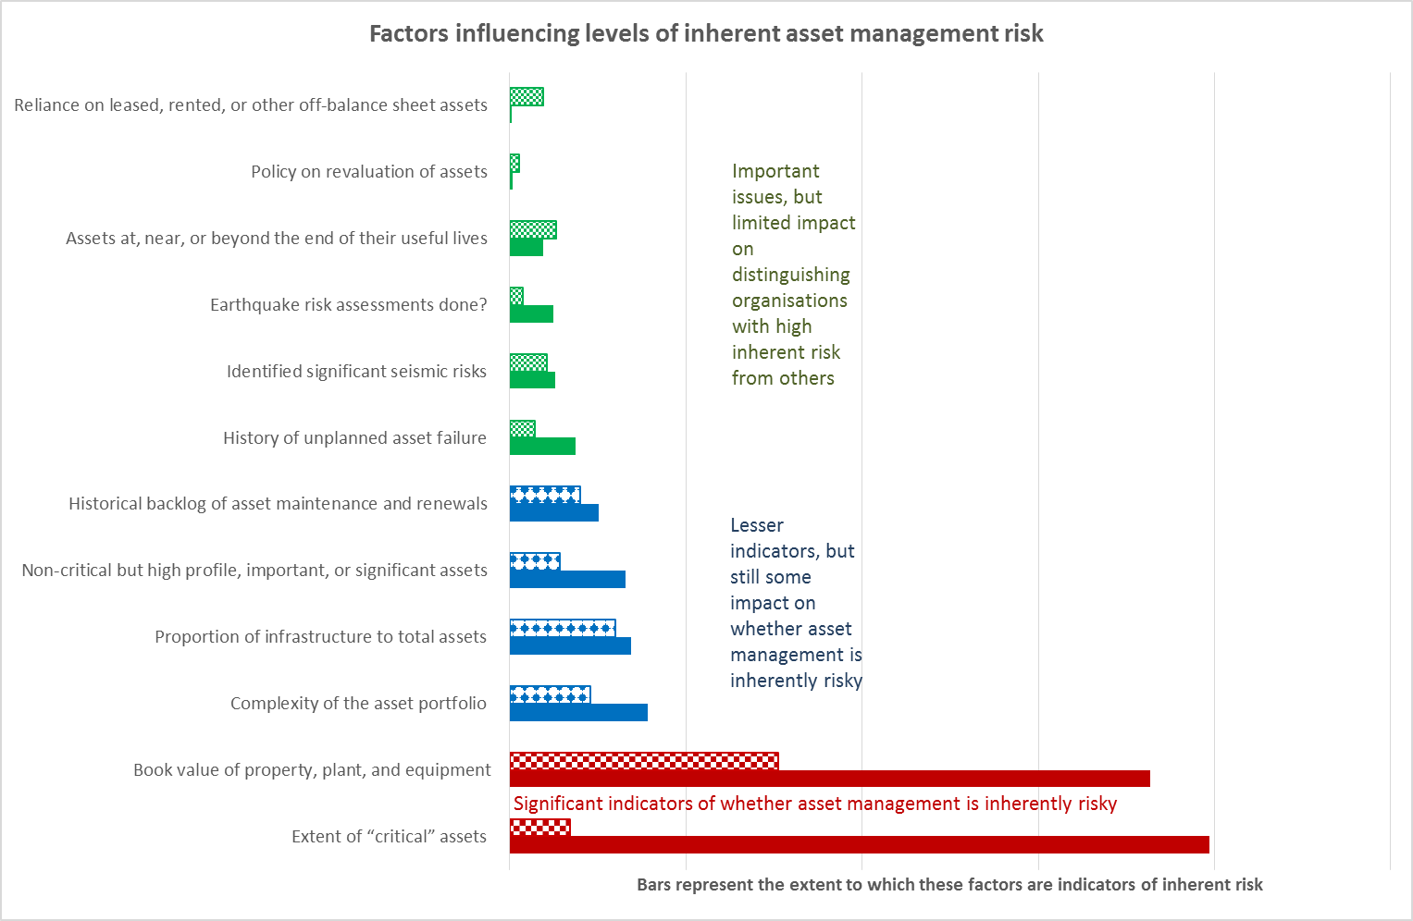
Inherent risk
Notes:
And now overlaid with the TEI sector results for 18 entities that we audit
The most significant factors change
Some reduce appreciably
Others are consistent with the wider sector
Some characteristics of the sector are more risk – highly bar where shaded longer than full

Slide 11
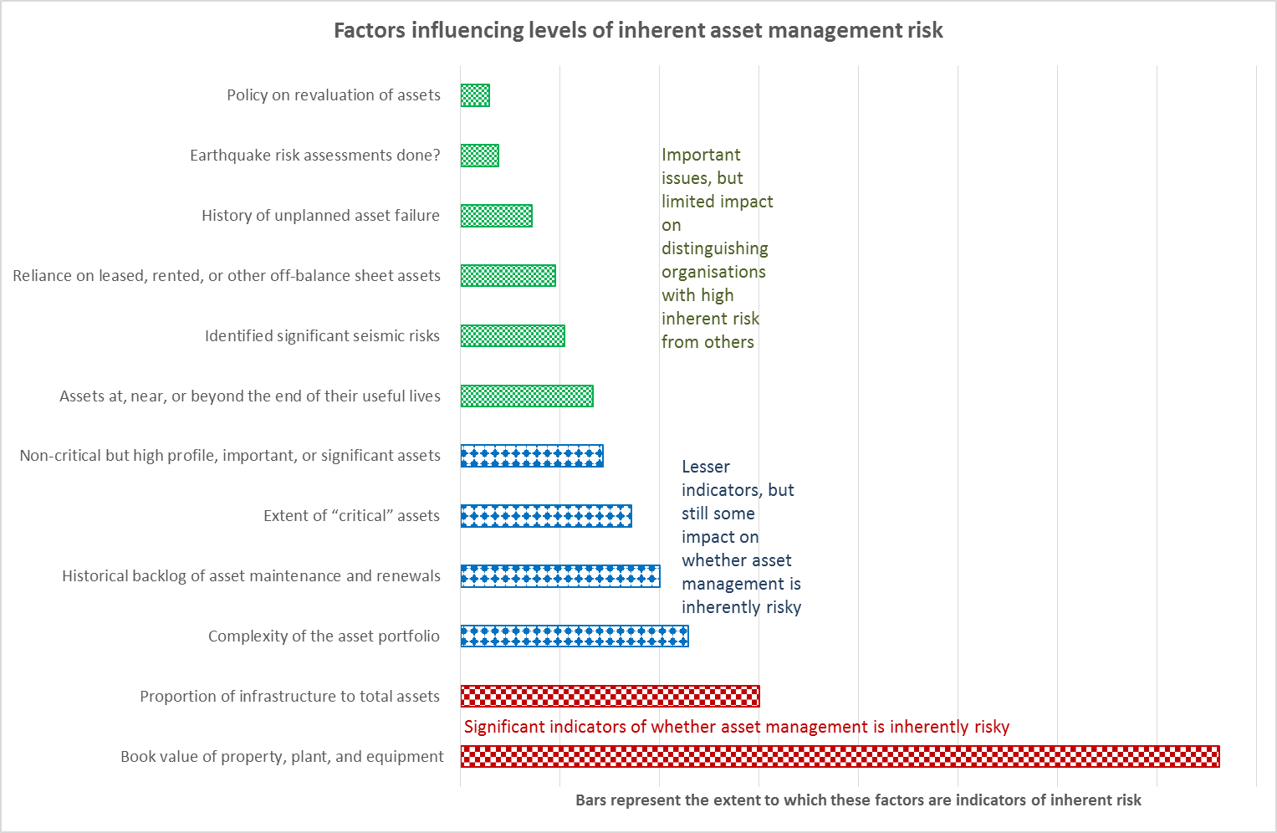
Inherent risk
Notes:
Let’s focus only on the drivers of inherent risk in the sector

Slide 12
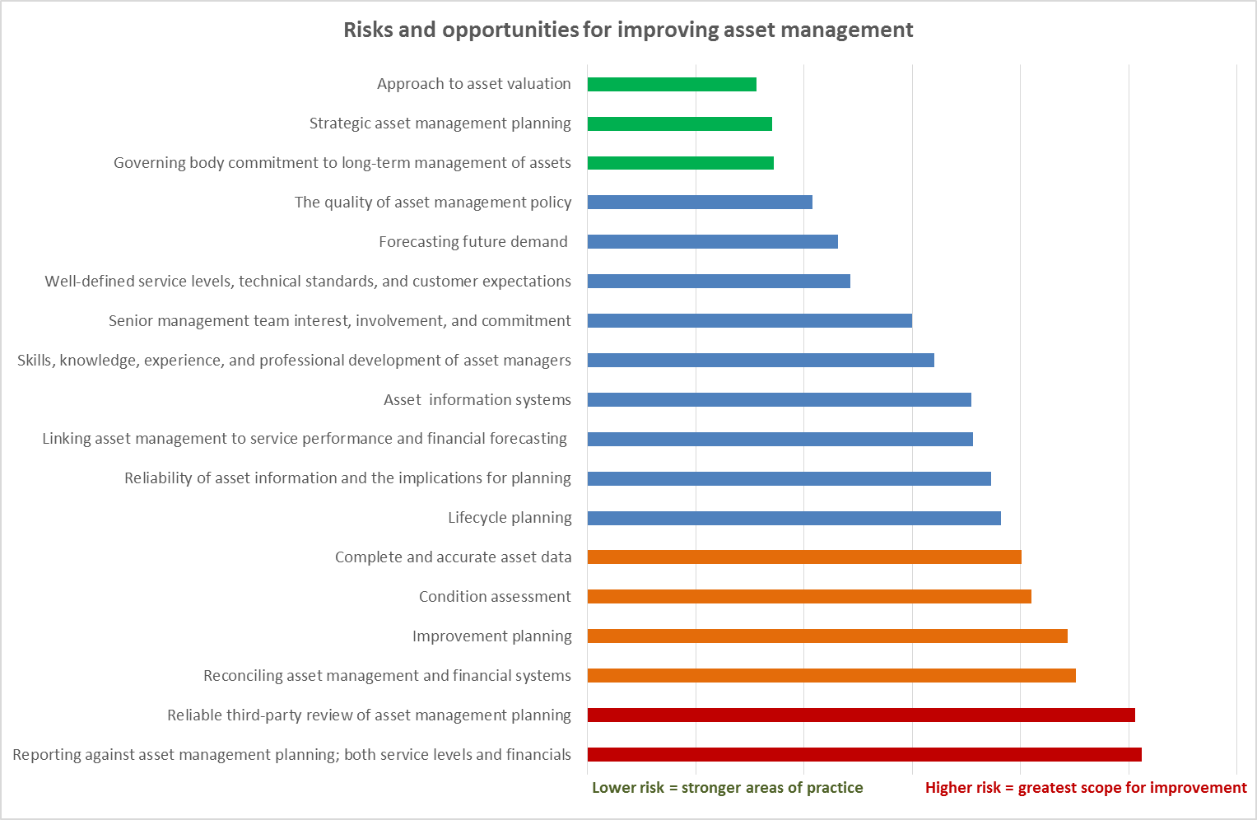
Where are the opportunities for improvement?
Notes:
We assessed the risks to effective control of asset management by asking 18 questions about systems and processes.
We distinguished between the systems and processes used to actually manage assets, and factors that give senior managers and governors confidence that assets are being well managed. It is important that senior managers and governors are assured that appropriate systems and processes are in place and operating well. Without this, they will not be well-enough informed to make key decisions. They may feel that they cannot rely on current practice or support investment to improve it.
Across the public sector, we assessed
Reporting against asset management planning – both achievement of service levels and delivery against financial forecasts; and
lack of third-party review as the greatest weakness.
External review provides assurance to governors that asset management practice is effective. It can challenge the robustness of strategic decisions. It draws on best practice and can bring a new perspective to planning. It also supplements in-house expertise with specialist input.
Other priorities for improvement emerging from our risk assessments include:
Condition assessment
Ensuring there is complete and accurate asset data; and
Reconciling data in different systems

Slide 13
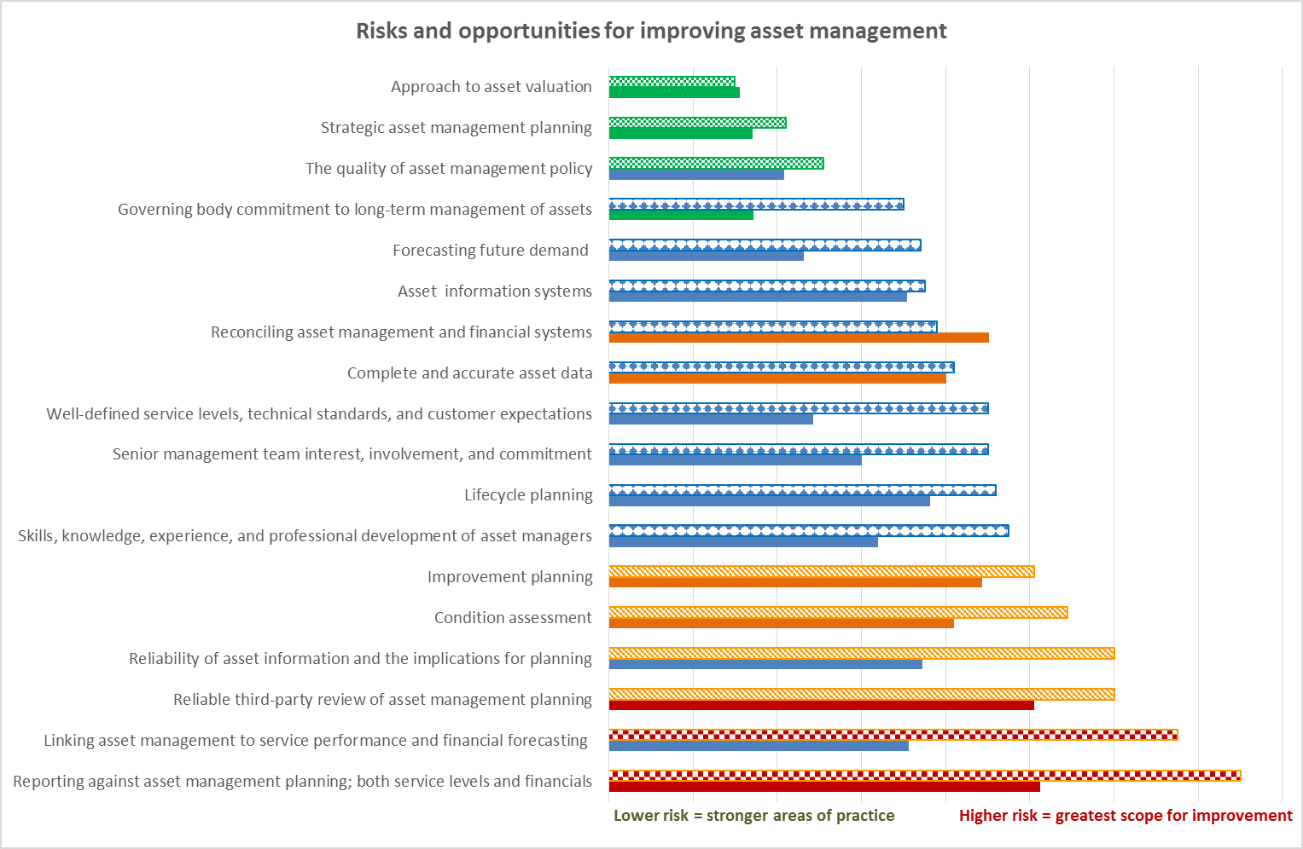
Where are the opportunities for improvement?
Notes:
So how different is the picture in the TEI sector?
Here we have the control risks ranked for the sector.
The order has changed
Linking Asset Management to service and financial planning moves into the top two, alongside reporting against plan
Factors that were risks nationally, are less so in the TEI sector – reconciling data being an example

Slide 14
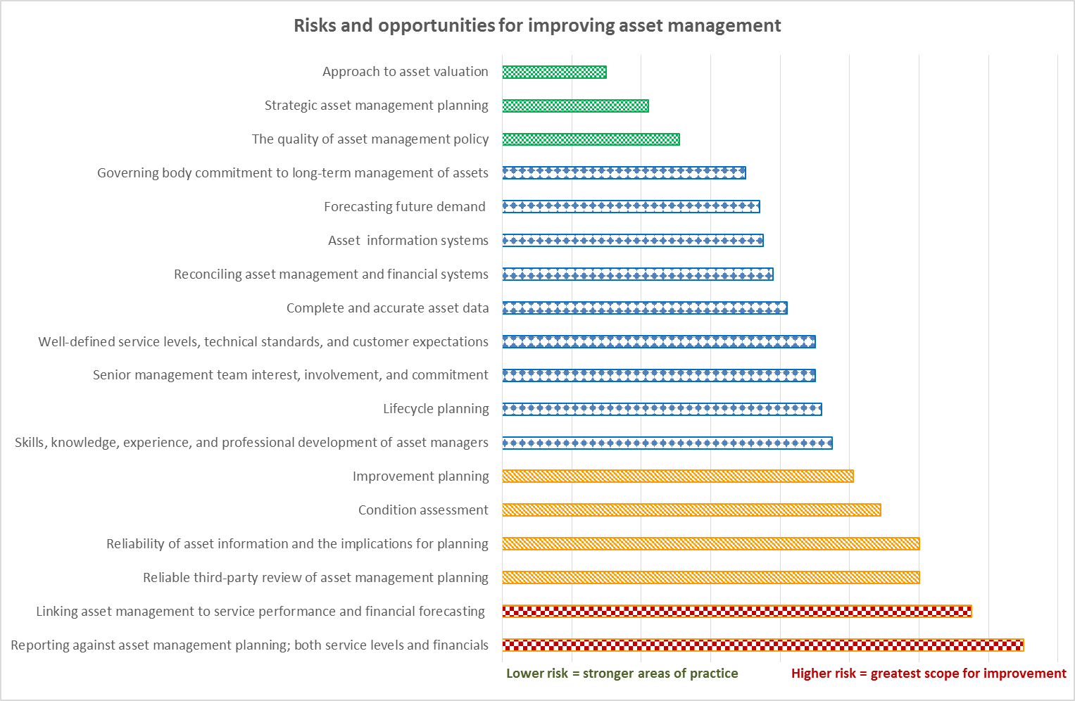
Where are the opportunities for improvement?
Notes:
There is still however, a theme around asset data

Slide 15
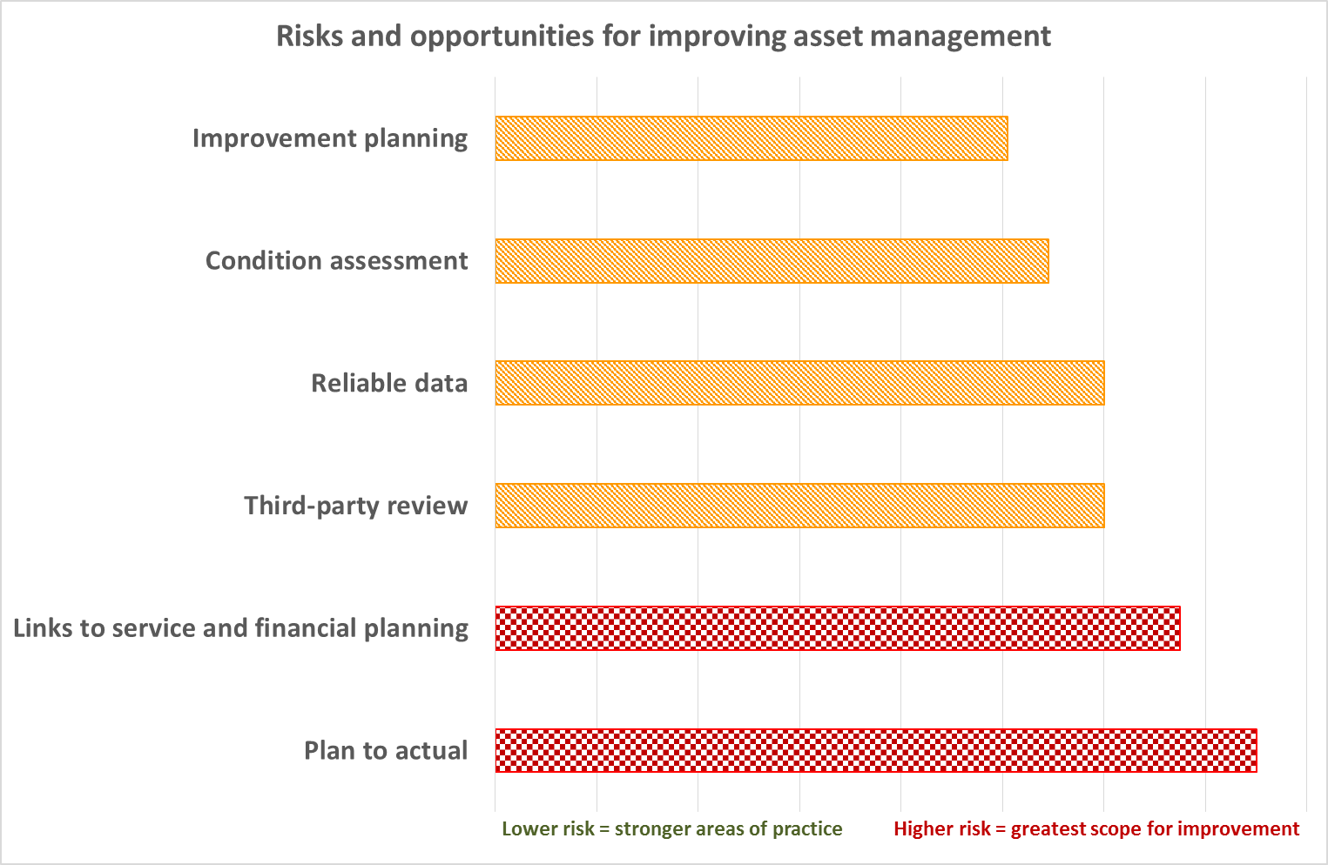
A closer look at the opportunities for improvement
Notes:
Drilling down into the areas with greatest opportunity for improvement, two general theme emerge
The planning system
Reliability of data – and real data on condition

Slide 16
The asset management pyramid
$
Whole
of Life
Levels of Service
Demand
Asset Knowledge
Policy
Risk
Continuous Improvement
Notes:
Asset management planning occurs at a number of different levels, from the high level of Corporate Strategy down to the detail of Operating plans for individual assets.
We see asset management planning as a series of levels in a pyramid, each one supporting the one above. The starting point is understanding the asset base.
Good quality planning relies on good quality asset knowledge. Confidence in data is needed to have confidence in the resulting plans. Asset knowledge needs to cover a description of the assets, their age, condition, performance, and value.
The quality of asset knowledge can depend on how well entities carry out their plans. Completed work often leads to better quality, updated asset information.
The order of levels in the pyramid is important. Each layer builds on, and is supported by the layer below it.
We believe that there are three factors that span the layers of the pyramid, enabling good quality planning to take place:
Policy needs to define the appropriate level of sophistication for planning, who is responsible for delivering it, what plans should look like, and how often they are updated.
Risk is associated with managing assets and itself needs to be managed. Critical assets, whose failure would have a significant effect on the organisation’s objectives need to be defined and singled out for specific attention.
Continuous improvement is important to ensure that planning keeps pace with technical developments and new asset types.

Slide 17
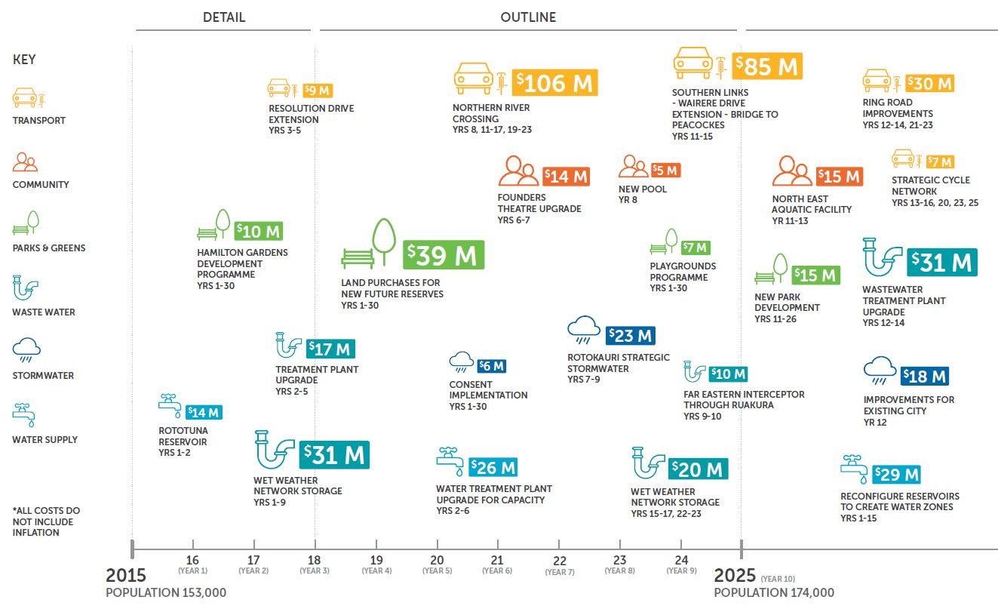
Strategic asset management
Notes:
The International Standard on asset management (ISO 55000) introduced the concept of the Strategic Asset Management Plan or SAMP, saying “integrating an organisation’s SAMP, with its long-term financial plans helps balance short-term financial needs with medium-term activity plans, and the much longer-term plans that some assets require”.
We couldn’t agree more. The standard recognises the need to bridge the gap between long-term strategic planning, and shorter-term operational planning.
The Local Government Act 2002 was amended in 2014 with the introduction of Infrastructure Strategies, designed to cover a 30-year period. Throughout 2015, we reviewed councils’ Infrastructure Strategies, in particular assessing how well they stepped up from a 10-year horizon to a 30-year horizon, and how well they supported consultation with stakeholders.
The new documents unleashed the creativity in many local authorities. There were many good examples emerging and we soon formed an impression of what was working well.
Our publication shares a number of those examples.
Infrastructure Strategies add a new dimension to planning. Perhaps the most important lessons for us in bridging the gap between strategic planning, and the detail of engineering based asset management planning are:
Be strategic – don’t get caught up in the detail, AMPs are for documenting that.;
Don’t be constrained by the legislation – if a good strategy needs it, put it in. Legislation sets out minimum requirements, not good practice guidance;
Be clear – tell the reader what is proposed and why – don’t just discuss issues;
Make sure that significant decisions have options and are clearly linked to strategic issues;
Link plans to address growth and demand with the analysis that supports it;
Explain how levels of service are defined in support of any work to change them.
For anyone writing a SAMP or an Infrastructure Strategy we have a range of notable examples in the document under a series of key headings that we think it is important to consider.

Slide 18
Planning for success
Good asset management takes a team
Asset Management Leadership
Asset Management Working Group
Asset Management Sponsors
Notes:
Effective planning takes a team, drawing on and co-ordinating resources from across the organisation. Asset management is a discipline that brings together:
engineering;
financial planning;
economic and demographic forecasting;
corporate and strategic planning;
performance monitoring and management;
risk management and lifelines planning; with
political decision-making and leadership.
It is important to ensure that there is some way in which these disciplines are able to work together, particularly at the point when the organisation is refreshing its planning and putting together a long-term strategic plan.
Bringing together a temporary structure to work on the development can be useful, much like treating it as a project.
The diagram shows Hamilton City Council’s approach – which has brought together three defined teams supported by a centre of excellence. The centre is led by a small (1.5 FTE) centralised team with contributions by key staff in other support areas and operational parts of the business.
The Asset Strategy staff in the CoE provide the consistency across the three key teams that operate within the organisation.
The Centre of Excellence approach has been developed to perform five primary functions:
Support: e.g. procuring and providing services to help asset managers, or providing subject matter experts.
Guidance: organisational standards, methodologies, tools, and knowledge repositories.
Shared Learning: The team manages and provides a corporate training programme for Asset Management.
Measurements: The CoE monitors AM practices and reports this to senior management.
Governance: Where necessary, the Team will analyse matters of concern and recommend to SLT plans of action. This may include reallocating limited resources (money, people, etc). It also has oversight of the portfolio to help ensure Council invests in the most valuable projects and to help identify economies of scale by coordinating projects.
We have a number of examples in our document of different organisations tackling the same issue. In some cases coordination goes beyond the boundaries of a single organisation so that planning can be integrated or so that smaller organisations can share resources.

Slide 19
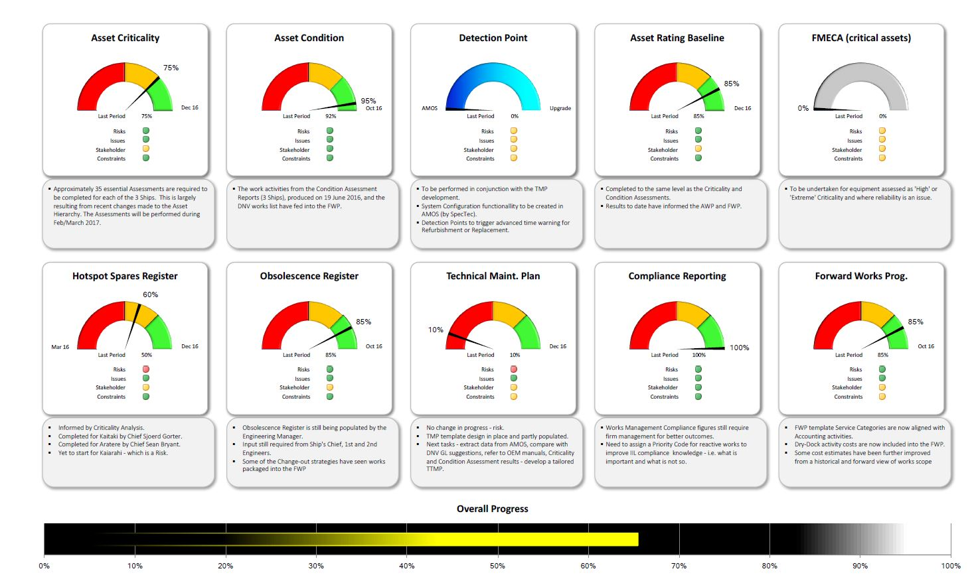
Data basics
Notes:
Regardless of the structures in place, in our view good quality data is at the heart of effective planning.
It provides the starting point for planning and allows analysis to be accurate and informative. It allows trade-offs to be determined with confidence so that the best value whole-of-life strategies can be established. It allows risk to be managed and issues to be addressed quickly and efficiently when they arise:
good planning relies on good quality data, and good asset management practice updates asset knowledge and information systems as work is carried out;
A virtuous circle where good quality data informs work, which in turn leads to better asset information should be the aim.
But data systems can only be as good as the way in which they are operated; The data in them needs to be reliable for the resulting analysis to be accurate.
It is important to be clear on the reliability of asset data and have firm plans in place to maintain its accuracy or bring it up to the level it needs to be; The most open organisations make clear assumptions about the effect any uncertainty in asset information will have on their plans; they are not surprised when plans need to change because they recognised the limitations of their analysis.
data needs to be clean, and free from errors that would make a material difference;
organisations need a clear process to update their data in a timely and accurate manner – condition information can be particularly useful
The slide shows KiwiRail’s KPI Dashboard for its Asset Management Knowledge Centre. Each dial represents KiwiRail’s view of its own data.
Risks, Issues, Stakeholders and Constraints are identified. A brief summary of activity under each heading is provided.
Across the bottom of the dashboard is an indicator of overall progress towards the targeted level of asset information robustness.
We like the accessible way in which the dashboard makes the importance of data clear and visible.
KiwiRail recognises the value of its asset information, and has invested in it.

Slide 20
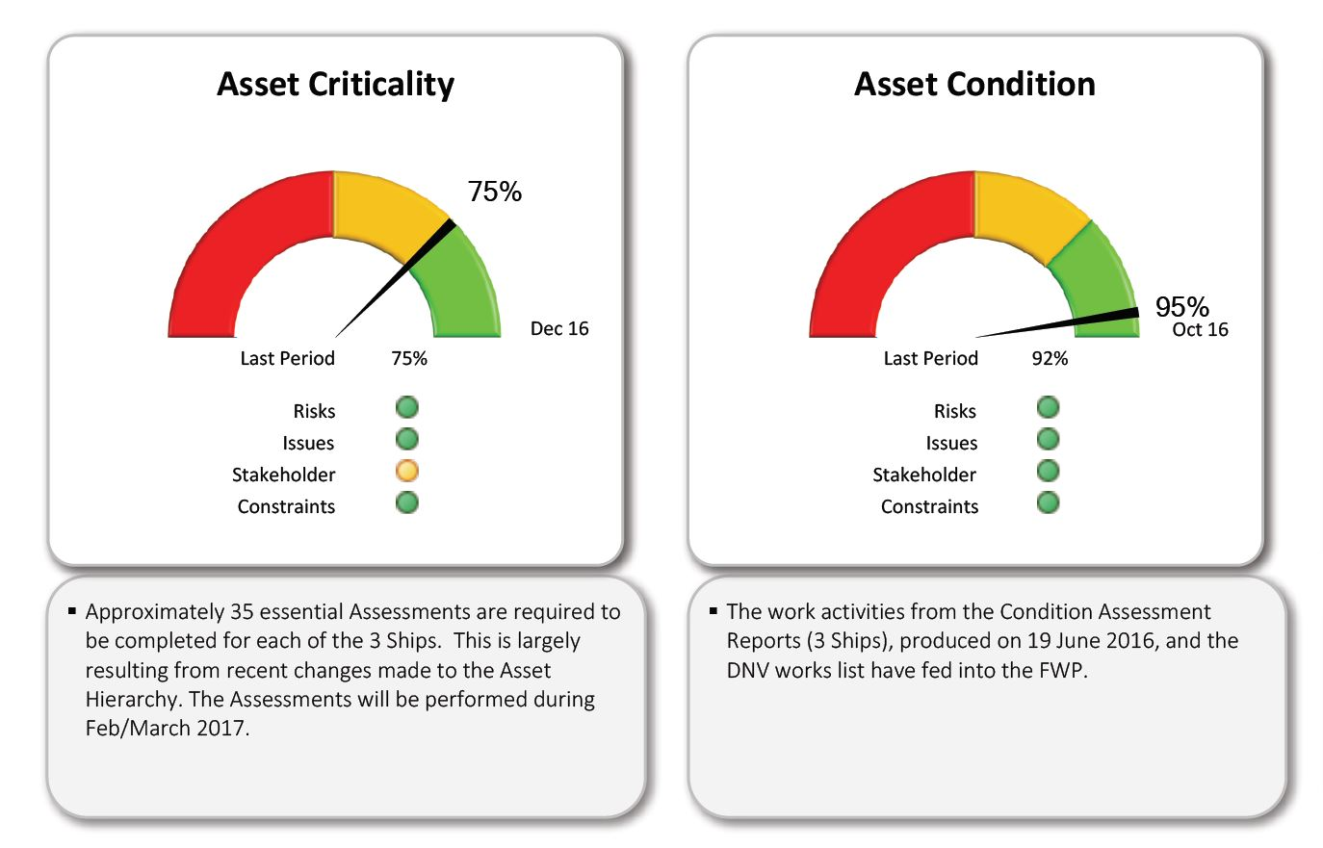
Data basics – a closer look

Slide 21
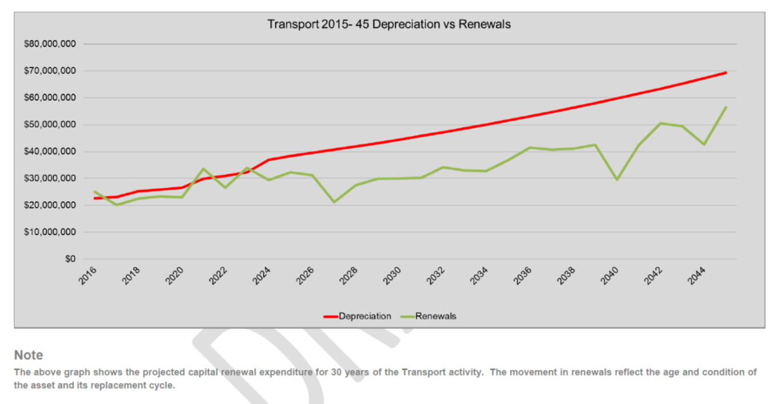
Track record of spending
Track record of actual spend against forecast: is forecast expenditure a reasonable estimate of what happens in practice?
Are depreciation and renewal forecasts reasonable?

Slide 22
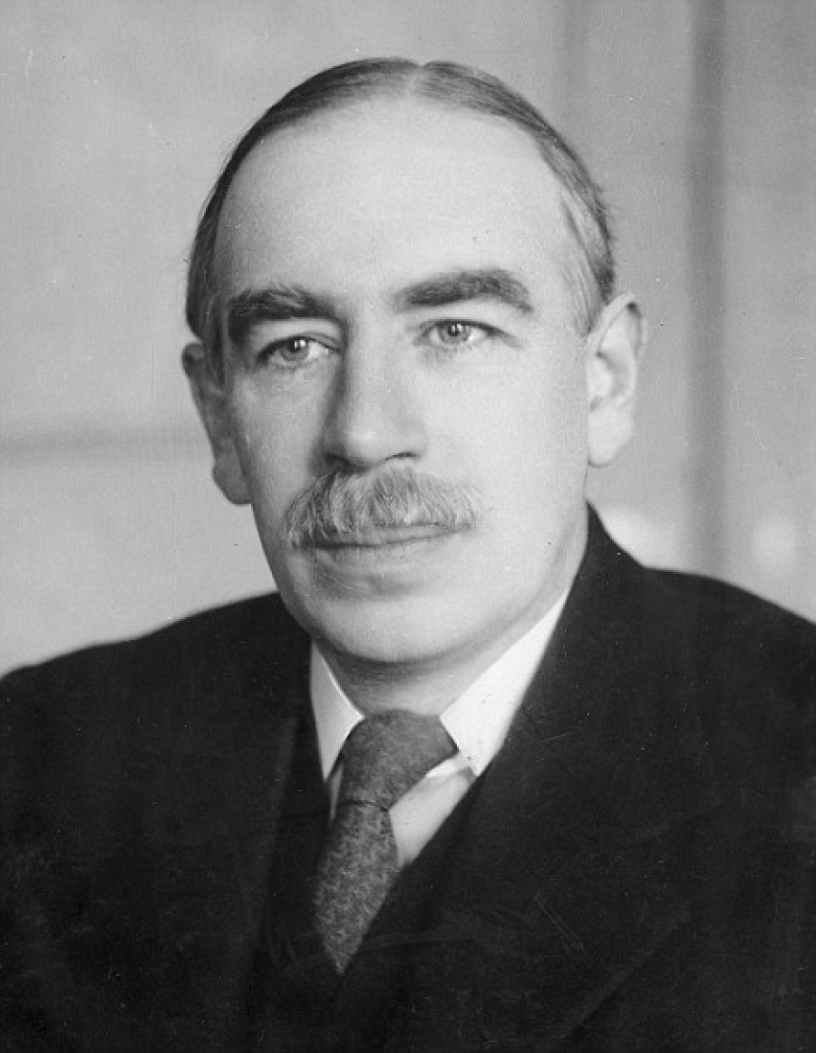
Well informed assumptions
“When the facts change, I change my mind.
What do you do?”
John Maynard Keynes, 1883-1946
Notes:
JMK was a British Economist who died over 70 years ago. One of the giants of modern economics he had great insight. Perhaps he foresaw the difficulties and uncertainties inherent in long term planning?
A few quotes from him illustrate the nature of uncertainty:
“There is nothing a government hates more than to be well informed; …it makes the process of arriving at decisions much more complicated and difficult”
“It is better to be roughly right than precisely wrong”
“There is no harm in being sometimes wrong – especially if one is promptly found out”
He did of course also have something to say about absolute certainty….
“In the long run, we’re all dead”
Good quality planning relies on clear assumptions to help address uncertainty.
Corporate assumptions ensure consistency across multiple service areas. A good set of assumptions balances these corporate considerations with factors specifically relevant to the asset group.
Asset managers should be provided with a clear set of corporate assumptions on which to base plans and financial forecasts. They should also have the opportunity to influence these assumptions and introduce specific assumptions relevant to their service area.
Clearly expressing your assumptions is an important part of accountability. It allows your stakeholders to take an informed view of your planning, and to understand what factors might lead plans to change.
Stakeholders can also take a view on whether assumptions are reasonable, which is all part of ensuring that the right debate takes place.

Slide 23
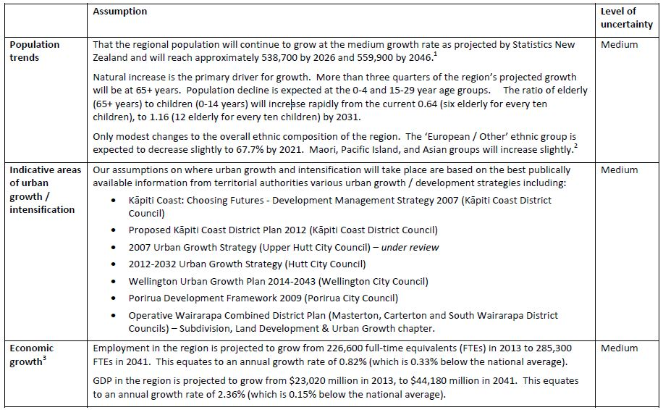
Well informed assumptions
Notes:
This slide shows an extract from Greater Wellington Regional Council’s corporate assumptions document – in this case, showing some of its non-financial assumptions. The entire document ran to 10 pages of clearly documented assumptions. Estimates of potential effects were included where the Council could assess these with confidence.
Even though you can’t read it – you can appreciate the level of detail that the council went to.

Slide 24

Helping your auditor can be helping yourself
Notes:
Asset management planning is not for the auditor’s benefit – but there are some things that make it easier to be accountable and can be helpful in their own right:
Make sure that the governing body is clear on its priorities, and engage early with auditors on significant issues.
Priorities, especially those requiring stakeholder consultation, need to be clearly defined ahead of an audit. The governing body has a lead role in determining acceptable scenarios. Being clear about scenarios underpins effective decision-making. We have found that, when staff have clear direction, long-term planning becomes more efficient.
Be realistic about time frames and follow a project-managed approach.
Assign a senior staff member responsibility for quality assurance.
Asset management planning is not a compliance exercise, and neither is the production of an asset management plan. The process and the resulting document need to be useful.
Documented plans do not need to be lengthy. They need to cover all the issues, but the best are readable, living documents.
A good plan sets out scenarios that link planning decisions to the organisation’s financial position. Clear assumptions and an assessment of data reliability complete the information required for accountability.
These are recurring themes from our work. They are important to us, but they are more important to you.

Slide 25
Top ten questions for governors and senior managers
Have you got a strategy for the long term sustainability of your assets?
Notes:
Long-Term Investment Strategy, Long-Term Plan, Infrastructure Strategy, or SAMP; whatever your asset-related strategic document’s name, there are some key questions that apply.
Reflecting on the findings from our work, we believe that there are ten questions that every senior manager and member of a governing body needs to know the answer to. If your organisation owns and operates a significant asset base, or your service delivery is highly reliant on assets, we think you should ask yourself these questions
Have you got a strategy for the long term sustainability of your assets?
This should set out your long term approach to owning and managing assets in support of service delivery. The levels of service you have committed to should be clear. The strategy should match the work that the assets require to meet these service levels and a funding strategy that ensures that this work is affordable.

Slide 26
Top ten questions for governors and senior managers
Have you set an asset management policy?
Notes:
Have you set an asset management policy?
This defines your approach. It should cover what you are trying to achieve; who is responsible; what you need in order to be successful; the appropriate level of sophistication for your planning; an assessment of whether you are already there or need to improve some things; a clear definition of when plans should be updated, by whom, and who approves them.

Slide 27
Top ten questions for governors and senior managers
Do you have good quality up-to-date asset management plans for achieving your strategy?
Notes:
Do you have good quality up-to-date asset management plans for achieving your strategy?
Plans need to be up to date, realistic and achievable. The plans should cover all assets, detail their life cycle management strategies and explain how to put these into practice. They should include detailed financial forecasts and budgets.

Slide 28
Top ten questions for governors and senior managers
Does your organisation have appropriate asset management skills and experience?
Notes:
Does your organisation have appropriate asset management skills and experience?
Good planning needs well qualified, experienced staff. You should be assured that you have appropriately qualified and experienced staff responsible for all asset categories. Staff should have access to continuing professional development. You should access external expertise when needed.

Slide 29
Top ten questions for governors and senior managers
Do you know the reliability of your asset information?
Notes:
Do you know the reliability of your asset information?
You should have formally assessed the reliability of asset information so that you understand the implications for your planning. With less reliable information you may make less well-informed decisions and face more unplanned work. You should be working to improve the reliability of your data.

Slide 30
Top ten questions for governors and senior managers
Do you have a structured approach to assessing the condition and performance of your assets?
Notes:
Do you have a structured approach to assessing the condition and performance of your assets?
Condition and performance information contribute to well-informed decision-making. Data should be up-to-date, reliable, and captured in an asset information system.

Slide 31
Top ten questions for governors and senior managers
Have you defined a clear and comprehensive set of service levels to be delivered or supported by the assets?
Notes:
Have you defined a clear and comprehensive set of service levels to be delivered or supported by the assets?
Support for service delivery is the purpose of asset management. For planning to be well informed, service levels need to be clearly expressed. They should cover technical standards and levels of performance as well as customer expectations of service delivery.

Slide 32
Top ten questions for governors and senior managers
How well do you forecast future demand for the services that are delivered or supported by your assets?
Notes:
How well do you forecast future demand for the services that are delivered or supported by your assets?
Current and future demand for your assets should be clear, including an assessment of alternatives and substitutes that people can choose, as well as changes in demographics and patterns of use. Understanding changing demand and its impact on assets is central to long term sustainability.

Slide 33
Top ten questions for governors and senior managers
Do you report, and get reports on, achievement of your asset management plan(s)?
Notes:
Do you report, and get reports on, achievement of your asset management plan(s)?
Good quality monitoring and reporting provides assurance that plans are being delivered in practice and are having the desired impact. Reporting should cover performance against service levels, delivery of planned work and actual expenditure against financial forecasts.

Slide 34
Top ten questions for governors and senior managers
Do you have a backlog of repairs, maintenance, and asset renewals? and what are you doing about it?
Notes:
Do you have a backlog of repairs, maintenance, and asset renewals? and what are you doing about it?
You should be aware of any deferred work, and have made a well-informed decision to defer it. You should understand the risks and knock-on implications. You should have a strategy of divesting assets that cannot be maintained, or catching up with the backlog for assets you need to keep.

Slide 35
Asset management and long-term planning
Notes:
So, to sum up, our latest publication:
Asset management and long-term planning: Learning from audit findings 2015 to 2017
is out now
This publication is intended to be a resource for public sector organisations that manage significant infrastructure networks
Copies are available here today. We will be sending a copy to every asset intensive public sector organisation. Electronic copies will also be available on our website.
You should have a flyer in your delegate packs with a brief summary of the key headings and the pyramid.
We conclude our publication, as I did today’s presentation, with 10 questions that we think governing bodies and senior management need to know the answers to.
The questions are also summarised on the flyer in your packs.
We think they represent a great starting point for any organisation reviewing its approach to planning.

