Slide 1

Asset Management Workshop
16 November 2017 Michael David
Notes:
To add or change the image in the background:

Slide 2
10-Year Capital Intentions Plans 2017-2026
Data provided by TEIs
Feedback

Slide 3
Capital intentions (sector) – what did we spend it on?
Previous year stats: 2016-2025
$8.8bn average of $877m p.a.
49% ($4.9bn) non-accommodation buildings
19% ($1.4bn) plant & equipment
18% ($1.3bn) IT & Library.
w-i-p spend $225k.
Spending peaks forecast for 2017 followed by a decline.
Approximately $9bn over the next 10 years, an average of $904m p.a.
46% ($4.2bn) of that is non-accommodation buildings, 13% ($1.1bn) for plant & equipment and 16% ($1.4bn) for IT & Library, 15% ($1.3bn) of work-in-progress.
Expect w-i-p spend to be largely buildings and some IT.
Overall spending has peaked in 2017 and expected to decline in later years.
However we still plan to spend more on buildings

Slide 4
Capital intentions (sector) – what drives the spending?
Main driver for spending is largely replacing and refurbishing existing assets.
This is not a bad thing - for not only all that is new or ‘modern’ is ‘productive’

Slide 5
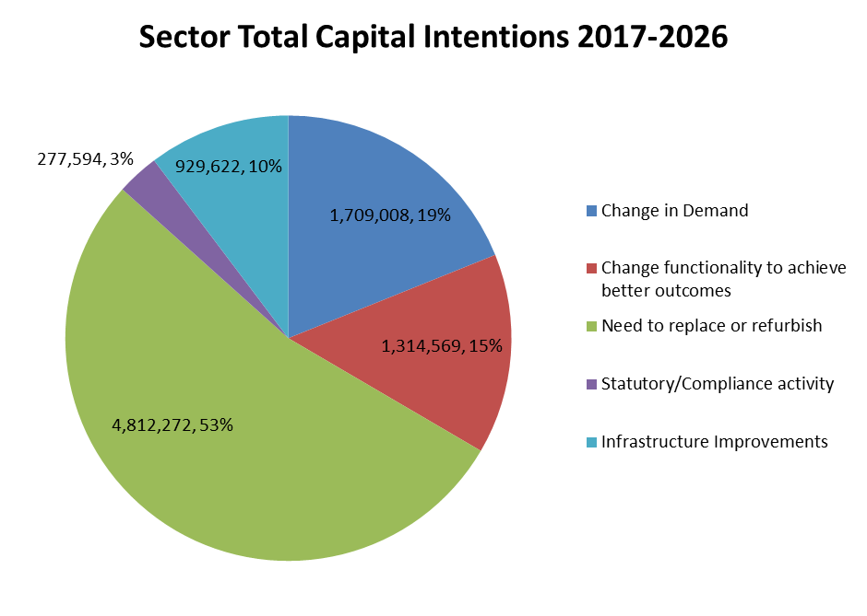
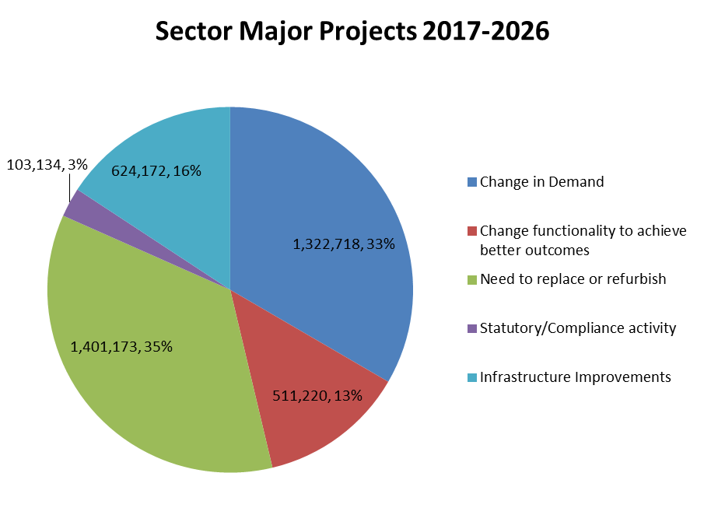
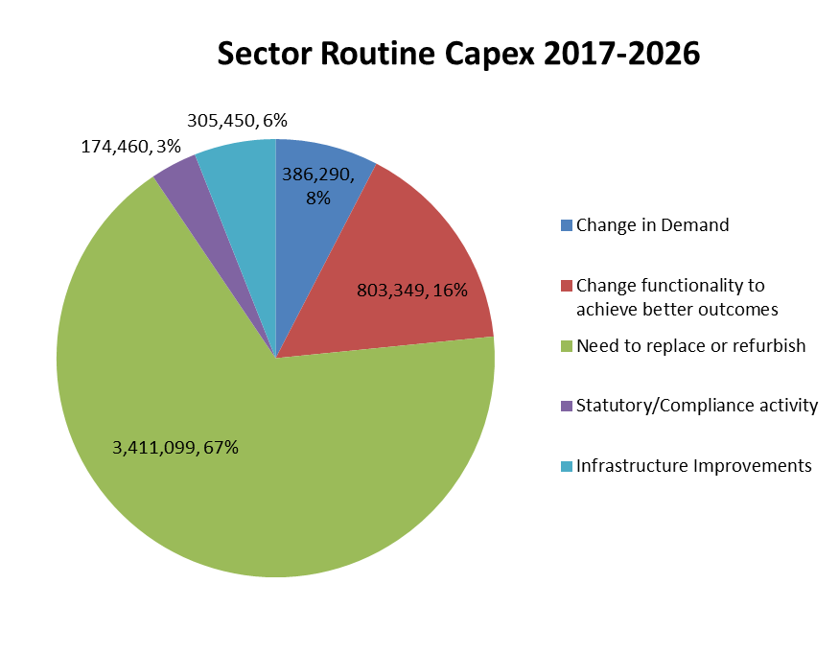
Spending drivers for major projects and routine capex capex
Mostly replacements & refurbishments (53%)
  especially for routine capex (67%).
  less significant for major projects (35%)
  total has reduced (by 9%) from previous year, partly by adding new drivers (infrastructure & statutory).
Change in demand increased (by 4%) from previous year) especially major projects (6%).

Slide 6
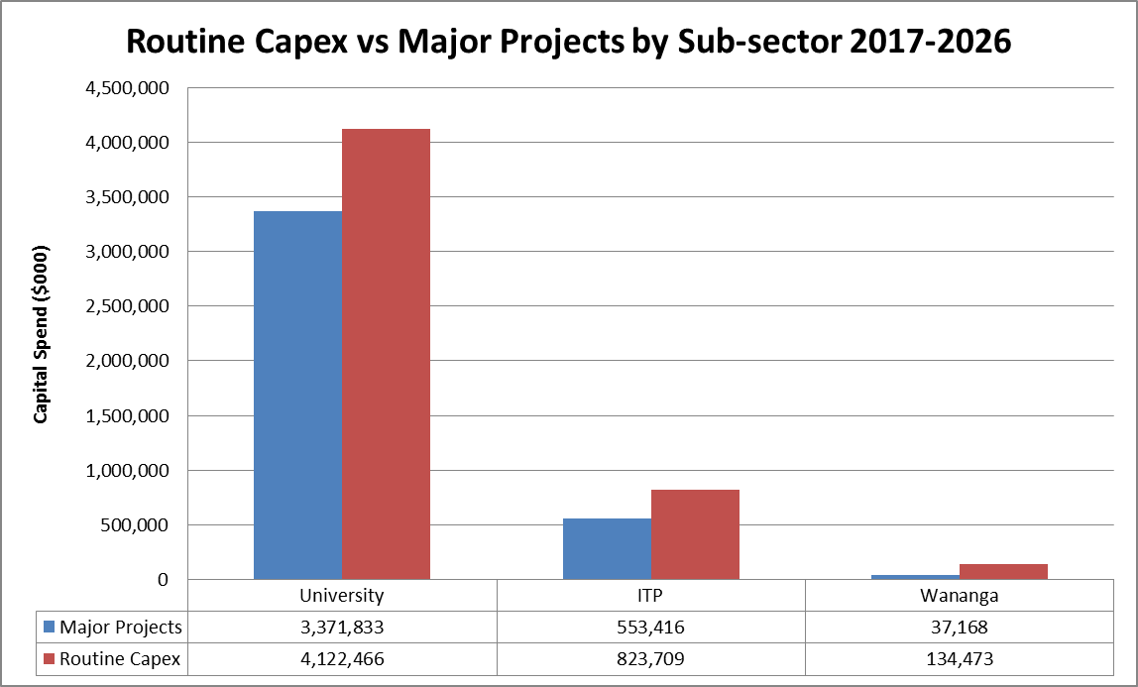
Where does this capital spend occur?
Previous year stats:
University $7.0bn, ITP $1.6bn, Wānanga $180m
Universities - routine capex (59%) is 1.4x major projects. ITPs (57%) 1.3x, Wānanga (93%) 14x
Routine 59% ($5.2bn) of total
Spending largely in the University sector ($7.5bn), ITPs ($1.4bn), Wānanga ($172m).
University sector – 55% is routine capex (1.2x major projects spend).
ITPs sector – 60% is routine capex (1.5x major projects spend).
Wānangas – 79% is routine capex (3.8x major projects).
Routine capex is 56% ($5.1bn) of total capex.

Slide 7
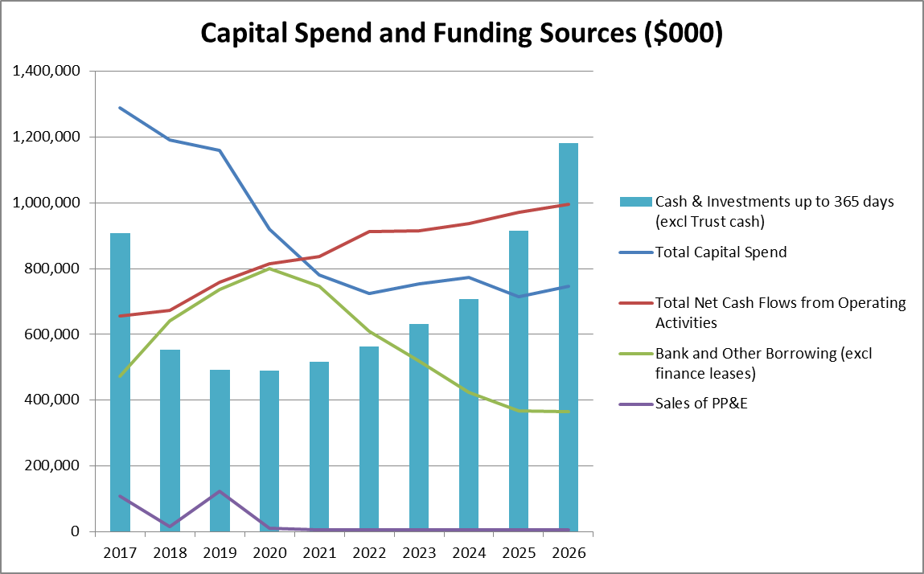
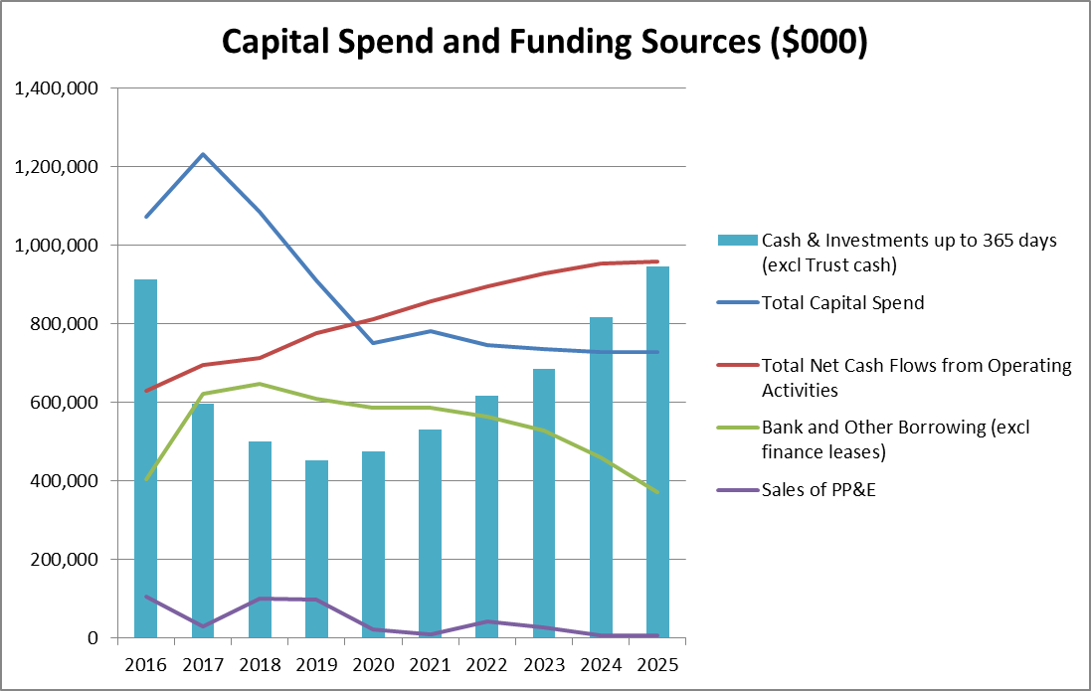
How do we fund our capital intentions?
Previous year stats:
Mainly through internal cash flows and debt.
Debt expected to peak at $647m in 2018 before declining.
2017 sees the peak in capital spending, eating up cash.
Debt falls as capital spending decreases
Still mainly through internal cash flows and debt.
Share of debt expected to increase in the short-term due to high capex spend. Debt peaks at $799m in 2020 before declining ($472m in 2017).
In the longer term capital spending could be supported by internal cash flows and disposals. This would enable more debt to be paid off.

Slide 8
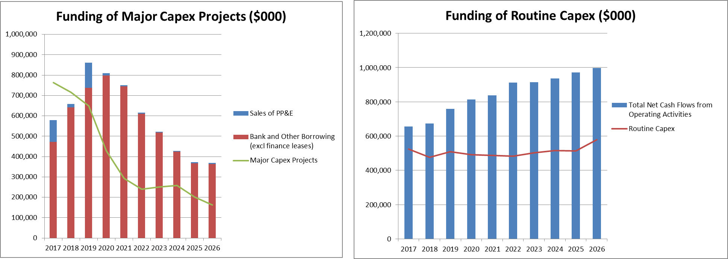
Are these funding sources adequate?
Debt and proceeds from assets sales do not cover major capex spend in 2017 and 2018 and relies on internal cash flows to fund shortfall.
Falling major capex spend from 2019 onwards ensures a comfortable debt buffer in later years to deal with unexpected shocks or new projects.
Internal cash flows comfortably covers routine capex at all times (viz. 1.7x).
Projected debt and asset sales more than covers major projects (viz. 1.5x).
78% of debt is in the University sector, rest in ITPs.

Slide 9
Quality of data received – improved?
Classification of major projects and routine capex much better and completed for full 10 years.
Known spending (to the TEC) on major projects included in plans.
Very little adjustment required (to get meaningful information).
Many TEIs are now providing supporting notes, helps TEC understand the figures
But…
Timeliness could still improve - many reminders needed.
1/27 TEIs did not provide any GSM info (2015 was 8/27)
0/27 TEIs did not provide FTE data (2015 – 2/27)
1/27 TEIs did not provide EFTS data (2015 – 2/27)
1/27 of TEIs did not provide any Accumulated Depreciation data (2015 – 5/27)
(4/27) of TEIs did not provide any Estimated Backlog Maintenance info (2015 – 17/27)
These omissions affects a number of asset performance indicators.

Slide 10
Asset Performance Metrics …Sector

Slide 11
Asset Performance Metrics …Universities

Slide 12
Asset Performance Metrics …ITPs

Slide 13
Asset Performance Metrics …Wanangas

Slide 14
Asset Performance – Key Metrics
¹TEFMA – Tertiary Education Facilities Management Association

Slide 15
Capital Asset Management
Data sourced from 2017 Independent Assessments
Feedback

Slide 16
Why are Independent Assessments required?
The expectation was first set out in Cabinet Office circular CO(10)2, which took effect on 1 July 2010.
The expectations relating to asset management were confirmed in in Cabinet Office circular CO(15)5, which took effect from 1 July 2015.
Independent assessment is integral to Investor Confidence Rating (ICR) process run by the Treasury for agencies, although TEC on behalf of the TEIs are exempted from the ICR process, recognising the work already done in the tertiary sector.
However, Treasury has recommended TEC look at improving asset management maturity as part of continuous improvement.
Overall performance in this area indicates the sector has still some way to improve, and independent assessments are a way evaluating this.
TEC is looking at ensuring consistent sector-wide meaningful performance targets to be used in the annual maturity assessments to enable more meaningful sector and sub-sector comparisons.

Slide 17
Overall results of assessments
Overall results have improved since 2015 (58), close to intermediate maturity.
All subsectors have improved - ITPs 2015 (56), Wanangas 2015 (56), Universities 2015 (60)
Sector has shown continuous improvement in asset management maturity since 2012, however…..

Slide 18
Overall results (cont….)
Certain areas need urgent attention –
        Asset Management Plans
        Financial and Funding Strategies, Improvement Planning, and Information Systems
        And to a lesser extent, Operations Planning and Reporting, Maintenance Planning

Slide 19
Universities results (cont….)
Similar areas need urgent attention –
        Asset Management Plans, Information Systems, Financial and Funding Strategies, Improvement Planning, and also Asset Register Data
To a lesser extent, Levels of Service and Performance Management, and Quality Management also need attention

Slide 20
ITPs results (cont….)
Similar to Universities
    Asset Management Plans need urgent attention, also
    Financial and Funding Strategies, Levels of Service and Performance Management, Asset Condition Assessment, Maintenance Planning, and Improvement Planning need attention
To a lesser extent Operations Planning and Reporting also need attention.

Slide 21
Wananga results (cont….)
Similarly
    Asset Management Plans, Financial and Funding Strategies need urgent attention, also Maintenance Planning
    Operations Planning and Reporting also needs attention
    To a lesser extent, Capital Investment Strategies, Asset Management Teams, and Improvement Planning also need attention.

Slide 22
Summary– Gap to target score
Asset Management Plans, Financial and Funding Strategies, Improvement Planning and Information systems are common concerns across the sector.
Maintenance Planning and Operations Planning and Reporting are also problematic.

Slide 23
Long Term Investment Plans (LTIP)
The requirement for LTIPs is set out in Cabinet Office circular CO(15)5, which took effect from 1 July 2015.
Purpose of the circular was “…to give effect to Cabinet's intention that there is active stewardship of government resources, and strong alignment between individual investments and the government's long-term priorities”.
For investment-intensive agencies, a Long Term Investment Plan (LTIP):
    describes an agency’s or sector’s investment journey subject to their long term vision and goals. It shows what will be invested in and how investment will occur in order to support the delivery of an agency’s or sector’s strategy,
    is a planning document with a horizon of at least 10 years and should be refreshed at least once every two years,
    covers all investments, assets, disposals, lease arrangements and as-a-service investments,
    is available for sharing (with central agency),
    provides evidence of affordability of investments and funding, and links to forecast financial statements,
    includes benefits from investments and whole-of-life costs,
    identifies risks.
LTIPs are therefore similar to a “(Strategic) Asset Management Plans (SAMP)” produced by TEIs.

Slide 24
(Strategic) Asset Management Plans
Status of asset management plans as per the independent assessments conducted in 2017
14* TEIs have asset management plans (AMP) that are current or less than three years old or currently being updated.
12 TEIs do not have a formal AMP in place or existing AMPs are more than four years old/out-of-date. In many instances information exists in a range of documents but not properly consolidated in an AMP.
Many AMPs do not incorporate ICT assets in their AMPs.
Seven TEIs have achieved intermediate level (65-80 on a scale of 0-110) for AMPs in latest independent assessments and 10 have achieved the core level (45-60). Highest score is 80.
10 TEIs have achieved only the minimum level for AMPs (25-40). Lowest score is 30.
Some of the positive comments in independent assessments –
…..a comprehensive and well developed document that describes the current asset planning environment, current programmes, planned investments, and financial forecasts. Progressive increases in the level of details and alignment with good-practice asset management plans. Provides a good summary of the level of service targets and shortfalls, projected changes in demand and planned responses.
……strong linkages between Campus Development Plan and SAMP, includes a monitoring and review programme. 20 year detailed financial forecasts included in the SAMP. Six monthly reporting on achievement of SAMP.
…..has iteratively developed a facilities focused SAMP
………..has broad input.
* WelTec & Whitireia are combined.

Slide 25
(Strategic) Asset Management Plans (cont….)
Some of the other comments in independent assessments –
…..not updated since 2012, no longer represents a fair AM practice
…..no organisation wide AMP exists, …..no formal AMP, …..AMP not updated and out of date
…..out of date, not useful as a planning or operational document, need to broaden scope
…..no AMP exists, information exists in other documents and folders
…..no consolidated document exists
…..limited value due to missing sections and old data
…..large sections incomplete, some sections not updated since….
…..data and information in various places, needs collation
…..several areas need further development
…..information in other documents/various places
Re ICT Plans
…..ISSP out of date, …..no ITS AMP in place, …..ICT excluded, …..lacks infrastructure and ICT
…..does not include IT and other classes of assets, …..no ISSP or faculty asset plans
….. no current plans for ICT, etc. (see hand-out on ICT seminar)
Denotes a situation that needs immediate and urgent attention.

