Slide 1
Te Whare Wānaga o Waikato
Jumpstart Programme
Associate Professor Tracy Bowell
Pro Vice-Chancellor Teaching and Learning

Slide 2
What is Jumpstart?
4-week summer programme in late January – February
1 paper (15 point) credit
Choice of papers
Full-time week with a programme of learning development and support sessions, workshops and tutorials built around classes for the chosen paper
Open to all new undergraduate students who have passed UE
Designed for new students who:
  Might need additional time or support to adjust to University study and life.
  Need to consolidate or fill gaps in subject understanding, knowledge or skills before embarking on their degree programme.
  Want a head-start on their first-year of study.
Notes:
Eligible for fees-free
Subsidised rate for accommodation in halls of residence

Slide 3
Why Jumpstart?
Part of a renewed focus on student success and retention
Evidence-based:
  For many students the availability of academic support – in the form of basic skills…supplemental instruction, and summer bridge programs – is critical to their ability to succeed in college. Tinto, Vincent, Rethinking Institutional Action, University of Chicago Press, 2012, 25.
Modelled on similar successful programmes we saw in the USA

Slide 4
Some of our Aims
Support transition from school learning environment to university
Creating community, sense of belonging – that they belong to University and at University and that University belongs to them
Making University smaller for students, making it feel more manageable
Enabling them to see that it works for them and they’ll be able to be successful
Passing first paper -> crucial sense of achievement
They know their way about (Wittgenstein)

Slide 5
Pilot 2018
Started with Engineering
General Physics and Mathematics for Engineers
3-week 15 point paper
21 students
90% pass rate
All students progressed beyond Semester A into Semester B 2018
Students’ results in their 2018 papers
Notes:
Why Engineering
Workforce needs
Students re-taking papers
Difficulty progressing into 2nd Year
Paper fills in gaps identified in maths and physics knowledge and understanding

Slide 6
Average Final Mark for Paper

Slide 7
Participation in assessments

Slide 8
Jumpstart Expansion 2019
Choice of 4 papers
  General Physics and Mathematics for Engineers (ENGEN100-19C)
  Basic Mathematics for University (MATHS168-19C)
  Pre-Law (LEGAL100-19C)
  Writing for Academic Success (WRITE100-19C)
Extended to 4 weeks
80 students
  44% female, 56% male
  12 admitted under special admission
Notes:
Chose on the basis of where we saw gaps – numeracy, literacy, students not quite prepared for Law, or who need to find out whether it’s really for them
4 weeks on basis of feedback from 2018 students and teachers

Slide 9
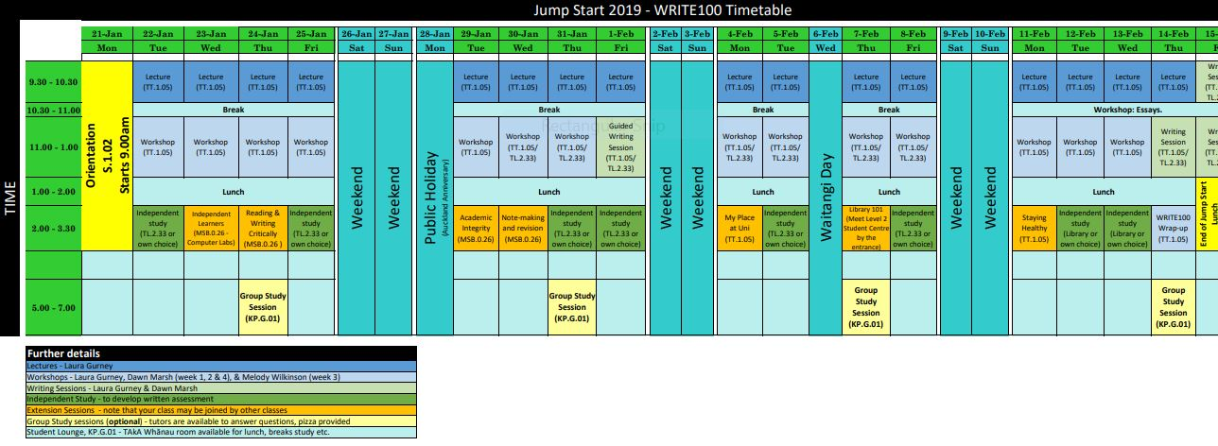
Notes:
Longer lead-in time for 2019
Orientation Day
Began with a Whakatau
Ended with a catered lunch, speeches
Students provided with a lounge

Slide 10
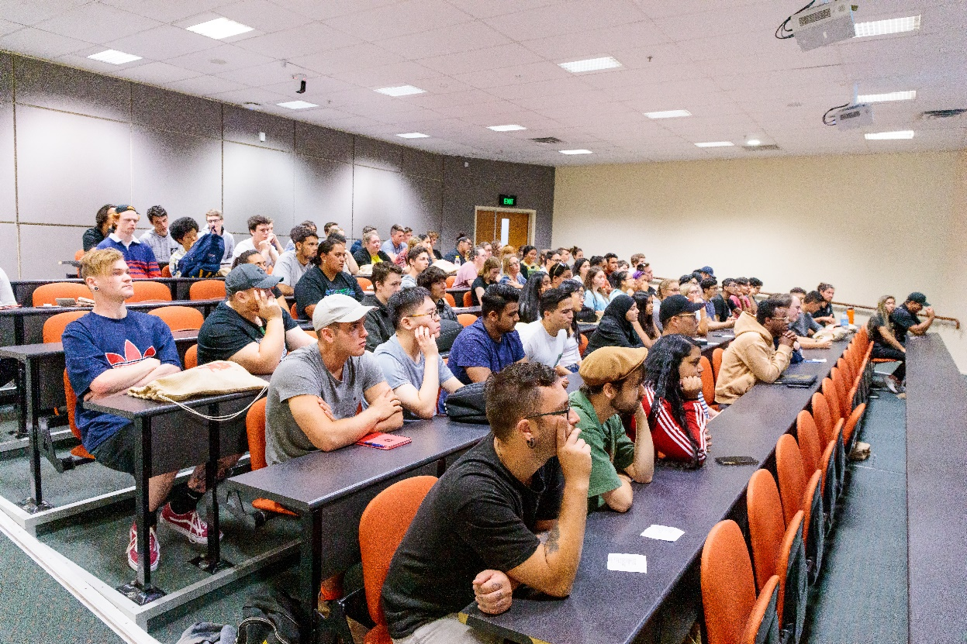
Activities
Day 1 – Orientation Day
Began with a Whakatau
Each week included:
Lectures
Workshops and tutorials
Supported study sessions
Independent study sessions
Notes:
More structured than usual 1st year timetable
More contact time
Support and development activities (extension) wrapped around lectures, workshops, tutorials
Supported study sessions – talk through details
Aim is to transition students from structure of school to becoming independent, self-directed learners
Each paper has a timetable more or less like this

Slide 11
Distribution Across Papers %

Slide 12
Students’ Ethnicity %
Notes:
Note, multiple could be chosen

Slide 13
New Student Status %

Slide 14
2019 Outcomes
A 94% pass rate was achieved over the four Jump Start papers (75 out of 80 students passed).
Students identifying as Māori(21) had a 95% pass rate (only 1 student did not pass)
Students identifying as Pacific(14) had a 95% pass rate (only 1 student did not pass)
10 out of the 12 Special Admission students passed (83% pass rate)

Slide 15
Pass Rates by Paper

Slide 16
Student Voice 1
95% satisfaction overall for Jump Start 2019 papers.
Students were happy overall with the timing and course content/delivery
Many found the 4-weeks intense.
The support/development were well-received
Notes:
Regular student evaluation of teaching (SET) methodology
Online, BLUE
52% response rate
We use top-box scores so 95% agreed or strongly agreed with the statement ‘Overall, this paper provided me with a good learning experience.’

Slide 17

Student Voice 2
The main reasons students joined Jump Start were to:
  Gain confidence (49%)
  Get used to University before the majority of students started (49%)
  Complete their first University paper early (37%)
  Make friends (35%)

Slide 18
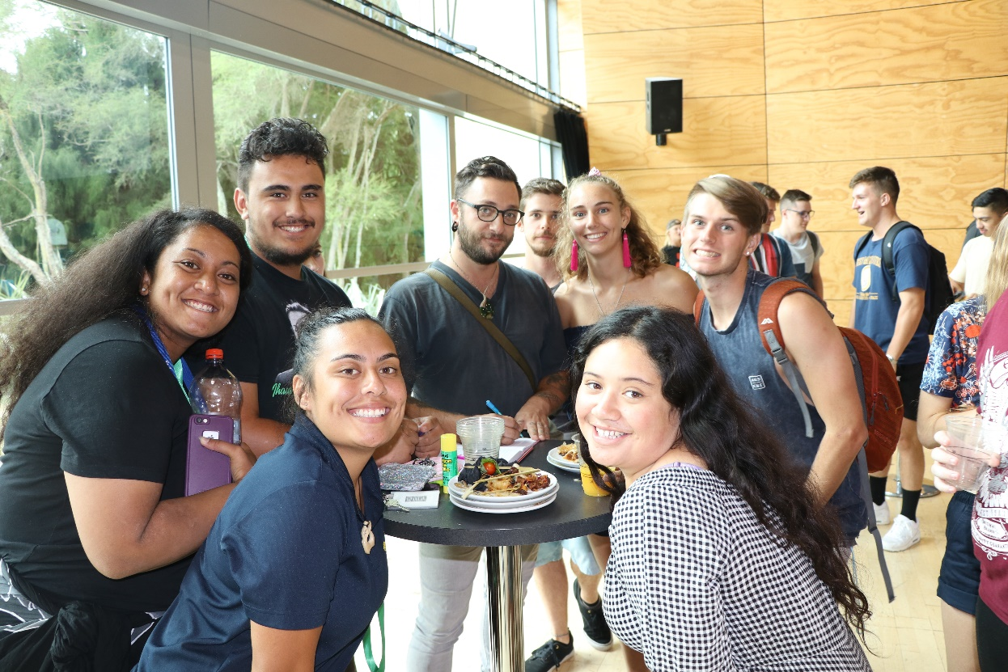
Student Voice 3
Thanks to jumpstart I made so many new friends giving me a confident step into the new uni life
Having the timetable with the extension sessions … enabled students to understand university
Jump Start is great. So far I've found friends and made connections with teachers. I am glad I took Jump Start. I strongly recommend joining Jump Start if it is your first year in Uni.

Slide 19
Māori Learners – New Student Status %
Notes:
N = 21
33% female
67% male
4 were special admission
All passed their papers

Slide 20
Māori Learners – Paper Distribution %

Slide 21
Māori Learners – Qualification Choice
Notes:
Also have age distribution
Also have last school attended and region
From the latter we see that:
12 from Hamilton and adjacent Waikato
Others from Thames Valley, South Waikato, Hawkes Bay, Bay of Plenty, Auckland, Northland, Manawatu

Slide 22
Pacific Learners – New Student Status %
Notes:
N = 14
Female 71%
29%
3 students entered under special admission
All passed their paper

Slide 23
Pacific Learners – Paper Distribution %
Notes:
3 students entered under special admission
All passed their papers

Slide 24
Pacific Students – Qualification Choice
Notes:
Also have age distribution
Also have last school attended and region
From the latter we see that:
9 from Hamilton and adjacent Waikato
Others from Thames Valley, South Waikato, Manukau, Hawkes Bay, Bay of Plenty

Slide 25
A Semester Papers Pass Rates %
Notes:
89% overall Jump Start pass rate of Sem A 2019 papers
This compares with an 82% pass rate of Sem A 2019 papers for all other 1st year students (excluding JS students)
WRITE100 note: 35% of class (7 students) were special admission; this cohort had a 39% pass rate in Sem A papers which would account for the lower overall rate for this paper.
Breakdown across each of a student’s 4 Semester A Engineering papers available

Slide 26
Retention into B Semester 2019 %
Notes:
97% overall Jump Start retention into Sem B 2019
This compares with an 85% retention rate of all other 1st year students (excluding JS students

Slide 27
Building for the Future
We have learned that special admission students need ongoing learning development and advising to support their transition to university study
Expanding to 5 papers
Offering WRITE 100 at our Tauranga campus
Ability to scale up
  Jumpstart itself
  Use of data to inform design and development of programmes
  Tailored support and advice for students
Notes:
WRITE 100
Engineering calculus paper
6 students -> JS
4 passed with average 75% pass rate, of which 3 achieved 80% or above, 1 was lower
2 were SA and found it more challenging
So looking at programmes and processes to put in place for those students
Ako Aotearoa – case studies of success
Blocking

Slide 28
Thank You
Sonya Breen, Associate Director, Student Retention Projects
University of Waikato Business Information and Analytics Team
Felipe Gomes, Digital Production Advisor, University of Waikato
The TEC for the invitation to present today
Students, academic and professional staff involved in Jumpstart 2018 and 2019

Slide 29
Ngā mihi nui ki a koe
Thank You for Listening

