Slide 1


Using data to inform
Higher Education policy
Prof Airini
Thompson Rivers University
airini@tru.ca

Slide 2
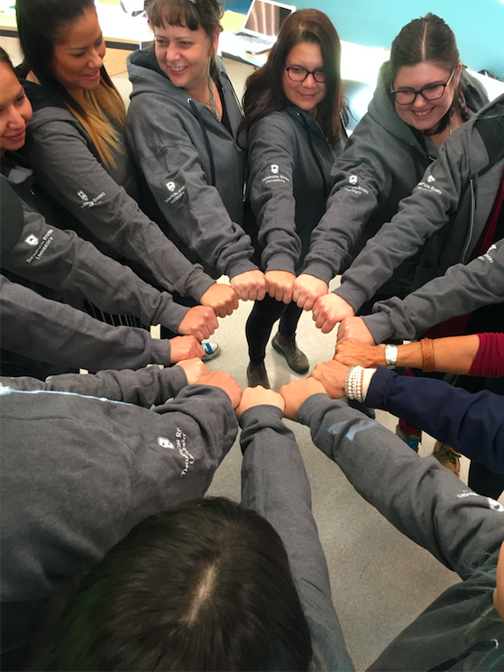
A tertiary education system
that works for everyone.

Slide 3
Using data to inform
Higher Education policy
Definitions
A context of success, and a call to accelerate the pace of change
Using data for policy pathways (4) to deliver student success for everyone
Final thoughts

Slide 4
‘Data’ facts used in analysis, critical thinking, research, and that are contextualised.
Higher Education: Tertiary education particularly bachelors and post-graduate education
Policy:
A course of action or principles adopted by government or an organisation.
The New Zealand Government sets education policy and the MoE develops it. Key bodies help shape national education policy (e.g. TEC, NZQA, NZTC, NZCER, etc), along with research.
Policy: A course of action or principles adopted by government

Slide 5
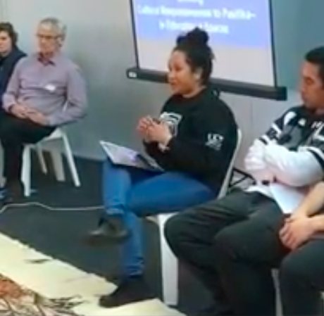
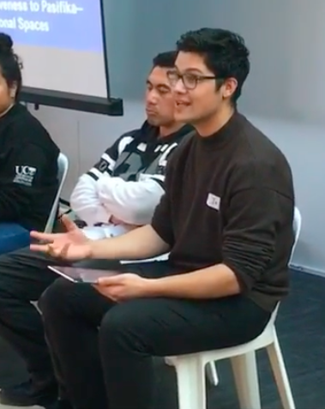

Success
To get my degree, and to still have my values, my culture and all my family in tact.
To feel good in one’s self and able to give back to our community & participate in our family life fully.
To make our standard of living better than now…& just to be able to work & support my family.
To change the stereotypes.
Ako Aotearoa (2017). Educational outcomes. Pasifika learner success.
https://ako.ac.nz/knowledge-centre/evaluating-pasifika-success-toolkit/definition-of-success-through-pasifika-student-perspectives/

Slide 6
Equity/ Parity targets
Transitions between Secondary & Tertiary
Research
Collaboration with business
Agreed performance indicators
Partnerships with Māori
Community-led plans
Professional learning for tertiary sector
Access to data
New Zealand’s tertiary organisations (& schools) are doing good things for student success and are making progress.
The potential for student success in tertiary education has never been greater.
Notes:
Today and tomorrow are filled with examples of good things.
Example of research:
Enhancement of Tertiary Education Strategy
Priority Frameworks
To determine innovative ways of working with Pasifika learners, families and communities;
to promote increased interest and participation in high- growth, high-demand industries.
The focus was Pasifika learners and optimal pathways and support (including support from families) through Years 11 to 13.
It included developing a model for alignment between senior secondary school, university success and the profiles needed for employment in high-growth, high-demand industries.
Included analyses of the NCEA data from two databases involving 32,000 students from 2007 to 2013 in Auckland and Northland schools.
2014: Professor Stuart McNaughton, Walter Fraser, Naomi Rosedale, and Jacinta Oldehaver

Slide 7
Equity/ Parity targets
Transitions between Secondary & Tertiary
Research
Collaboration
Agreed performance indicators
Partnerships with Māori
Community-led plans
Professional learning for tertiary sector
Access to data
Conventional thinking and approaches have not always been up to the task of better serving Māori and Pacific learners.
Notes:
There is more to do.
The average impact of socio-economic background on student’s performance is above the OECD average, and large performance and completion gaps persist within the student population. Moreover, Māori and Pasifika students represent more than one-third of the student population, and diversity of the student population is increasing, while they face lower outcomes and may be less likely to complete their secondary education. System-level policies, schools and post-secondary schools should focus on improving the educational success of students from diverse backgrounds and delivering quality education across all schools.
The long-term performance of the university system depends on its ability to teach a broad cross- section of students; adapting to dramatic demographic shifts occurring as a result of social mobility, migration and immigration. Stuart Middleton has argued that the changing demographic in New Zealand is “the largest challenge for higher education” (Middleton, 2008, p. 3). The net effect is that those population groups that have traditionally provided successful students are being replaced by increasing numbers of students “from groups that are traditionally underserved by higher education” (Middleton, 2008, p. 3). This is an issue for both universities and economic growth.
Māori and Pasifika student success in tertiary education is of national strategic relevance. By 2021 more than 25 percent of New Zealand’s population will be Māori or Pasifika because of their higher fertility rates and younger population profile (Department of Labour, 2008). Māori and Pasifika will make an increasing proportion of the eligible workforce in New Zealand, at a time when the median age of the population continues to grow.

Slide 8
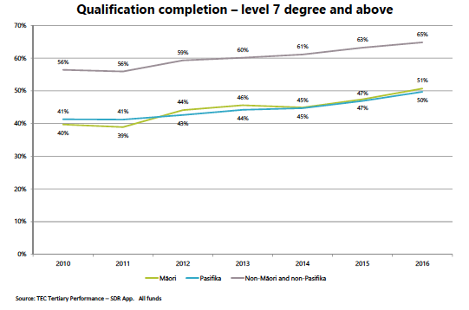
The Challenge:
To accelerate the pace of change
Notes:
By 2030, 30 percent of New Zealanders will be Māori or Pasifika, and as such it is essential that tertiary education improves its delivery to these groups

Slide 9
Higher Education policy matters
Why:
An education system that delivers equitable
and excellent outcomes.
How:
A tertiary education system that works for everyone.
What:
Within five years we intend to achieve participation and completion patterns for Māori and Pasifika that are the same as for other New Zealanders in the system
TEC briefing to the incoming Minister, 2017Zealanders
in the tertiary

Slide 10
Shifting from
Misinformation and
focusing on what leads to failure
to
Using accurate data for policy pathways to
deliver student success for everyone
Notes:
Misinformation examples:
Pacific are immigrants – more than 60% of Pacific New Zealanders were born in NZ.
Maori experience in HE is the solution for Pacific experience (and vice versa)
Maori experience of deprivation matches Pacific peoples’.
Equity means equality

Slide 11
Using data to inform Higher Education
policy pathways to student success
Outcomes pathway
Partnership pathway
Research pathway
Innovation pathway
Notes:
Shifting policy from addressing the determinants of failure to finding pathways that will lead to success

Slide 12
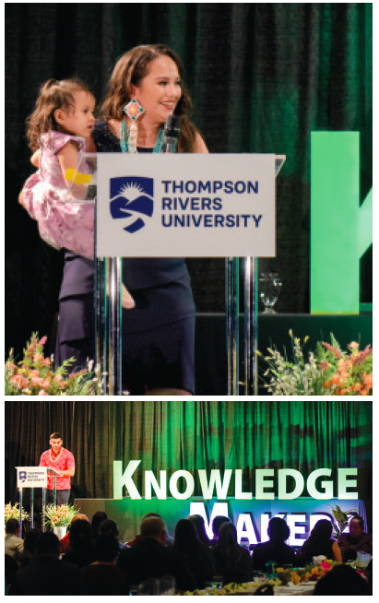

Outcomes pathway
We will accelerate student success in Higher Education when:
Policy supports institutions to achieve stretch targets that are fair, reasonable, and measureable.
Notes:
Knowledge Makers Outcomes framework
By 2022: Proportion of Indigenous faculty at TRU is on par with the regional Indigenous demographic (13%)
By 2024: Proportion of faculty who are Secwepemc is on par with the Secwepemc regional demographic
By 2022: 100 undergraduate Knowledge Makers, with at least one published research article each.
By 2024: 50 Masters Knowledge Makers, graduated, with at least two published research articles.
By 2026: 20 doctoral Indigenous Knowledge Makers, graduated, with at least four published research articles.

Slide 13

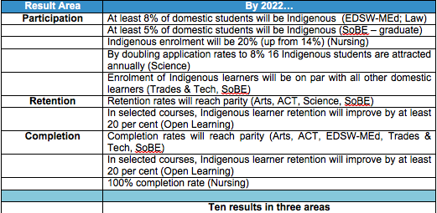
https://www.tru.ca/indigenous/coyote.html

Slide 14
Outcomes pathway
Questions: How will Higher Education policy:
enable each institution to have stretch target(s) to accelerate student success and report on progress?
factor in the transitions (from school, from tertiary education)?
ensure institutions have access to supplemental resources?

Slide 15
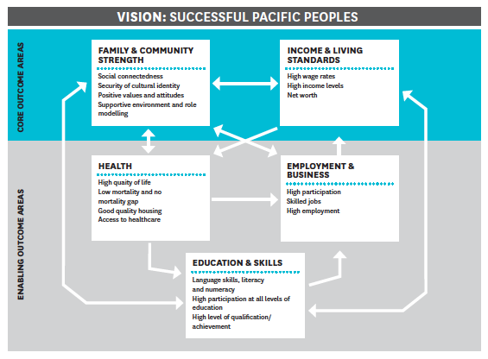
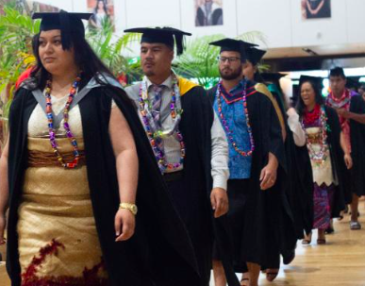

Partnership pathway
We will accelerate student success in Higher Education when:
Higher Education policy is informed by data from partnerships with, and within, communities.
Q: What data will count for all in a partnership approach to policy making?
MPIA. (2010). Careers for Pacific peoples
U of Canterbury Pasifika Strategy
Onehunga High School Health Science Academy
Notes:
OHS Health science academy – in partnership with Waitemata Auckland and Counties Manukau DHBs. (https://www.onehungahigh.school.nz/curriculum/pathways/health-science/)
U of C Pasifika Strategy (2019-2023) : Informed by Pasifika students, ARA Institute of Canterbury , Lincoln Universit and Ako-funded research.

Slide 16
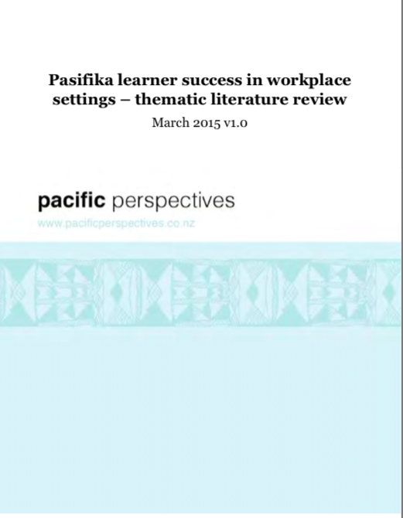

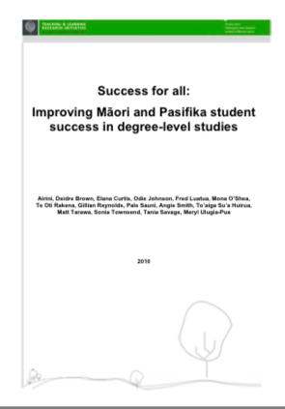
Research pathways
We will accelerate student success in Higher Education when:
Higher Education policy is informed by a comprehensive database of New Zealand Education research, and a multi-year New Zealand Education Research Plan
Q: What research is still needed for Higher Education policy?
Collaboratively developed 10-year statement of priorities for a New Zealand education research system;
Ensuring state-funded investments in education research make the greatest contribution to a New Zealand education system that delivers equitable and excellent outcomes for all learners.
Notes:
A New Zealand Education Research Plan 2020–2030:
A collaboratively developed 10-year statement of priorities for a New Zealand education research system;
Ensuring state-funded investments in education research make the greatest contribution to a New Zealand education system that delivers equitable and excellent outcomes for all learners.
Why: Education research impacts on all learners through improving equitable and excellent outcomes across education sectors.
How: World-class education research
What: A world class education research system that improves equitable and excellent outcomes.
Actions: Public discussion paper followed by Government agency workshops, written submissions from stakeholders, regional consultations and topic-specific workshops, including workshops for prioritisation, Māori education research, Pacific education research, learning support/diversabilty/disability research, and developing the education research workforce; and creation of NZ Education Research Plan.

Slide 17

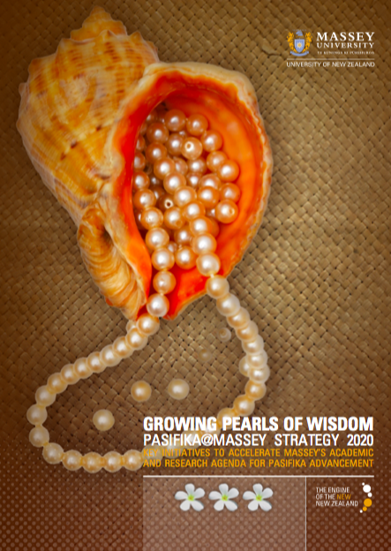
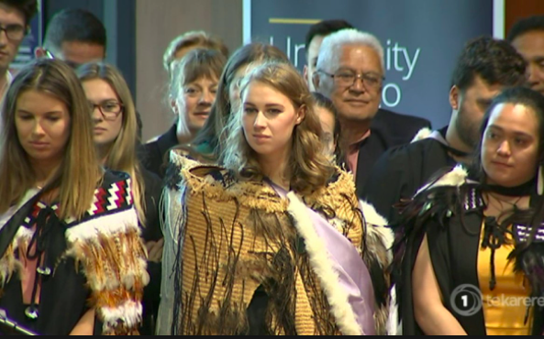
Innovation Pathways
We will accelerate student success in Higher Education when:
Higher Education policy is informed by data from ‘Success Innovators’.
Enable Institutions who are underway with initiatives with potential to deliver accelerated student success outcomes, to expand and use innovative approaches.
Women in Trades
Pasifika@Massey Strategy
University of Otago Maori Medical graduates

Slide 18
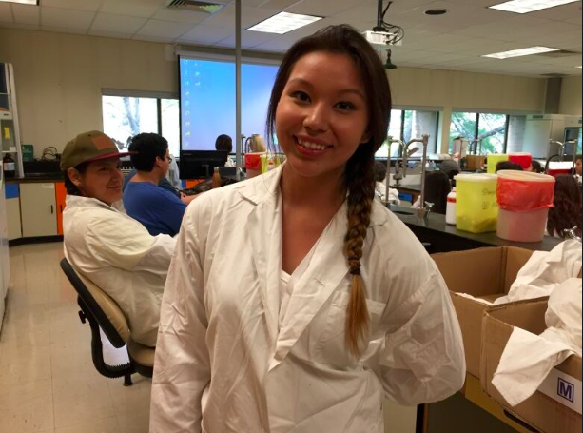
Innovation Pathways
Evidence-informed
Strategically relevant
Potential to scale up and/or adapt
Accelerating change in student success outcomes
Sharing outcomes and practices, & working with other institutions to mentor
Block teaching
Primary-tertiary bridging
Summer+ prep
Data strategies – predictive/ context analytics
Indigenising curriculum
Online platforms to increase access
Women in Trades
U of Otago Maori Medical graduates
Summer Science camp

Slide 19

Innovation Pathways
A learning community in the spotlight

Slide 20
Using data to inform four Higher Education policy pathway to student success
Outcomes pathway
How will policy: enable each institution to have stretch target(s) to accelerate student success, and report on progress; factor in transitions (from school, from tertiary education); and ensure institutions have access to supplemental resources?
Partnership pathway
What data will count in a partnership approach to policy making?
Research pathway
What research is still needed for Higher Education policy?
Innovation pathway
How will learning from site-specific Innovations be scaled up? How will impact be counted?
Notes:
Conclusion – slide 1

Slide 21
Shifting from
Misinformation and
focusing on what leads to failure
to
Using accurate data
for policy pathways to deliver
tertiary education success for everyone
Notes:
Conclusion – slide 2

Slide 22
Student Success: Policy data pathways
Outcomes
Partnerships
Research
Innovation
‘Spotlights’
Notes:
Conclusion – slide 3 (End)

Slide 23
Using data to inform
Higher Education policy
for tertiary success for everyone.
Prof Airini
Thompson Rivers University
airini@tru.ca

Slide 26
1. Student-centred
Student learner
Institution practices
Government policy
Employment & business
Family & community

Slide 27
Family & community economic & cultural strength
Education sector responsive
Partnership approach to government policy & operations
Increased income & living standards
Student education & skills higher in quality & achievement
2. Partnership
Notes:
TLRI (2010): Success is more than we think: “Success” includes movement towards and achievement of pass grades or higher, a sense of accomplishment and fulfilling personally important goals and participation in ways that provide opportunities for a student to explore and sustain their holistic growth. The concept of “success” is a broad one that links with individual and community notions of potential, effort and achievement over time.
Career Futures for Pacific Peoples (MPIA, 2010)

Slide 28
Student Success
Institution-wide approach
Data, information, needs analysis & actions
Secondary & tertiary collaborate
Employer/Business engagement
Maori & Community partnerships
Culturally responsive
3. Evidence-informed institution

Slide 29
Knowledge Makers
2016-2018
2 National Scholarships
1 National Research Grant ($50,000)
16 Research Assistants
6 Graduate Research Scholarships
4 continued to Masters
1 International Internship
2 Post-Baccalaureate Studies
1 Mainstream Undergraduate Research Grant (UREAP)
1 social innovation business model
2016-2019
Knowledge Makers Undergraduate Circle
Knowledge Makers Graduate Circles
Knowledge Makers International: Mexico, USA, Canada, Australia, Aotearoa New Zealand
National Teaching Excellence Award (Canada)
– Alan Blizzard Collaborative Teaching Award
Notes:
Since its inception three years ago Knowledge Makers has had 42 participants. Of which two have gone onto post-baccalaureate study, two have received national graduate scholarships, one has received a national research grant, four have gone onto masters degrees, nine have gone onto to be research assistants, five have received graduate studies scholarships, one has participated in an international internship, one has received mainstream funding for an undergraduate research project, one has started his own business and 42 have published some more than once.
Airini

Slide 30
62 Knowledge Makers
85 Articles
2016-2019
30 Nations and Bands
Secwepemc Nation, Tkemlups te Secwépemc, Shushwap Nation, Ojibway Nation, Saulteau First Nation, Métis, Seton Lake Band, Dakelh Nation, Stó:lō Nation, Cold Lake First Nations, Waywayseecappo First Nations, Treaty Four Gimley, Ahnishinaabe, Chippewas of Nawash Unceded First Nation, St’at’limc Nation, Ts’Kw’laxw First Nation, Tsimshian, Carrier, Mi’kmaq, Nsyixcen: Upper Nicola Band, Tlingit, Neskonlith Indian Band, Inuit: Nunatsiavut region, Haida, Tahltan, T’exlc (Williams Lake Band), Tsqescen (Canim Lake), Stella’ten First Nations, Te Tsq’escen, Gitanmaax Band, Nak’azdli and Saik’z First Nation, Dene, Simpcw, Nisga’a, Nak’azdli Whuten and Skidegate, Haida Gwaii.

