Slide 1

Equitable opportunities for disabled students
Melissa Lethaby, Disability Information and Support

Slide 2

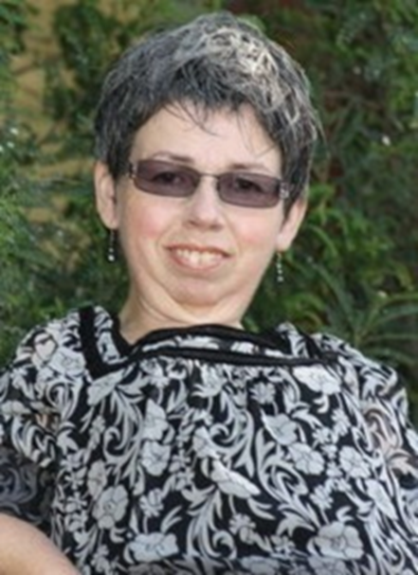
Introducing Disability Information and Support
Disability Information and Support (DI&S) was established in 1992 and was resourced by one part-time staff member.
Disability Information and Support now employs 13 staff members and approximately 250 casual staff members during the course of the year.

Slide 3

Vision and Philosophy
Our vision is to work in partnership to promote an inclusive environment that celebrates diversity, promotes comprehensive academic support, and empowers individuals with impairments to achieve their full potential.
The philosophy of Disability Information and Support is two fold:
To provide appropriate learning support to enable students to successfully as independently as possible.
To promote the development of an environment which is physically and attitudinally inclusive of the needs of students with disability or impairment.

Slide 4
What do we mean by ‘disability’?
“Disability is not something individuals have. What individuals have are impairments. They may be physical, sensory, neurological, psychiatric, intellectual or other impairments. Disability is the process which happens when one group of people create barriers by designing a world only for their way of living, taking no account of the impairments other people have…”
‘New Zealand Disability Strategy, Making a World of Difference’ 2001

Slide 5
Disability and/or Impairment
Disability: limitation of opportunities to take part in society on an equal level with other due to social and environmental barriers.
Impairment: is part of the individual, it is a characteristic, feature or attribute that contributes to the persons identity. It may be physical, sensory, neurological, psychiatric or intellectual and cause a loss of physiological function.
Notes:
Examples:
A student who uses a wheelchair has a mobility impairment, usually meaning they are unable to walk; their impairment is part of who they are (e.g. it is part of their physical being). The same student becomes disabled when they are unable to access a building because there is no flat access available or the doors are not wide enough to accommodate their wheelchair.
A student who is unable to hear is Deaf or has a hearing impairment, their impairment is part of who they are (e.g. it is part of their physical being). The same student becomes disabled when others refuse to use a NZSL Interpreter, face them when speaking or use another format for communication.

Slide 6

Students as essential partners
We see students as essential partners and work within a human rights approach where consultation, participation and student empowerment are valued.
Notes:
The ethos of Disability Information and Support is to move from a transactional model of provision – where students are passive recipients of supports, to a transformational model of resource usage, where students take an active part in planning their educational journey.

Slide 7

Who does DI&S support?
Students who have a disability, impairment, medical condition or injury that affects their ability to study.
Students can self-refer or be referred to our service.
In 2018, DI&S resourced 1427 students and this represented 6.67% of the total student population.

Slide 8
Number of students studying at the University of Otago who identified to Disability Information and Support as having a disability/impairment

Slide 10

How is support arranged?
Student Advisors are available to discuss each student’s requirements and work collaboratively to develop a support plan.
DI&S requires documentation from a relevant professional confirming the student’s need for assistance. This is required to:
  ensure the most appropriate support system is put in place for the student.
  To ensure we do not work against the strategies put in place by professionals working with students.
  To protect the integrity of the student’s degree
  To justify any flexibility and accommodations for academic assessments.
The information provided by students in relation to their impairment and support requirements will be held in confidence

Slide 11

Types of support available
Notetaking
Individual subject tutoring or generic tutoring
Alternative formats for course materials
Equipment pool
Lab Demonstrators or Research Support
Alternative Test or Exam Arrangements
Individual Library Tours
Library Retrieval Services
Access to study rooms with specialised equipment and software
Mobility parking permits
Ensuring teaching spaces are accessible.

Slide 12

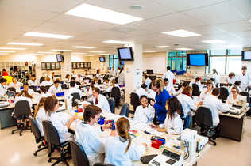
Improving outcomes
Our role encompasses the identification of potential barriers to participation and achievement with the aim of improving tertiary outcomes for disabled students.

Slide 13

Fostering pathways
Positive relationships contribute to success!

Slide 14
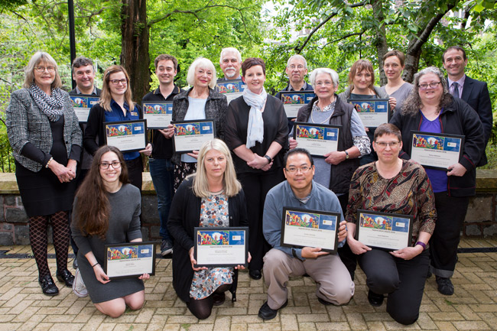
Recognising exceptional support
Awards are one way to recognise those who offer exceptional support to our service.

Slide 15

Utilising networks
We work closely with a number of external agencies. They play a vital role in supporting disabled students. With the right support, disabled students are flourishing at Otago and evidence shows that they are succeeding at similar rates to their non-disabled peers.

Slide 16

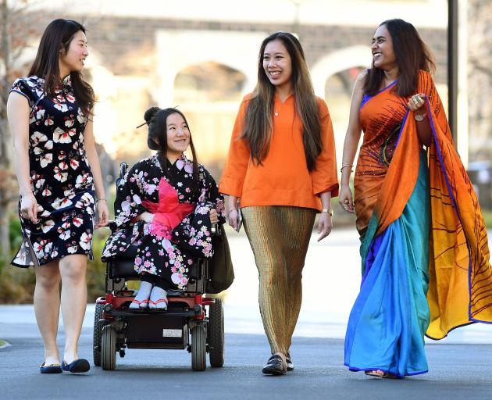
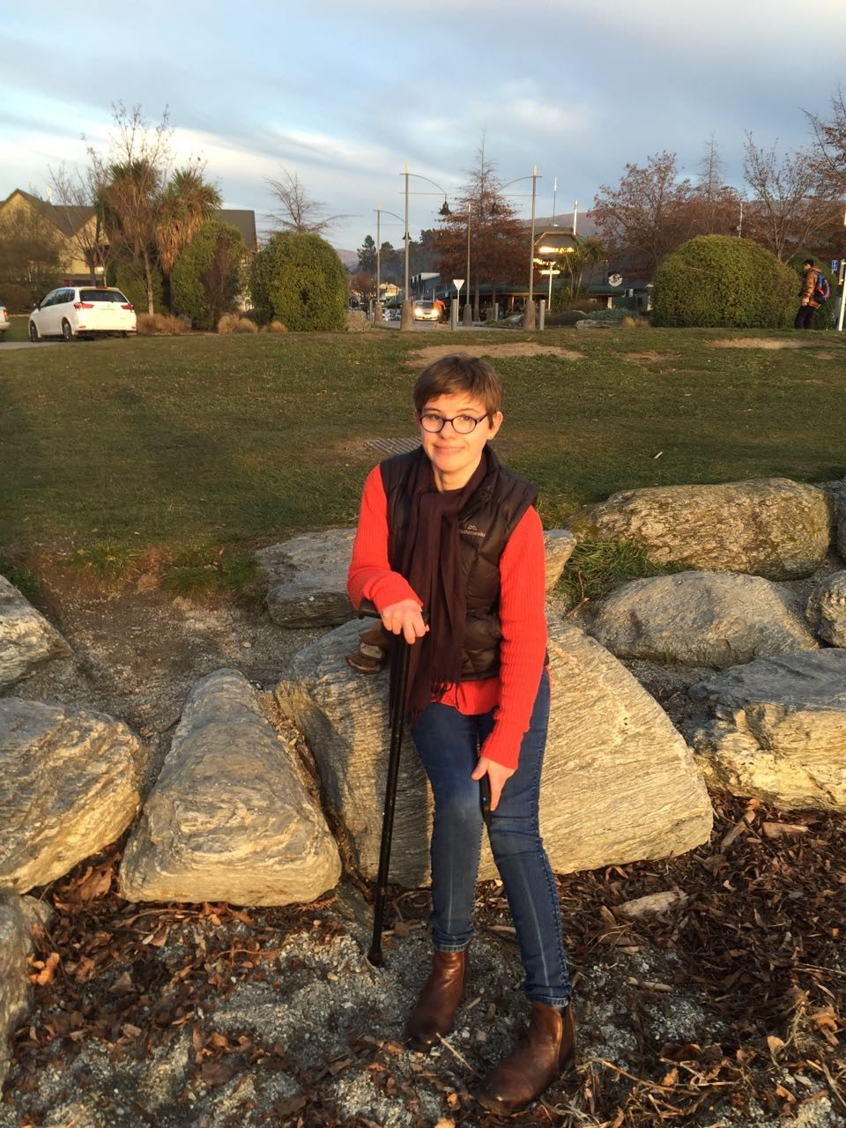
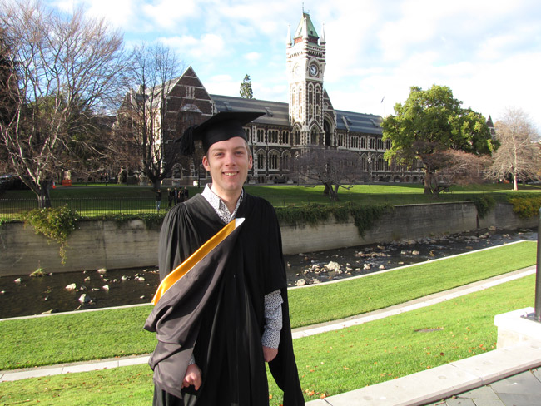
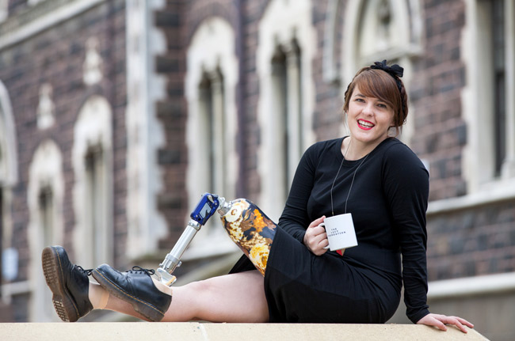
Student success

