Slide 1


TEC Conference
Auckland 6 August 2019
Georgia State University:
A Systematised Approach
To Learner Success
Timothy M. Renick, Ph.D.
Sr. Vice President for Student Success
twitter: @tim_renick

Slide 2
The Challenge in Front of Us
82.4%
Top Income Quartile
40.2%
36.1%
Third Income Quartile
14.9%
16.5%
Second Income Quartile
10.9%
Bottom Income Quartile
6.2%
8.3%
Source: New York Times, “The Reproduction of Privilege,” March 12, 2012

Slide 3
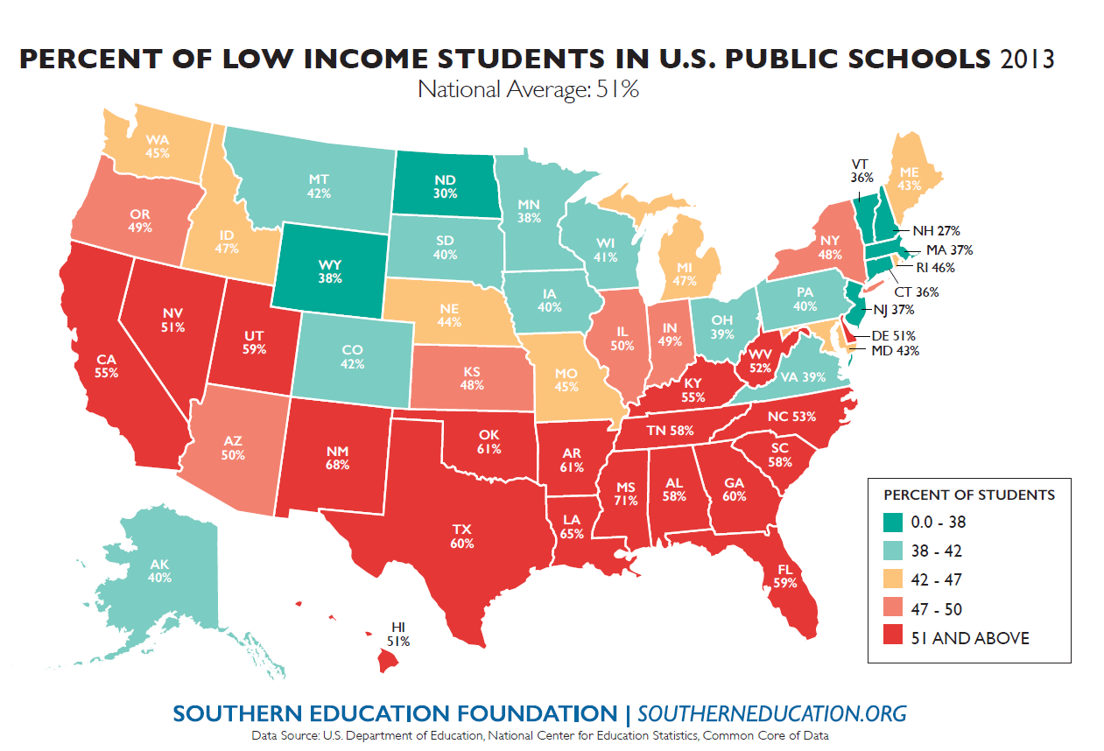
Changing Demographics
No FLC
FLC
No FLC
FLC

Slide 4
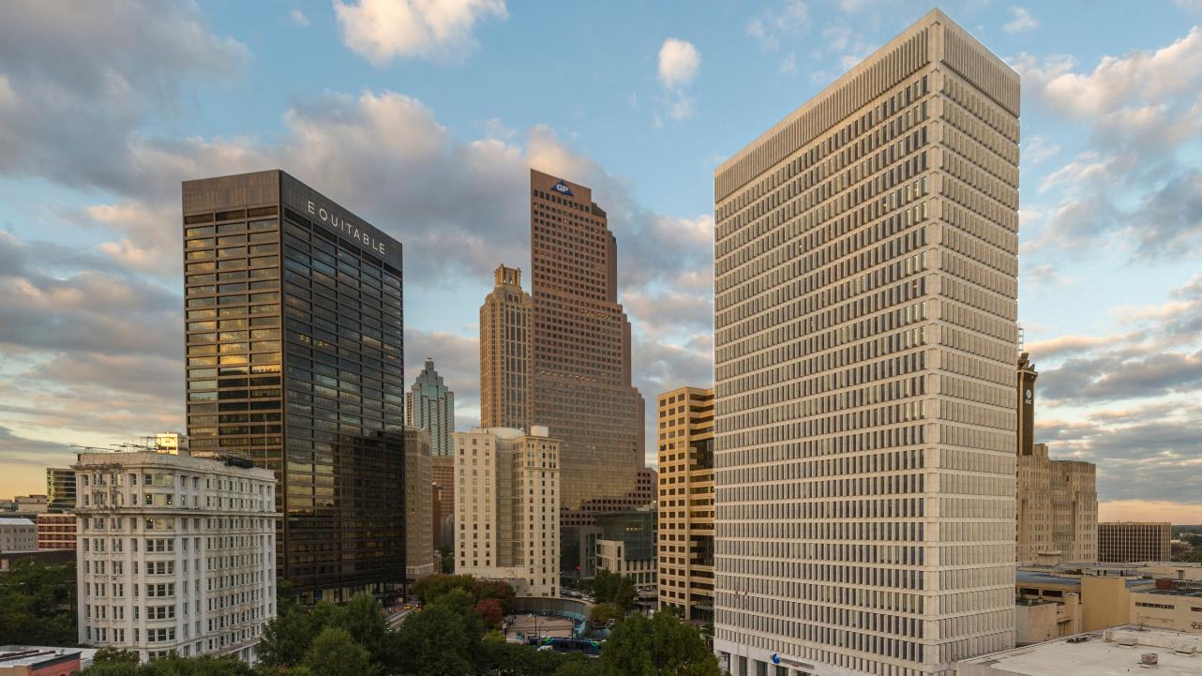

34,000 Students on the Atlanta campus (Research 1 Institution)
53,000+ Students as of 2016 with Perimeter College consolidation
#2 in the U.S. in Innovation (2019 US News and World Report)
#2 in the U.S. in Undergraduate Education (2019 US News and World Report)

Slide 5
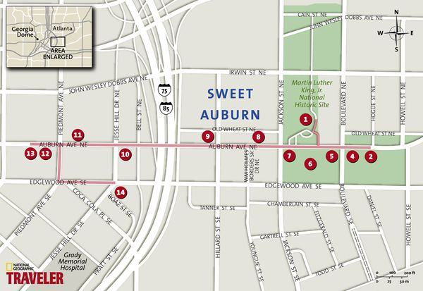
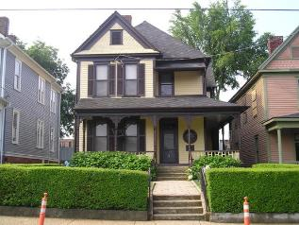

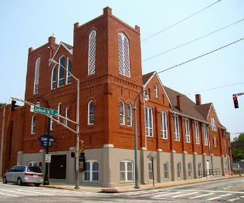


Slide 6

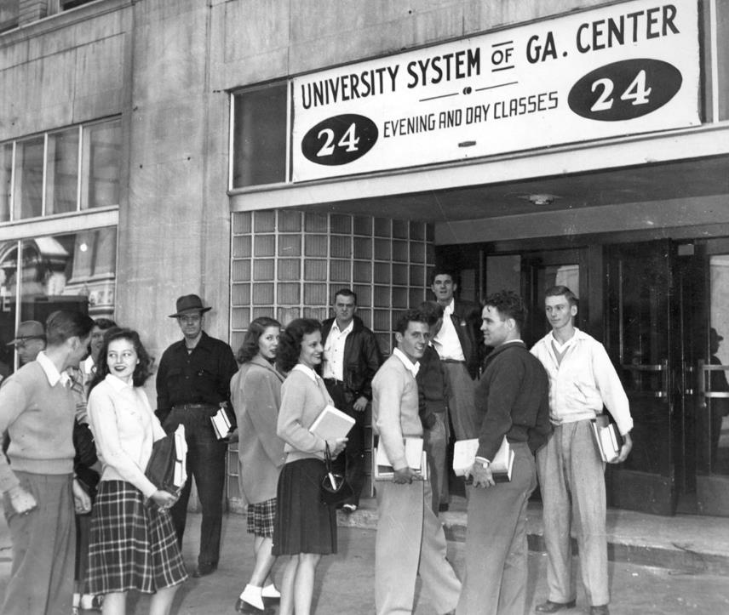
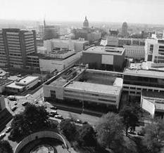

Slide 7
Graduation Rates by Race & Ethnicity
Where we were: 2003
WHITE
AFRICAN
AMERICAN
HISPANIC
No FLC
FLC
No FLC
FLC

Slide 8
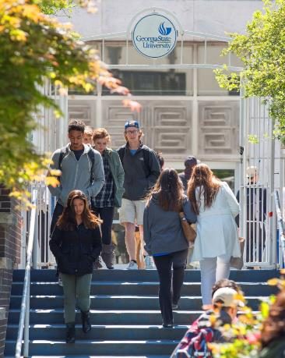
Changing Demographics: Race & Ethnicity

Slide 9

Low-Income Students

Slide 10

SAT SCORES
-33 points
Notes:
Need approval on image – istock purchase

Slide 11

Appropriations Cuts
-$40 million
Notes:
Need approval on image – istock purchase

Slide 12
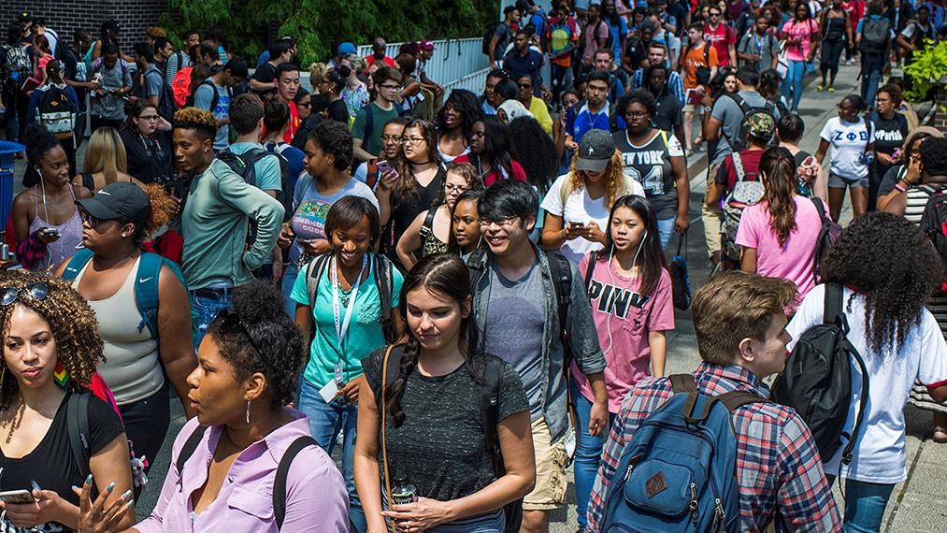
Are We the Problem?
Notes:
Need approval on image – istock purchase

Slide 13
19%
Percent of Confirmed Freshmen Who Did Not Enroll Summer 2015

Slide 14

Summer Melt
Fall 2015
Confirmed GSU Freshman Who
Never Attended Any College: 278
Non-white 76%
First Generation 45%
Low Income 71%
Avg. High School GPA 3.34

Slide 15

The Hidden Obstacles to Enrollment
Federal Financial
Aid Application
Verification Request
State of Georgia
Immunization Proof
Taking Placement
Exams
Registering for Classes

Slide 16
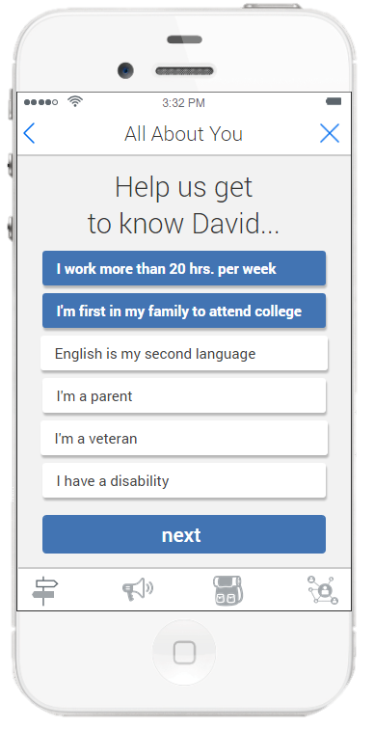
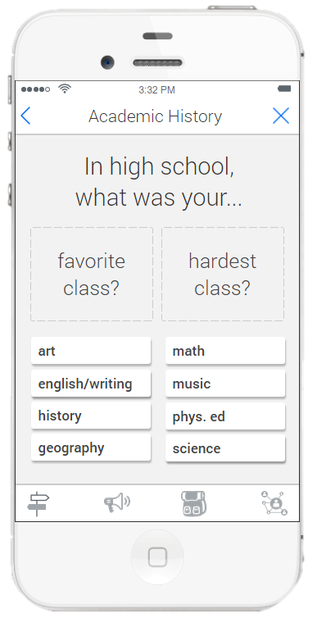

Personalized Interactions Before Enrollment Source: EAB

Slide 17
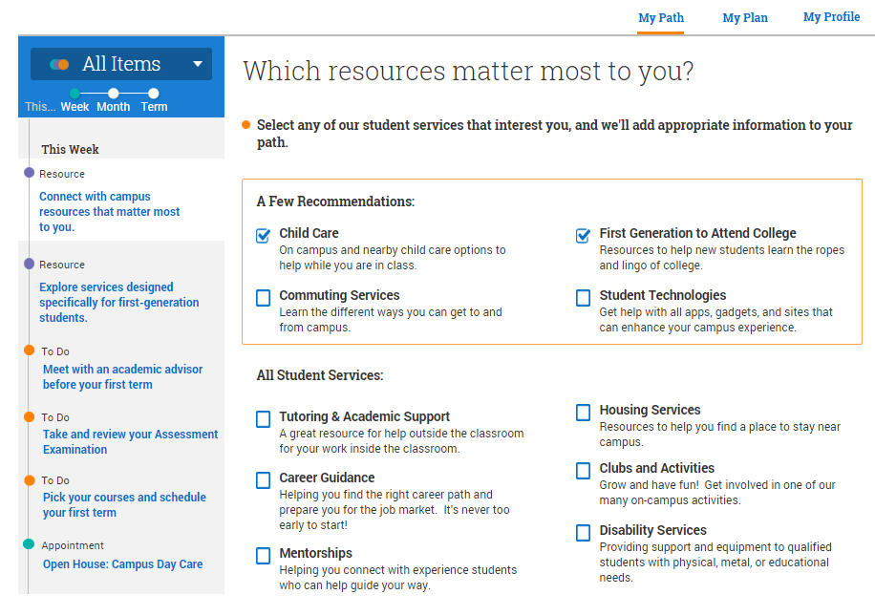
Portal to Guide Students Through Next Steps

Slide 18
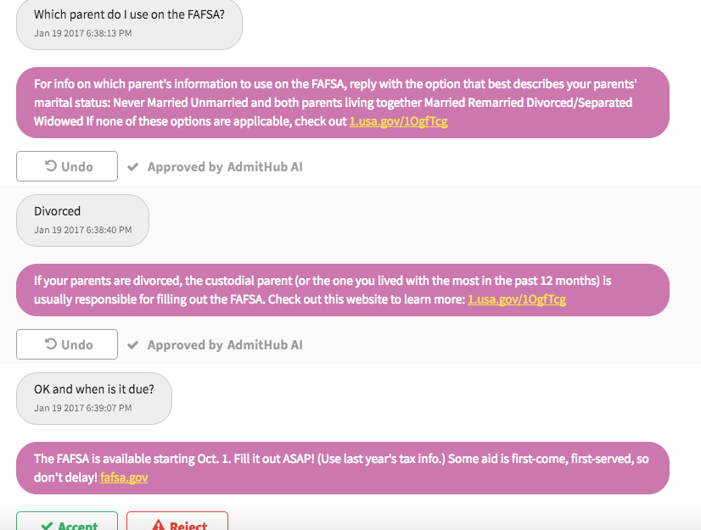
24/7 Responses Using a
Chatbot
on Smart Devices

Slide 19


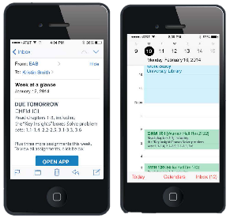
201,000

Slide 20

Three-Year Drop in Summer Melt: 37%
+362
Students per year

Slide 21
2.6
Average Number of Majors Cycled Through By Graduating Seniors in 2010

Slide 22

Overwhelming Choices

Slide 23
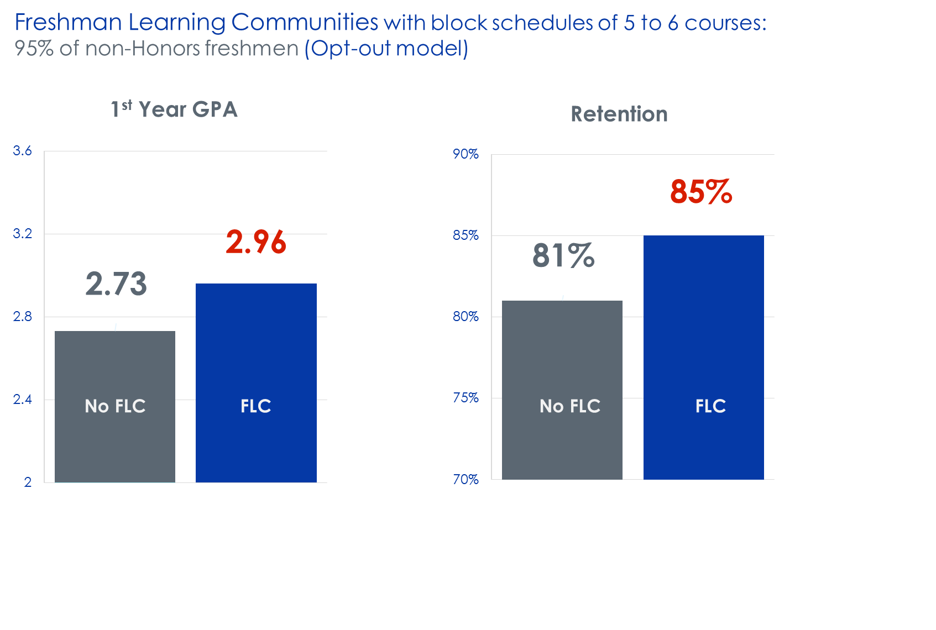
Freshman Learning Communities & Meta Majors

Slide 24

Choice Architecture: Meta Majors
Business
Education
Exploratory
STEM
Humanities & Arts Health Professions
Policy/Social Science
24

Slide 25
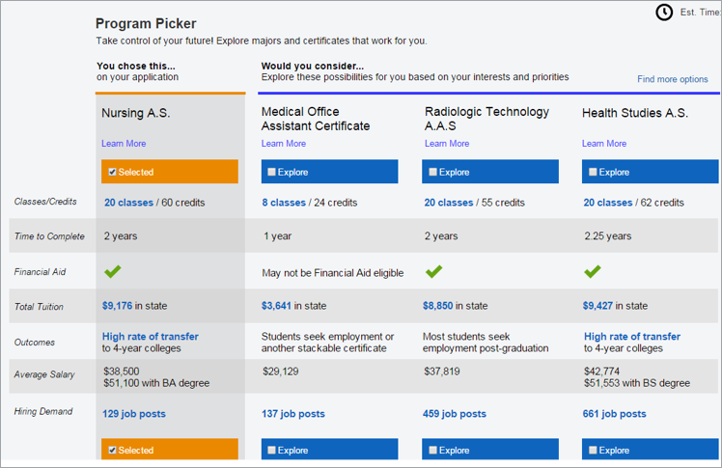
Academic Guides with Live Job Data

Slide 26
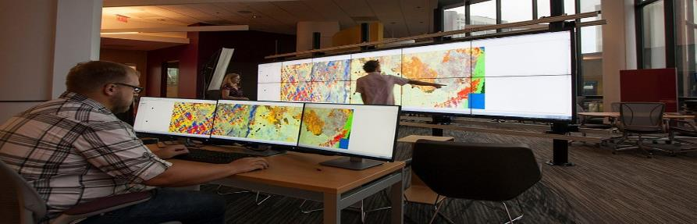
Faculty and Department Seed Grants
The Department of History
Skills-Based Approach to U.S. History Survey Courses
Use Tableau to interpret historical data
Data viz software as tool for presenting historical findings
Did NOT require any alteration to existing SLOs

Slide 27


Signature Experiences
For-Credit Outside-the-Classroom
Experiences offered by every major
70% of graduating seniors complete at least one

Slide 28
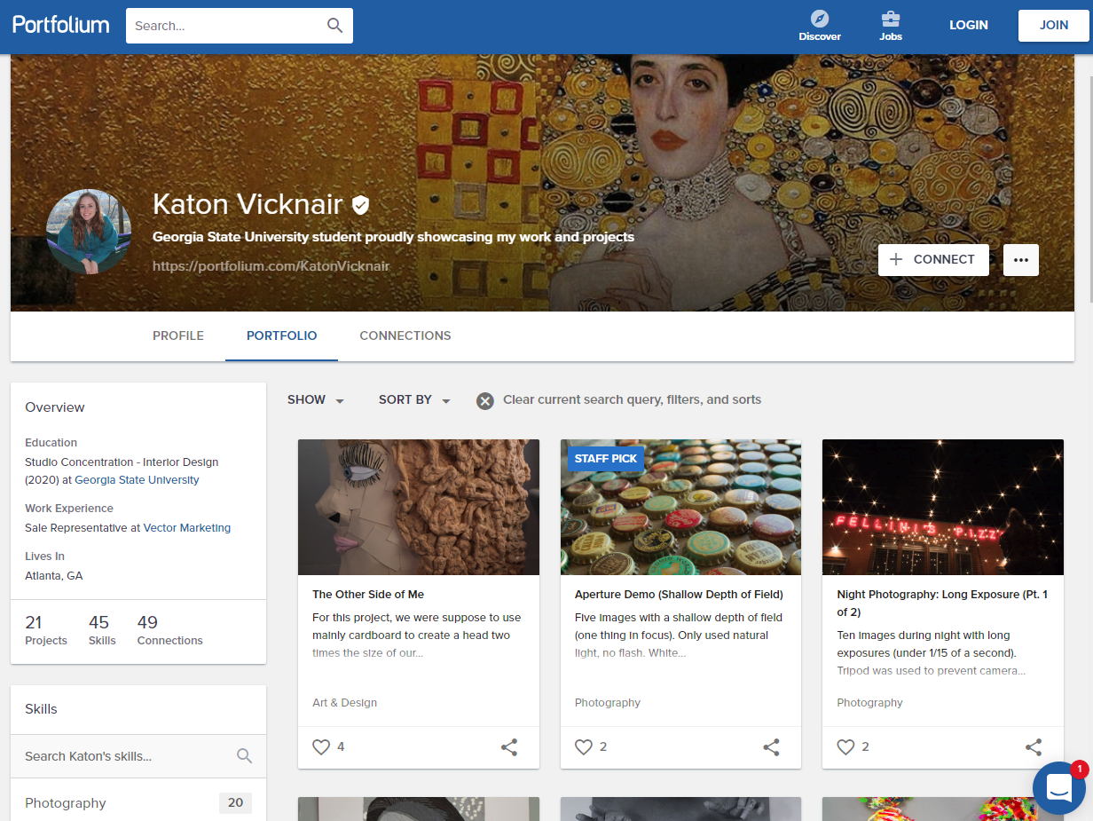
My GSU Experience

Slide 29

Meetings of Pre-Seniors with Career Counselors
685%
3-year increase
No FLC
FLC
No FLC
FLC

Slide 30

-32%
Drop in Major
Changes After the
Freshman Year

Slide 31
43%
Percent of Students Receiving Non-Passing Grades in Introductory Math Courses in 2008

Slide 32
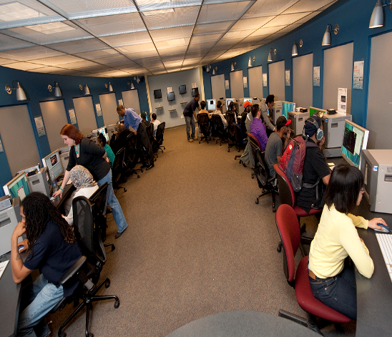
Strengthening Math Pathways
Pre-Calculus, College Algebra, Intro to Statistics
DFW Prior to Change: 43% DFW Today: 28% (35% drop)
Number of Students enrolled in courses taught through the MILE, 2017-18: 8,500
+1,275 Students Passing

Slide 33

Adaptive Learning at Scale
 |  | STUDENTS | SECTIONS | DFW
POLS 1101 | American Government | 4694 | 55 | 16.3%
MATH 1070 | Elementary Statistics | 2701 | 76 | 25.2%
ECON 2105 | Principle of Macroeconomics | 2340 | 38 | 19.2%
PSYC 1101 | Introduction to General Psychology | 2252 | 26 | 21.8%
POLS 2401 | Global Issues | 2250 | 35 | 18.9%
FILM 2700 | History of the Motion Picture | 2226 | 59 | 15.2%
ECON 2106 | Principles of Microeconomics | 2122 | 31 | 24.7%
MATH 1101 | Introduction to Mathematical Modeling | 2019 | 56 | 26.5%
MATH 1111 | College Algebra | 1540 | 45 | 20.2%
SOCI 1101 | Introductory Sociology | 1432 | 29 | 20.2%
MATH 1113 | Pre-calculus | 1289 | 34 | 27.5%
CHEM 1211 | Principles of Chemistry I | 1096 | 37 | 17.2%
BIOL 1103 | Introductory Biology I | 1051 | 48 | 24.8%

Slide 34
Eliminating Bottlenecks: Peer Tutors
Supplemental Instruction (SI)
BIOL
POLS
PHIL
CHEM
ACCT
PHYS
CRJU
Course GPA
No SI: 2.41
SI: 2.91
One-Year
Retention
No SI: 83.5%
SI: 91.2%
Students: 9,700
No SI
SI
No SI
SI
No SI
SI
No SI
SI
No SI
SI
No SI
SI
No SI
SI

Slide 35
1,000+
Number of Fully Registered Students Being Dropped Each Semester for Non-Payment in 2010-2011

Slide 36

< 30%
Likelihood that a college student who stops out for financial reasons will ever complete degree at the institution

Slide 37

Who were we dropping
Seniors
Academically on track
Balance below $1,500

Slide 38


Panther Retention Grants
Graduated: 86.5%
Grant Recipients
Graduated 2016-17: 1,321

Slide 39

13,000
Grants Awarded
Since 2011

Slide 40
5,760
Students Who Dropped Out of
Georgia State in 2010

Slide 41

Advisement: GPS Advising
Predictive Analytics Project with EAB

Slide 42
Registration Tracking and Academic Maps
B.S. in Chemistry
SEMESTER 1 | SEMESTER 2
Complete 1 of ENGL 1101, ENGL 1102 or ENGL 1103 (C or Better) Complete MATH 1113 or Higher (B- or Better) Complete CHEM 1211K (B- or Better) | Complete ENGL 1102 or 1103 (C or Better) Complete MATH 2211 or Higher (B- or Better) Complete CHEM 1212K (B- or Better) Maintain a cumulative GPA of 2.25 or Better
SEMESTER 3 | SEMESTER 4
Complete CHEM 2400 (B- or Better) Complete MATH 2212 (C or better) Complete PHY 2211k (C or better) | Complete CHEM 3410 (C or better) PHY 2212k ( B- or Better) (C or better) Maintain a cumulative GPA of 2.25 or Better
SEMESTER 5 | SEMESTER 6
Complete CHEM 4000 with a C or Better Complete CHEM 4110 with a C or Better | Complete CHEM 4010 with a C or Better Complete CHEM 4120 with a C or Better
SEMESTER 7 | SEMESTER 8
Complete CHEM 4160 with a B- or better | Complete CHEM 4190 with a C or Better

Slide 43
Performance in ‘Marker’ Courses
Graduation Rate in Major by Introductory Course Grade

Slide 44
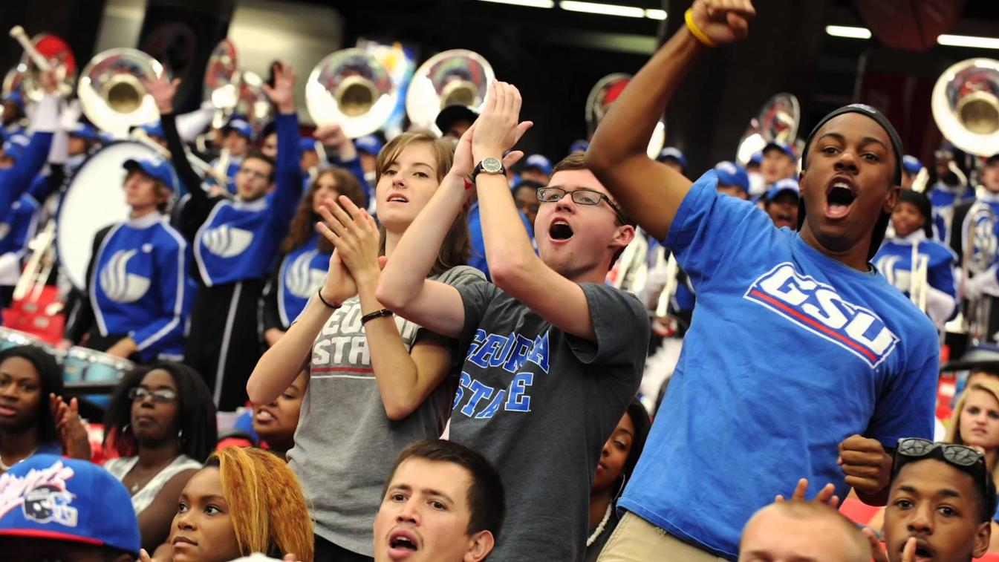
51,545
58,260
Notes:
Need approval on image – istock purchase

Slide 45
Results: Increased Retention
Increased Average First Term Retention
Fall to Spring Retention

Slide 46

Results: Decline in Time to Degree

Slide 47

r
ROI for Students
$18 million
Savings to the Class of 2018 in tuition
and fees when compared to the
Class of 2012
47

Slide 48

STEM Degrees
Awarded Since 2011
(compared to gains in enrollment)
African American +114% (14%)
African Am Male +153% (15%)
Hispanic +275% (24%)

Slide 49
Impacts

Slide 50
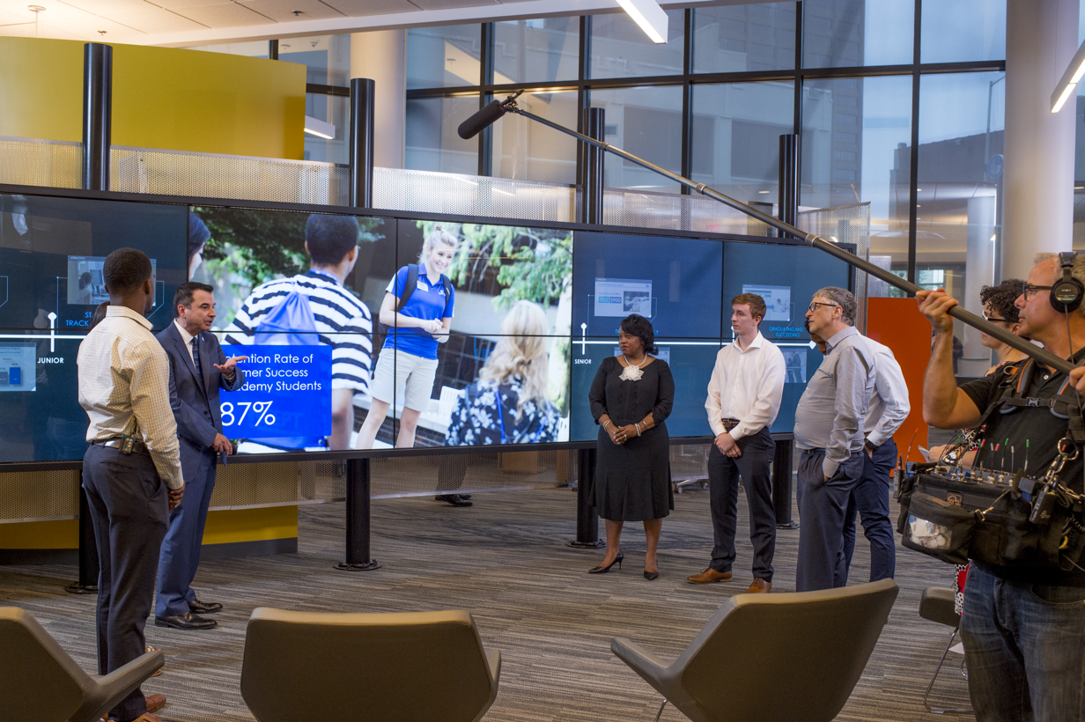
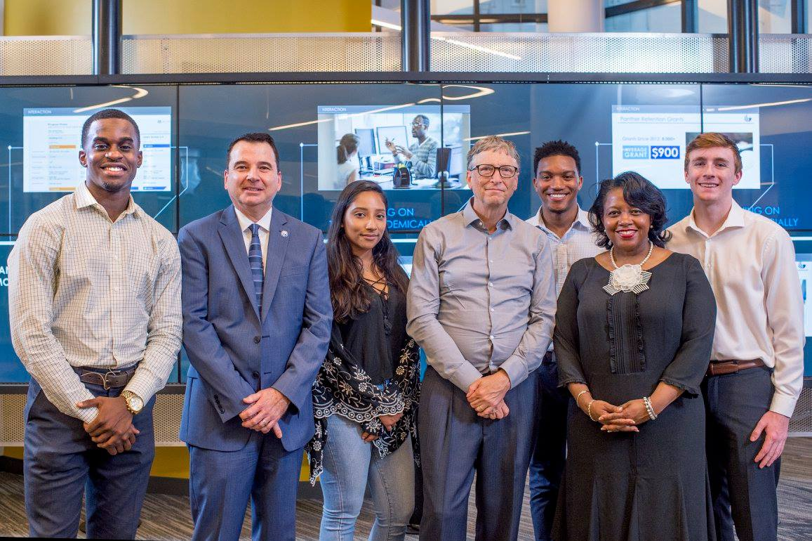
Overwhelming Choices

Slide 51

Overwhelming Choices

Slide 52

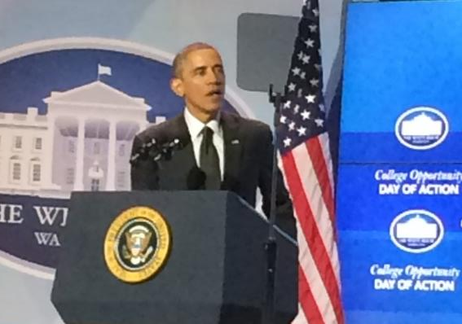
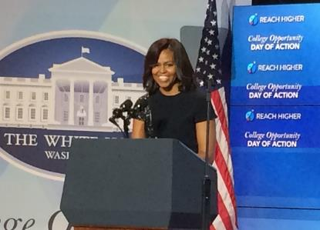

Growing Recognition

Slide 53



The Cost of Inaction
The Calculus of Student Success: ROI
1-point increase in retention =
325 students
Average student tuition
& fees annually/student = $9,800
ROI for each 1-point increase =
$3.18 million/year

Slide 54

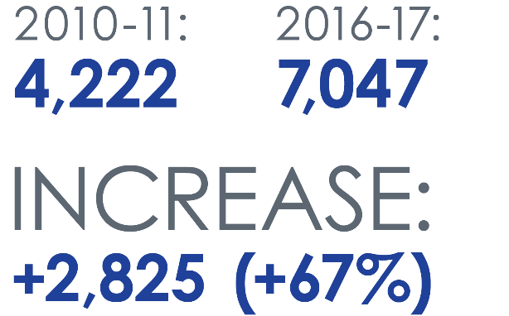
Georgia State Undergraduate Degrees Awarded

Slide 55



Bachelor’s Degrees Awarded Annually
 | 2009-10 | 2017 - 18 | 6-Year Change | % Change
African American | 1,001 | 2,040 | +1,039 | +103%
Pell | 1,498 | 3,428 | +1,930 | +129%
Hispanic | 196 | 557 | +361 | +184%

Slide 56
Graduation Rates by Race & Ethnicity

Slide 57

#1 in Degrees Conferred to African Americans
Top 100 Degree Producers: Non-Profit Universities
2018 African-American Bachelor's - All Disciplines Combined
 |  |  |  | Total | %Grads | %Chg
 |  | Institutions | State
1 |  | Georgia State University | GA | 1,930 | 38% | 7%
2 |  | FAMU | FL | 1,477 | 95% | -7%
3 |  | University of Central Florida | FL | 1,401 | 24% | -1%
4 |  | University of Maryland-University College | MD | 1,443 | 11% | 8%
5 |  | Howard University | D.C. | 1,194 | 78% | 0%
6 |  | North Carolina A & T State University | NC | 1,227 | 91% | 6%
7 |  | Florida International University | FL | 1,087 | 19% | 7%
8 |  | Florida Atlantic University | FL | 1,054 | 11% | 9%
9 |  | University of Memphis | TN | 1,011 | 33% | 3%
10 |  | The University of Texas at Arlington | TX | 992 | 13% | -7%
Source: Diverse Issues in Higher Education, 2018

Slide 58
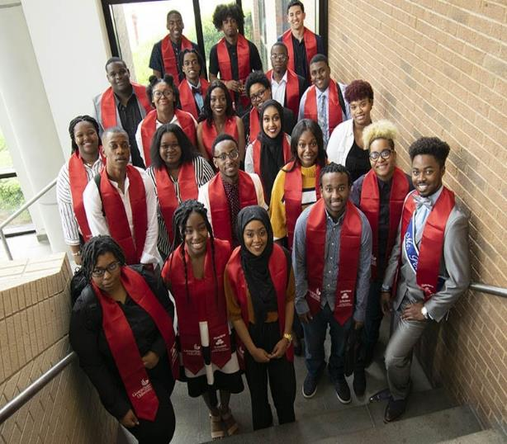
LIFT Program at Perimeter College
2017 Entering Cohort:
100% Pell, 100% URMs
Learning communities,
Predictive-analytics tracking,
Proactive advising,
Scholarships, Panther
Retention Grants,
Near-peer mentoring, SI
2-year Associate-Degree
Graduate Rate: 85%

Slide 59

http://success.gsu.edu
twitter: @tim_renick
Notes:
Need approval on image – istock purchase

