Slide 1
Once Left Behind, Now Well Ahead TEC Oritetanga Learner Success Conference 6-7 August 2019
Dr Stuart Middleton
Specialist Advisor to the Chief Executive
Manukau Insitute of Technology
New Zealand

Slide 2
Ngā mihi nui hoki kia koutou

Slide 3
NZ’s slightly dirty little secrets!
Students were dropping out of school
There were large gaps in academic preparation for further education and training
NZ had seen the growth of a substantial group of NEETs
Pathways between secondary schools and postsecondary education and training were at best broken

Slide 4
An opportunity comes along
THE PROBLEM: the education system was fragmented, disjointed, performing to low levels, providing inequitable outcomes for many.
The SOLUTION: an approach that........
addressed early school leaving / disengagement,
developed Pathways and Managed Transitions,
Led to seamless progression,
through early access to applied learning,
which accelerated students not slowed them down.

Slide 5
A new approach emerges: MANUKAU TERTIARY HIGH SCHOOL
Target Group
Failing Students offered a place in the THS
Fulltime enrolments at MIT (at age c.15 years)
Integrated senior secondary / tertiary learning
Work simultaneously towards NZ School Qualifications (NCEA) and NZ qualifications
THEY WOULD NOT BE TAKEN OUT OF SCHOOL,
THEY WOULD BE IN SCHOOL
BUT THEY WOULD NOT BE AT SCHOOL

Slide 6
THS Programme – Year 1
Emphasis on essential skills:
Literacy, Numeracy, Social and Digital Skills
School Qualifications: NCEA Levels 1 and 2
MIT / NZQF Qualifications
MIT Certificate in Tertiary Pathways (Level 1)
MIT Certificate in Pathways to Tertiary Studies (Level 2)
Other Courses
Preparing for Careers and Professions
(Students complete courses in four technical disciplnes in Years 1 and 2)
Managing Learning
Individual Education Plan / Academic Advisories
Seeking additional support (within MIT)

Slide 7
THS Programme - Year 2
School Qualifications
complete NCEA Level 2 then start Level 3 (if UE) OR start MIT VET Quals
MIT Qualifications
NCEA Level 3 (Degree Bound) start degree preparation
OR
MIT / NZ VET courses L 3/4
Other Courses
Continue Preparing for Careers and Professions
Academic Support
Pastoral Care

Slide 8
THS Programme Year 3
School Qualifications
NCEA Level 3 – Small group University Entrance
NCEA Level 2 - Small group completing NCEA Level 2
MIT / NZ Career Qualifications at L3 (generally)
Most of the group move into a wide range of MIT / NZ programmes
In reality students are full-time MIT tertiary students but they retain a capability of accessing THS support
Year 4 - Continued access to and support of THS

Slide 9
THS Programme Year 3
School Qualifications
NCEA Level 3 – Small group University Entrance
NCEA Level 2 - Small group completing NCEA Level 2
MIT / NZ Career Qualifications
Most of the group move into a wide range of MIT / NZ programmes
In reality students are full-time MIT tertiary students but they retain a capability of accessing THS support
Year 4 - Continued access to and support of THS

Slide 10
Who were the students? 2010 – 2016 (n = 916)
GENDER Male 60.10%
Female 39.90%
ETHNICITY NZ Maori 44.60%
NZ Pakeha 24.10%
Pasifika 26.80%
Other 4.40%
SCHOOLS Decile 1 – 3 71.40%
Decile 4 – 7 15.50%
Decile 8 - 10 12.20%

Slide 12
Student Success 2010 - 2016
Characterised as failures at Year 10.......
Qual. | NZQF Level | %
 | 1 | 67.0%
NCEA | 2 | 30.0%
 | 3 | 2.0%
 | 1 | 2.0% | 69%
 | 2 | 31.0% | 62%
NZQF / MIT | 3 | 27.0% | 29%
 | 4 | 18.0%
 | 5 | 10.0%
 | 6 | 3.0%
 | 7 | 6.0%
....... acknowledged as successes 4-5-6 year later.

Slide 13
Consequential changes
The THS opened the doors……
Youth Guarantee Policy (YG)
Fees Free Youth Guarantee places
Trades Academies
Dual Pathway Programmes
More Tertiary / Industry Cooperation
Customised training (MIT in Schools)
New Pathways to Postsecondary
MIT in the Pacific (Tonga/Samoa)
New Pathways to Employment
Vocational options in some
Secondary Schools

Slide 14
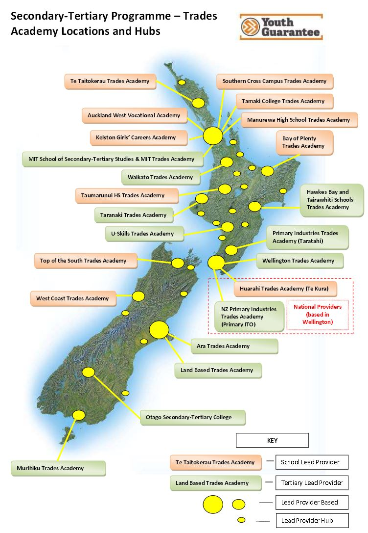
Impact
Impact of Changes Post-MIT THS
Over 900 students have been through the MIT THS
32,000+ have been through a Secondary/Tertiary Trades Academy
74,600+ students have benefitted from the Youth Guarantee Fees Free Places
(Figures supplied by NZ Ministry of Education, September 2018.)

Slide 15
The MIT Tertiary High School development has been a significant change agent in New Zealand Education
Early access to vocational and technical education and training.
Multiple Pathways and Managed Transitions
Seamlessness and Flexibility
Acceleration for students who are falling behind
A clear line of sight to employment creating a Sense of Purpose
“Every great advance replaces traditional complexities by a new simplicity.” Simon Winchester

