Slide 1
Institution Wide Leadership@EIT
Notes:
Kei aku rangatira
Kua hui mai nei
Hei whakawhanake
I ngā kaupapa o te wā
Tēnā koutou Katoa

Slide 2
Our Regions

Slide 3
reaching out into our communities..
Over 600 EFTS (1800 students) were delivered in sites outside of a main EIT campus

Slide 4
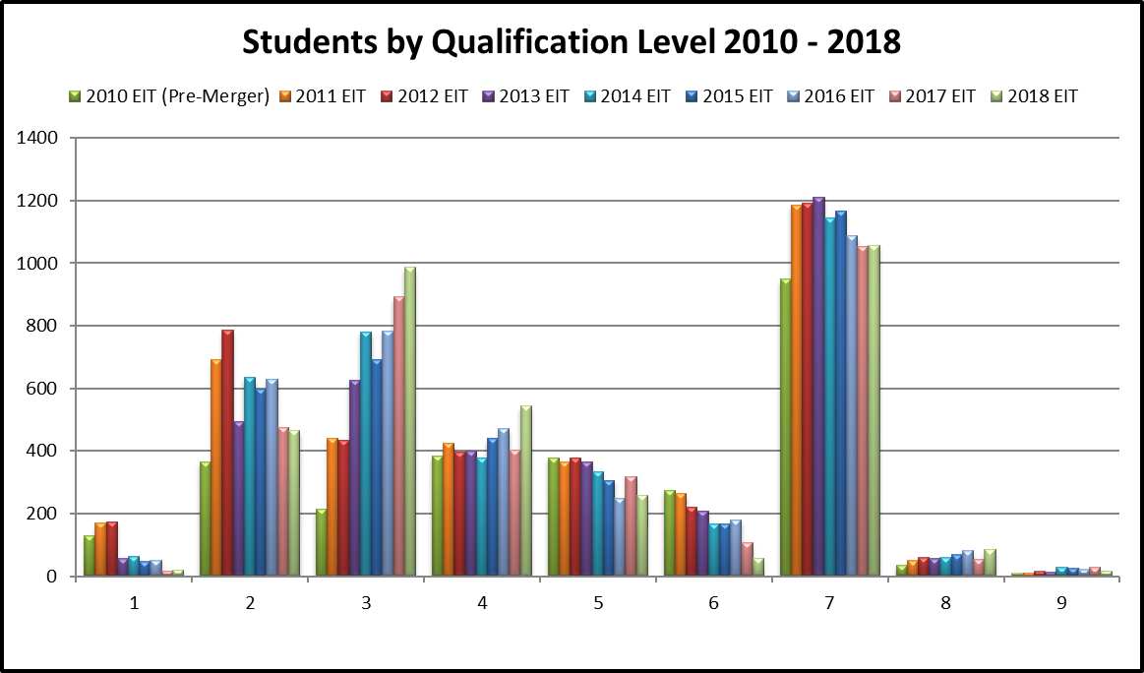

Slide 5
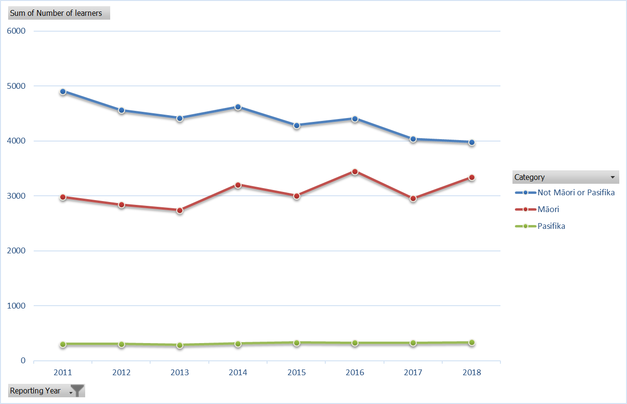
Learner Cohorts @ EIT
Notes:
Whilst 50% of students are Maori, some 76% would be considered priority learners by TEC definitions

Slide 6
Māori Participation
42% Hawke’s Bay (23%)
75% Tairāwhiti (45%)

Slide 7

Change in population by age, next ten years
Hawke’s Bay
Tairāwhiti

Slide 8
Change in Māori population by age, next ten years
Hawke’s Bay
Tairāwhiti

Slide 9
EIT EPI principles (est 2009)
we will adopt and pursue any administrative or structural (to qualifications) changes that improve our performance;
we will use the data to identify where we need to adopt improved teaching and learning strategies to lift performance, and support effective learning;
we will use the data to determine where we are ineffective and question whether we continue with low performing programmes;
we will not, however, avoid ‘hard to succeed’ cohorts of students or difficult communities as a way of lifting our EPIs, and will accept that retained commitment to those communities will have an adverse impact on our EPIs;
we will not ‘game’, such as, by only pursuing easy to achieve courses or students, to lift our EPI data;
we will not compromise on our academic standards for the intention of improving performance indicator data.

Slide 10
merger principles underpinning success
focus on student success in quality education
genuine partnership with open and transparent processes
respect histories - acknowledge strengths and weaknesses
build shared vision, organisational values and cultures
strong local identity, but an integrated institution
effective decision making and influence at local level
effective decision making across institution
effective pooling of resources
focus on people
be prepared to make hard decisions
be prepared to accept change
effective open communication

Slide 11
leadership is critical
  leadership has to own it – be visible and vocal

Slide 12
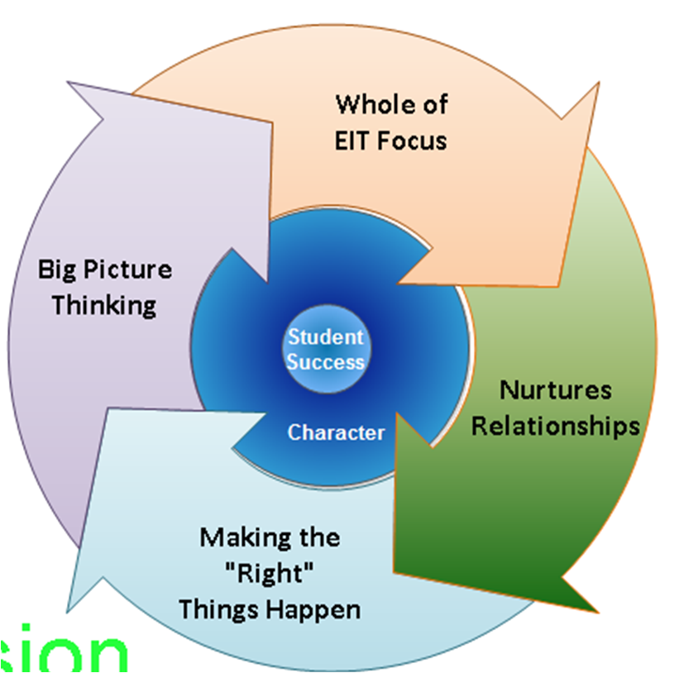
EIT Leadership Framework

Slide 13
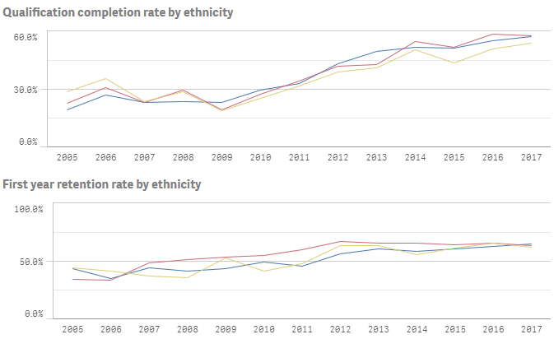
EIT’s EPI Story
Non Maori and Pasifika
Maori
Pasifika

Slide 14
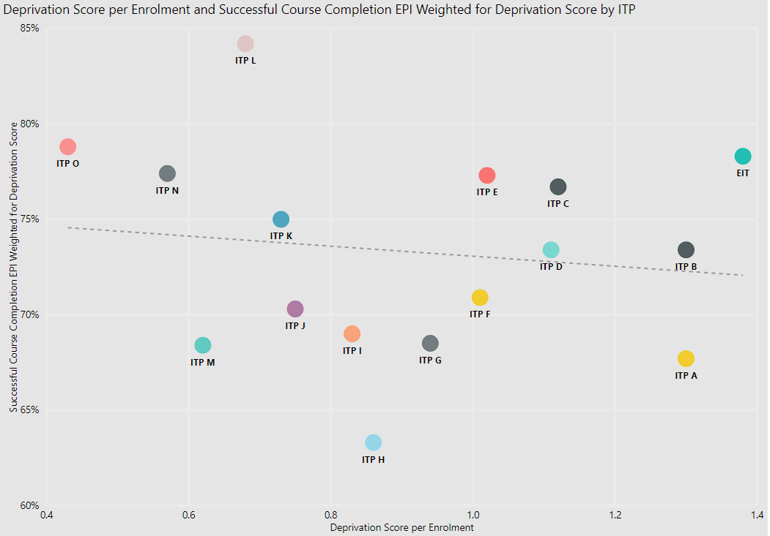

Slide 15
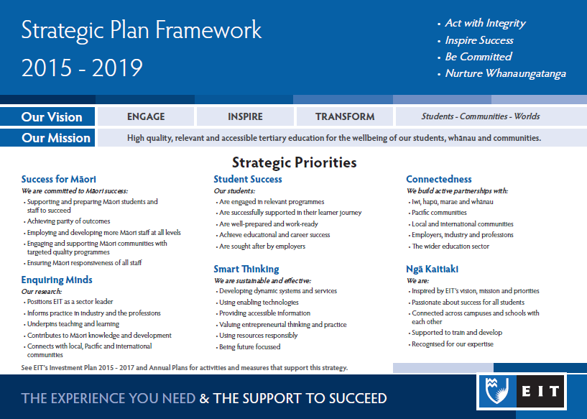
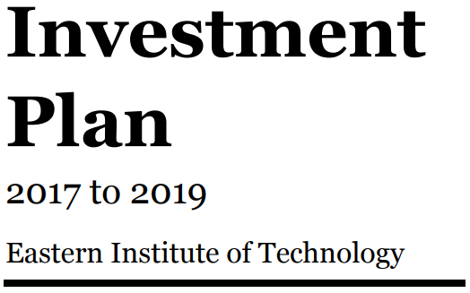
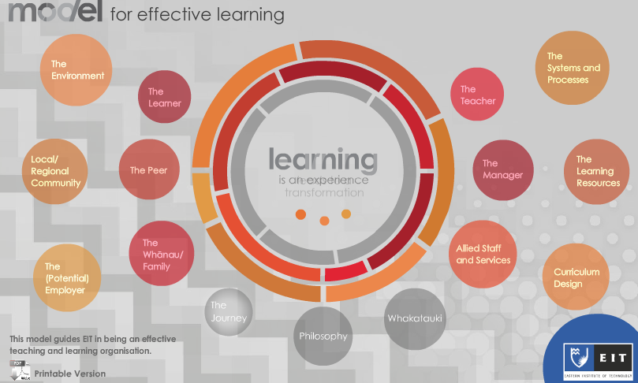


EIT strategic framework

Slide 16
Institute Strategic Plan- what we report on
Notes:
Developed institute wide via large scale staff involvement
What emerged was a desire for a specific priority around Maori students, whereas traditionally there were more generic student success statements.
This in turn allowed other frameworks to begin to specifically address how they ensured success for Maori, e.g. the model of learning, our learning design framework
And the (via self assessment) realizing we needed to up our own caspabilities, hence Herea te ra

Slide 17
Model for Effective Learning
Teaching and Learning at EIT

Slide 18
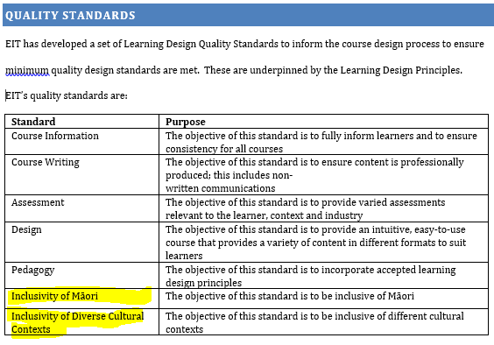
Learning Design Framework
The Learning Design Framework (LDF) outlines established principles and design processes to support developers when creating programmes and courses.
The framework aligns with EIT’s Model for Effective Learning, Programme Development Policy Set, Blended Delivery Policy Set, and the design principles. Importantly, the Learning Design Framework reflects the collective learnings and continuous improvement arising from EIT’s ongoing experiences with programme development and delivery.
The EIT delivery model is underpinned by well-established and emerging educational theory, principles and practice.

Slide 19

Maori Capability Framework
Herea te ra is a staff development tool that has been created to promote greater Maori student achievement. It describes a set of core and advanced capabilities designed to support staff in their work with Maori students and communities

Slide 20
Where to from here
Continuing to build staff capability
Ongoing self assessment
More powerfully using of data
Mātauranga Māori

Slide 21
Be clear on underpinning principles and vision
Use data to better understand and strategise, act and monitor
Self - assess
Take opportunities to drive change
leaders own it – be vocal and visible
rinse it through everything
Build cohesive strategic framework that underpin strategies and plans

