Slide 1

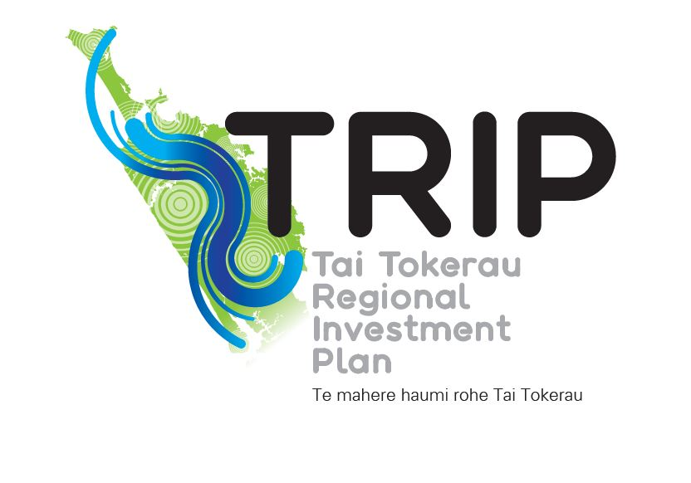
Tai Tokerau Regional Investment Plan (TRIP)
An inclusive, unified approach to identifying
Regional demand

Slide 2
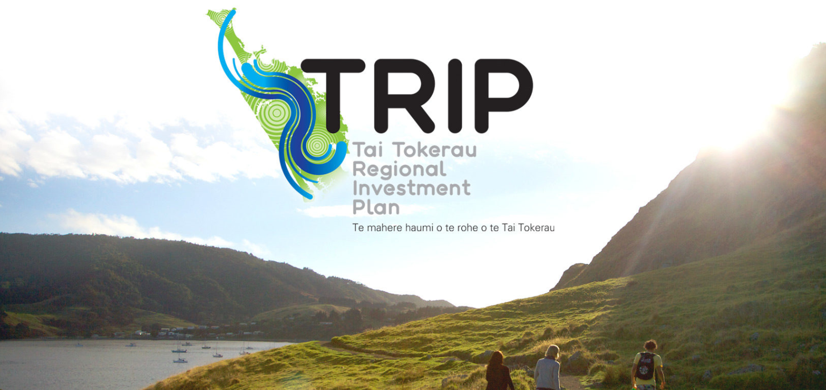

TRIP Resources
Library https://trip-resource.nz/

Slide 3

The Demand Imperative
TRIP’s priorities are in meeting the needs, demands and requirements of industry, iwi and community stakeholders by delivering vocational education in a collaborative way to better meet ākonga needs. It sets the platform for genuine cultural and behavioural change within the education sector in Tai Tokerau.
DEMAND NOT SUPPLY
Collective response to demand
For the region, by the region – not for individual organisations
Impact Investment funding to remove barriers to learning and provide an equitable platform for all ākonga to be successful.
Eliminate achievement gaps

Slide 4
Kaupapa Māori
Co-design from concept to implementation
Reflects the partnership principles of Te Tiriti through co-governance and co-leadership
Relationships are at its core from whanau to governance.
TRIP is informed and shaped by what we know works for Māori.
Tikanga runs through the approach taken as there is a responsibility to uphold the well-being of people (manaakitanga) and the life supporting capacity of Papatūānuku in perpetuity (kaitiakitanga).
He Tangata, He Whenua, He Oranga the economic growth strategy for Te Tai Tokerau Māori economy (one of TRIPs foundational documents) also had tikanga as its framework.

Slide 5
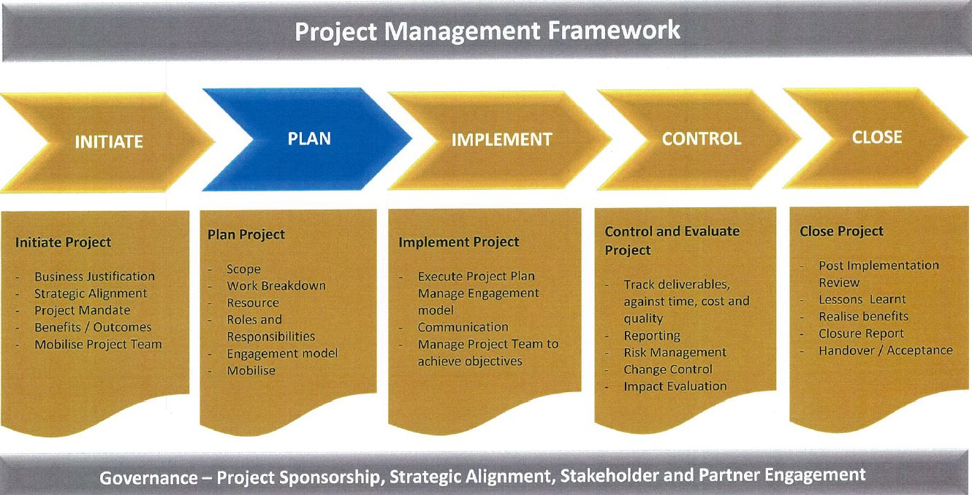
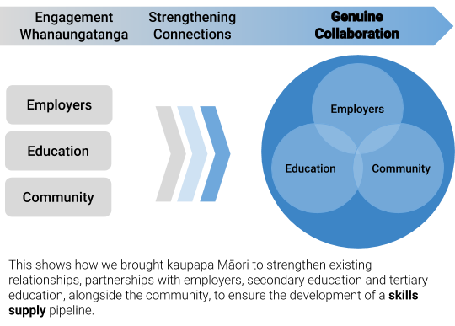
The Methodology
Kaupapa Māori
The project management framework used is aligned to the Project Management Body of Knowledge (PMBOK) from globally recognised Project Management Institute (PMI), and was guided by qualified and experienced Project Management resource.

Slide 6
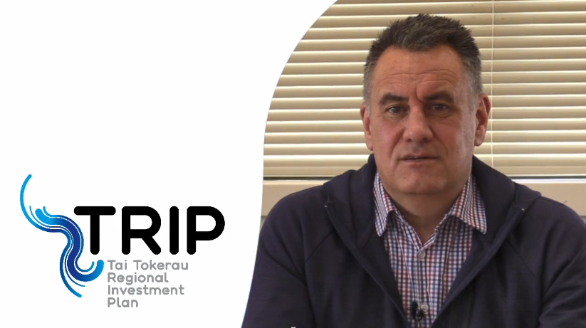
The Process
TRIP Sponsor – Phil Alexander-Crawford on process

Slide 7
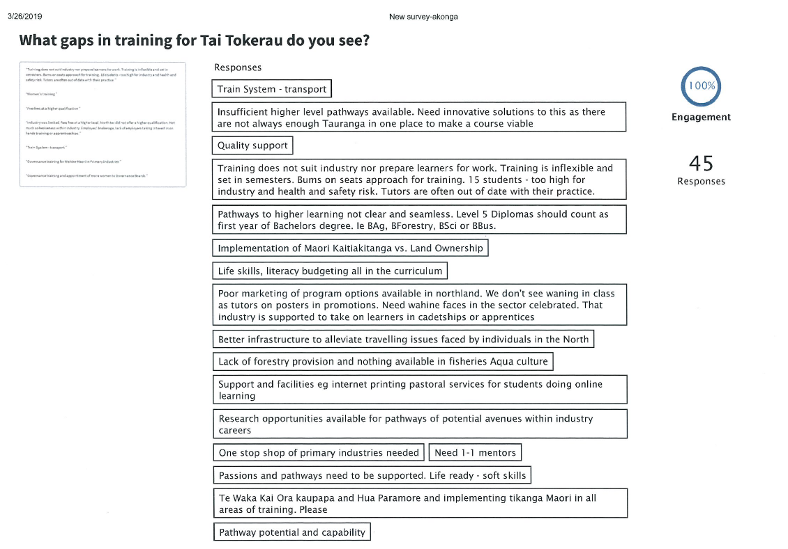
Example – Ākonga Survey (Poll Everywhere)

Slide 8
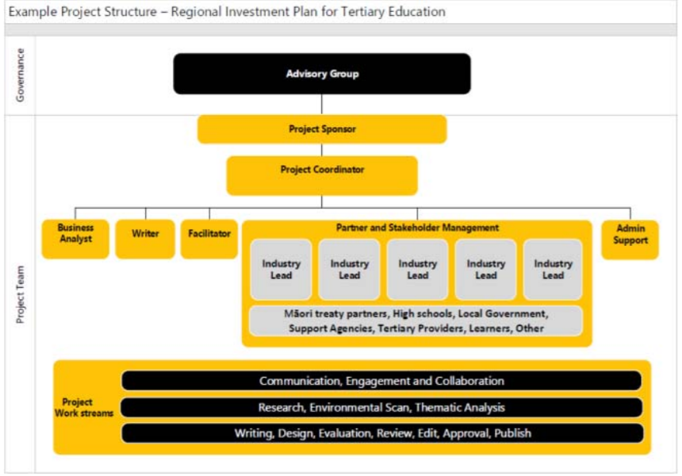
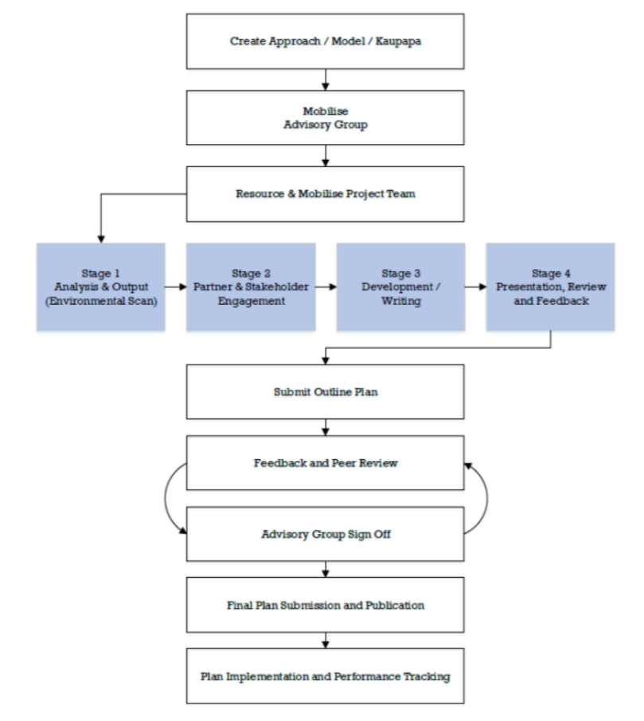

Slide 9
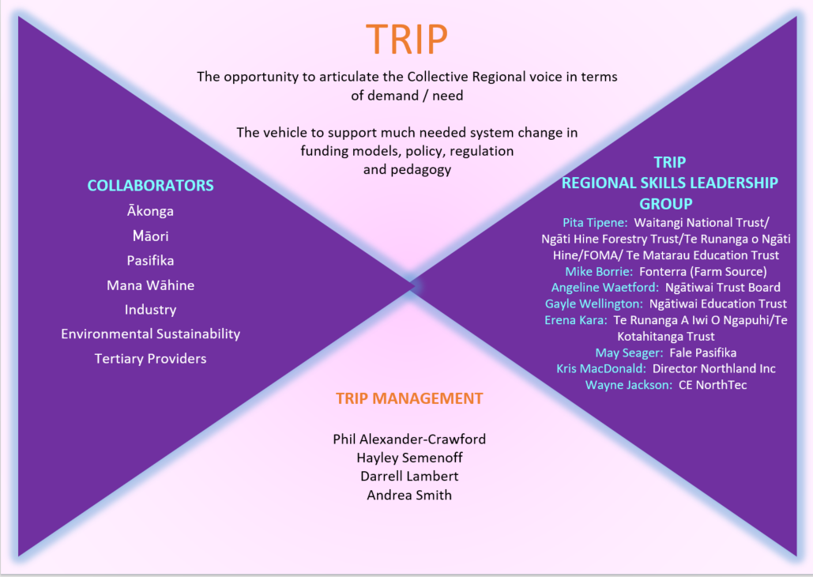
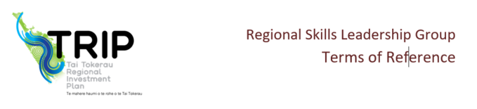
Regional Relevance
TRIP
The opportunity to articulate the Collective Regional voice in terms of demand / need
The vehicle to support much needed system change in funding models, policy, regulation and pedagogy
The TRIP Regional Skills Leadership Group is dedicated to our region, its people and are connected to or can whakapapa to Te Tai Tokerau. They know the importance of relationships and can make co-ordinated decisions as to the best needs of the region.
DRAFT

Slide 10
Co-Leadership
Crown Partnership
What does this look like to our Māori and Pasifika partners?
Re-establishing mana
Governance responsibility for Māori
Understanding of each others backgrounds – Tikanga / Kawa etc
Like a marriage
Start with whanau / re-establish Hapū / to create stronger iwi capacity
Equitable opportunities
Support structures to allow Māori success
Co-design in education to meet needs of whanau
All staff in education trained in Te Whakaputanga and Te Tiriti
All staff in education to gain insight into te Whakaaro Ao Māori

Slide 11
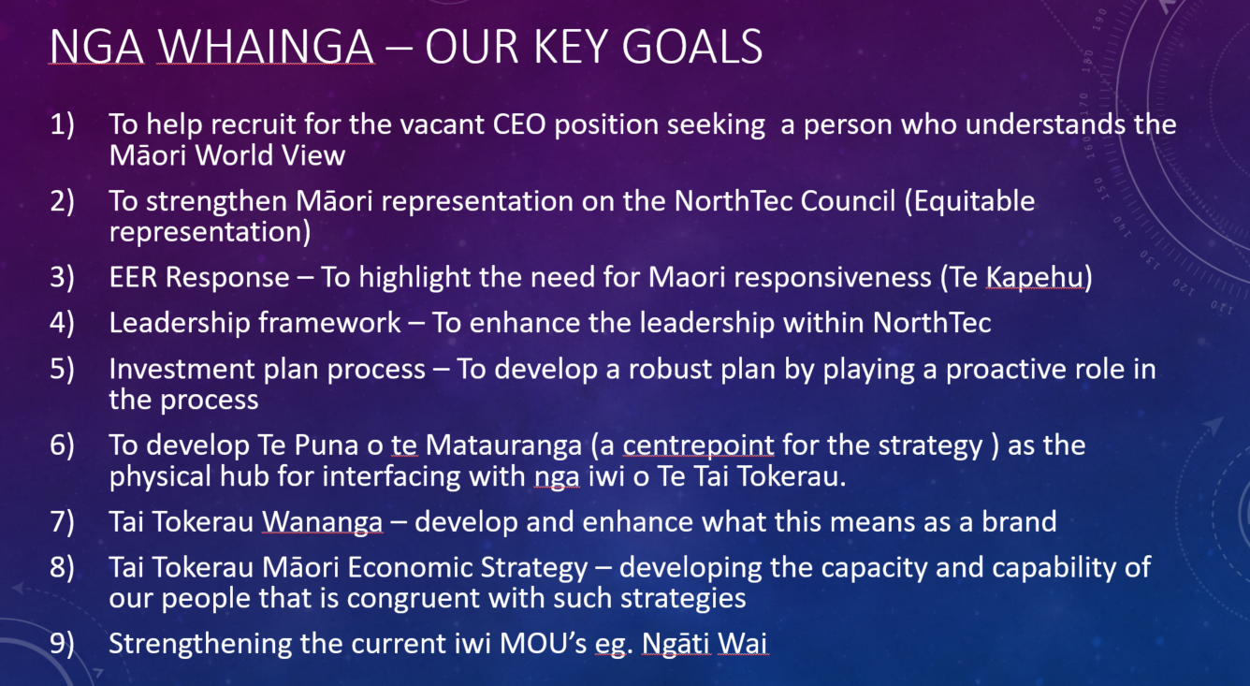
Crown Partnership

Slide 12
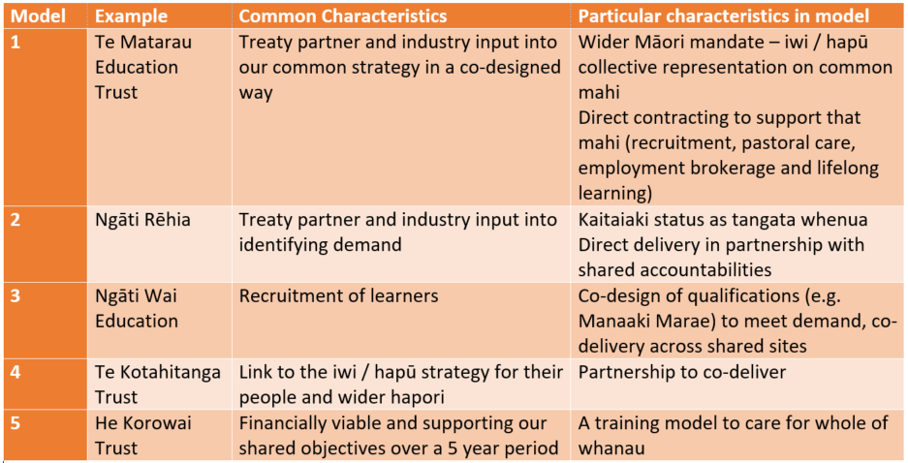
Crown Partnership

Slide 13
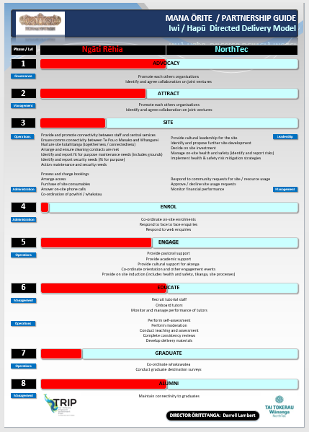
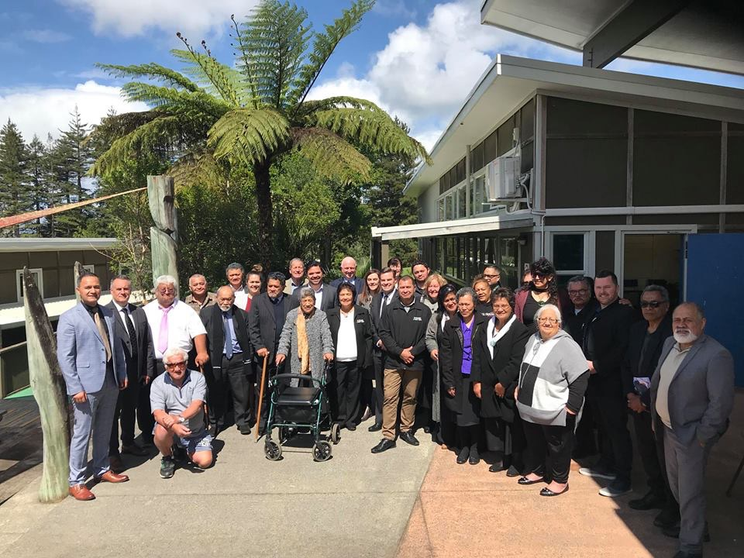
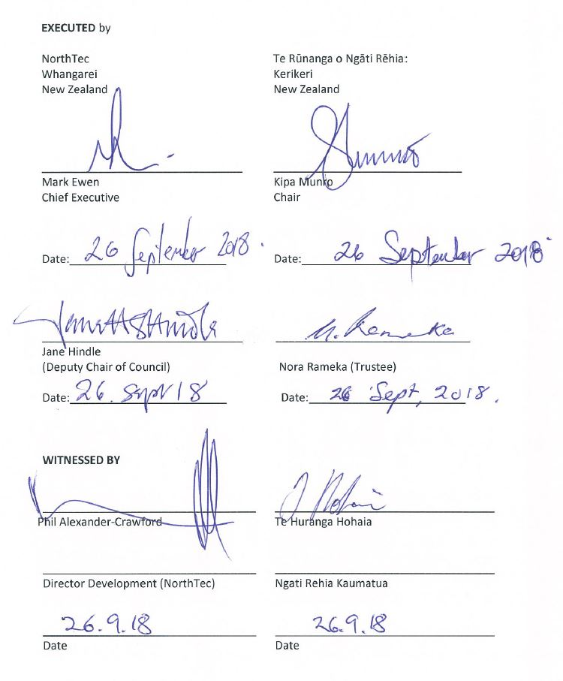
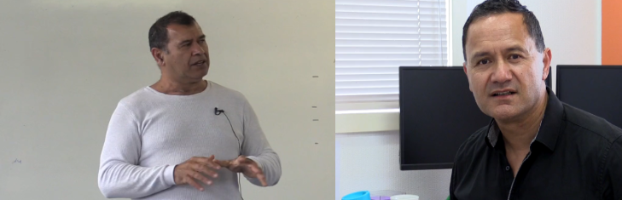
Iwi Led Delivery
Te Runanga o Ngāti Rēhia

Slide 14
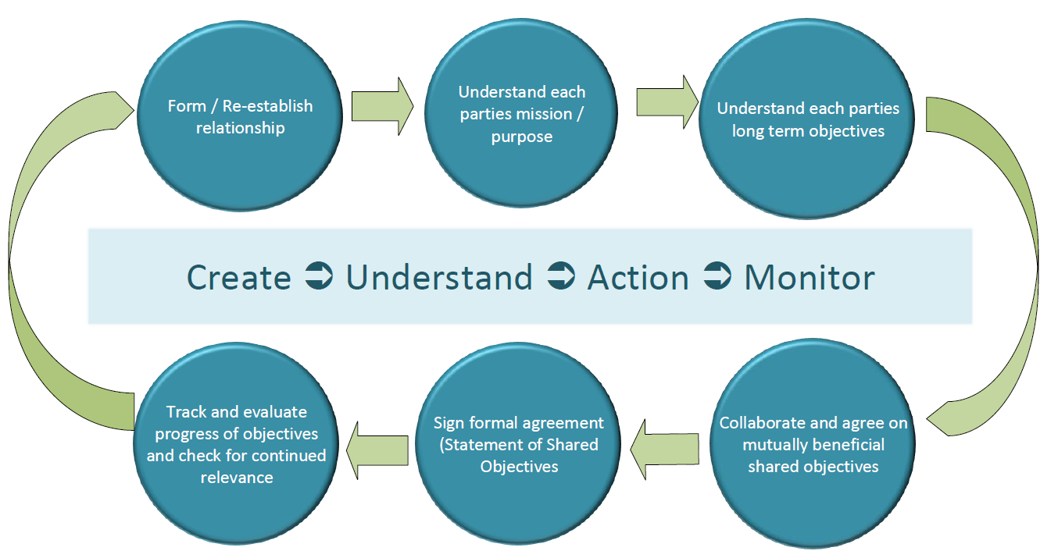
SOSO: the new MOU
Ngāti Rēhia, Northland Inc, Sport Northland, Creative Northland, Chamber of Commerce

Slide 15
The Change Management Vehicle
Regional Model of Implementation for National Applicability
If it works in Tai Tokerau given our regional challenges it can work in any region while respecting regional difference.
TRIP can support a unified education system through:
Identification the needs of industry and Ākonga including work integrated learning
Data analysis (changing face of employment / automation / upskilling)
Increasing the relevance of education to industry
Providing equitable access to education for Ākonga (Māori and Pasifika)
Being culturally responsive
Increasing hapori and whanau literacy
Working across sectors to find solutions to barriers
A demand not supply led environment (non-competitive)
Establishment of shared resources and transparent relationships

Slide 16
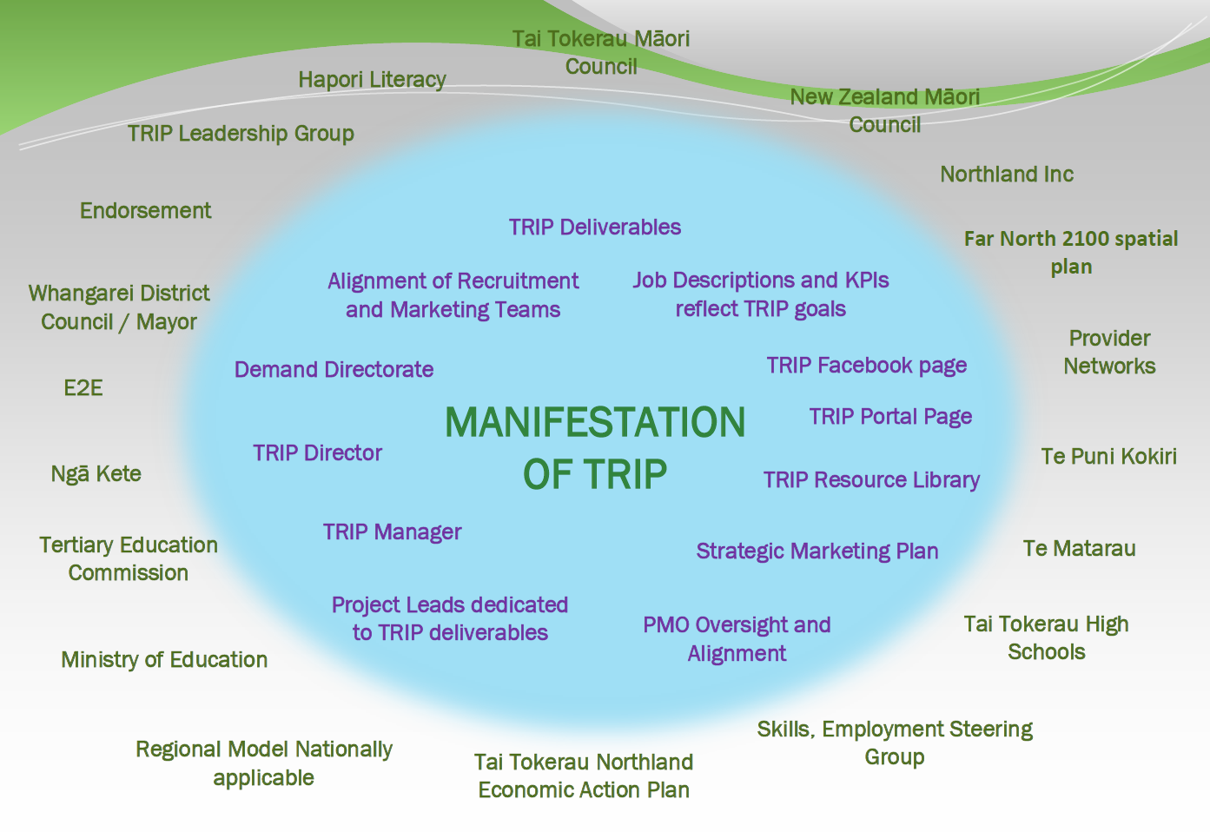
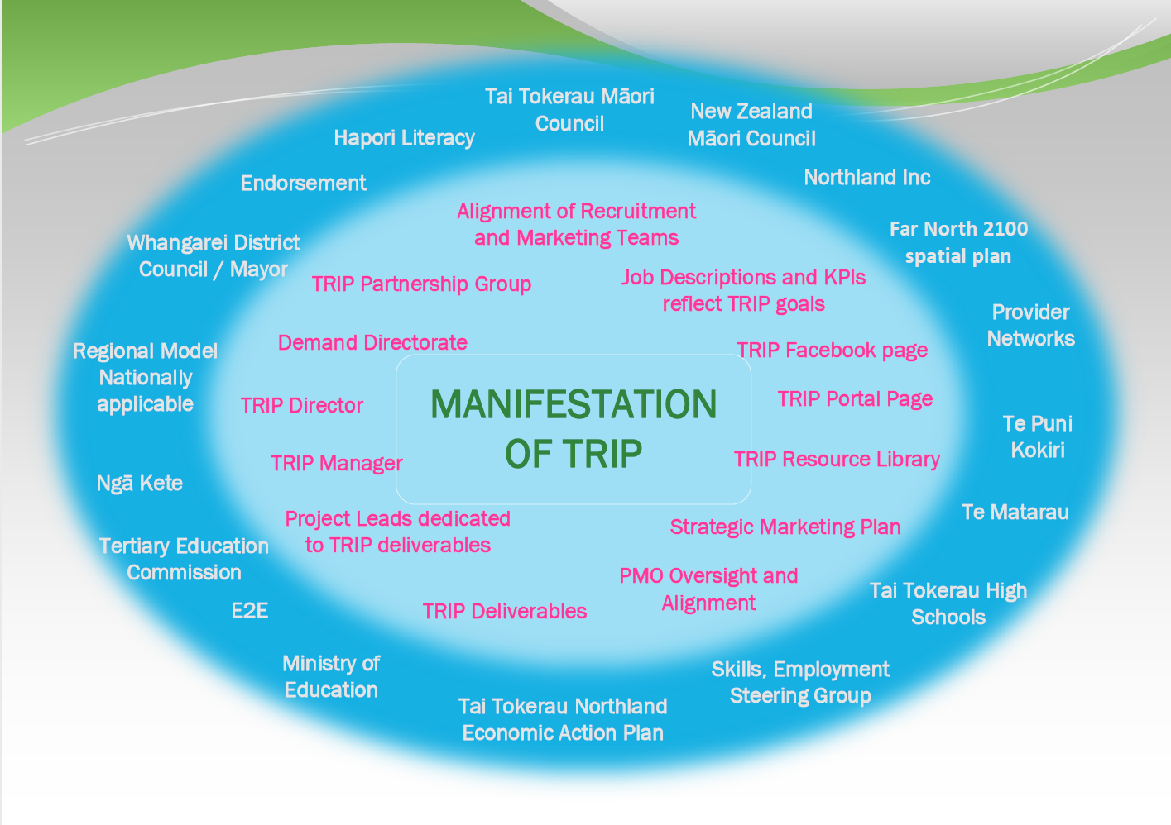

Slide 17
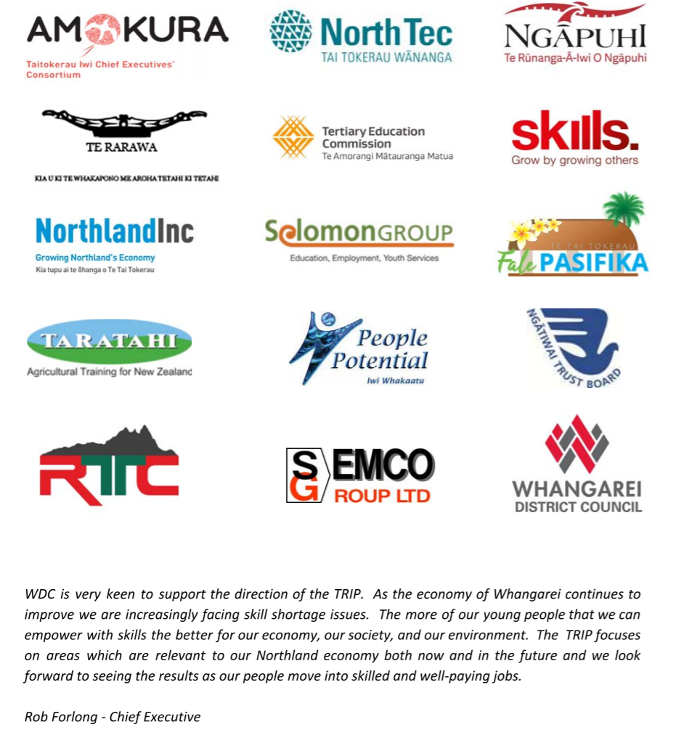
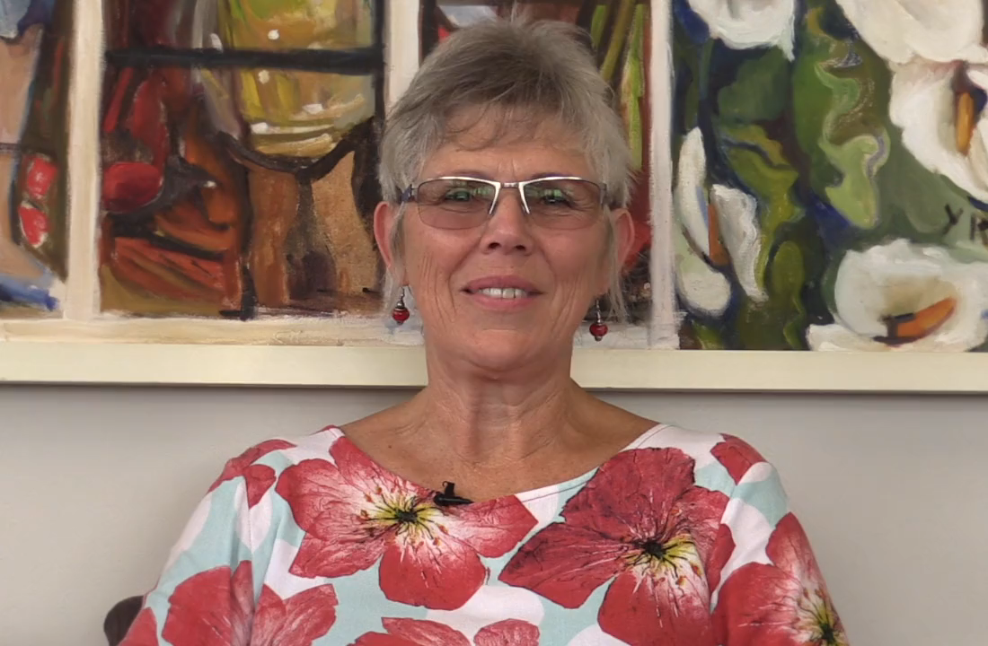
Endorsement

Slide 18
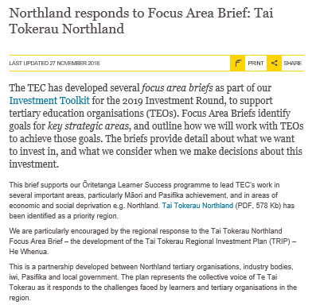
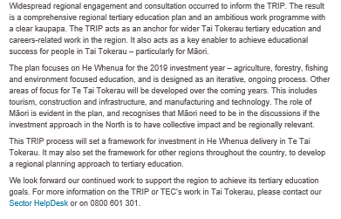
TEC Feedback
https://www.tec.govt.nz/news-and-consultations/northland-responds-to-focus-area-brief-tai-tokerau-northland/

