Slide 1



Ōritetanga – Tertiary Success for Everyone
Pūhoro STEM Academy
7 August 2019

Slide 2

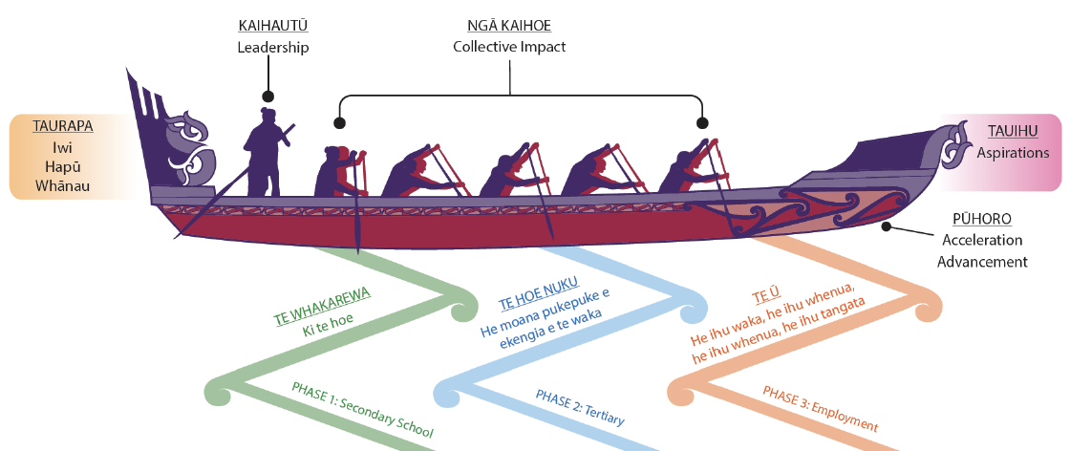
He waka eke noa -
Our Framework

Slide 3

Our Tauira
Affiliating to
68
iwi throughout Aotearoa
630
registered students from four regions
Aspirations across over
40
different STEM related professions
Over
2500
registered whānau members

Slide 4
Transitions
14%
will study a business qualification
11%
went into apprenticeships and NZDF (all STEM)
66%
of this cohort were not originally on an academic pathway
87%
transition to tertiary (at degree level) in 2018
68%
will study STEM related qualifications

Slide 5
Parity Impacts
92% retained to Year 13 (incl. senior sciences)
87% entered university at degree level (67% in STEM courses)
100% of Pūhoro cohort passed more than 85% of semester 1 courses
Semester 1 Successful Course Completion rate was 94%
100% of Pūhoro cohort retained to Semester 2

Slide 6
Key Learnings
Whānau critical driver of success
Intensive support in secondary school (weekly mentoring and tutoring, career exposure, focus on value drivers)
Tertiary exposure over a longer period of time (from Year 11)
Sense of community both in the secondary programme and tertiary programme (Phase 2 students mentor and tutor Phase 1 students)

Slide 7
Contact
Naomi Manu
Founder and Director – Pūhoro STEM Academy
n.manu@massey.ac.nz
www.puhoro.co.nz
021 742 638

