Slide 1
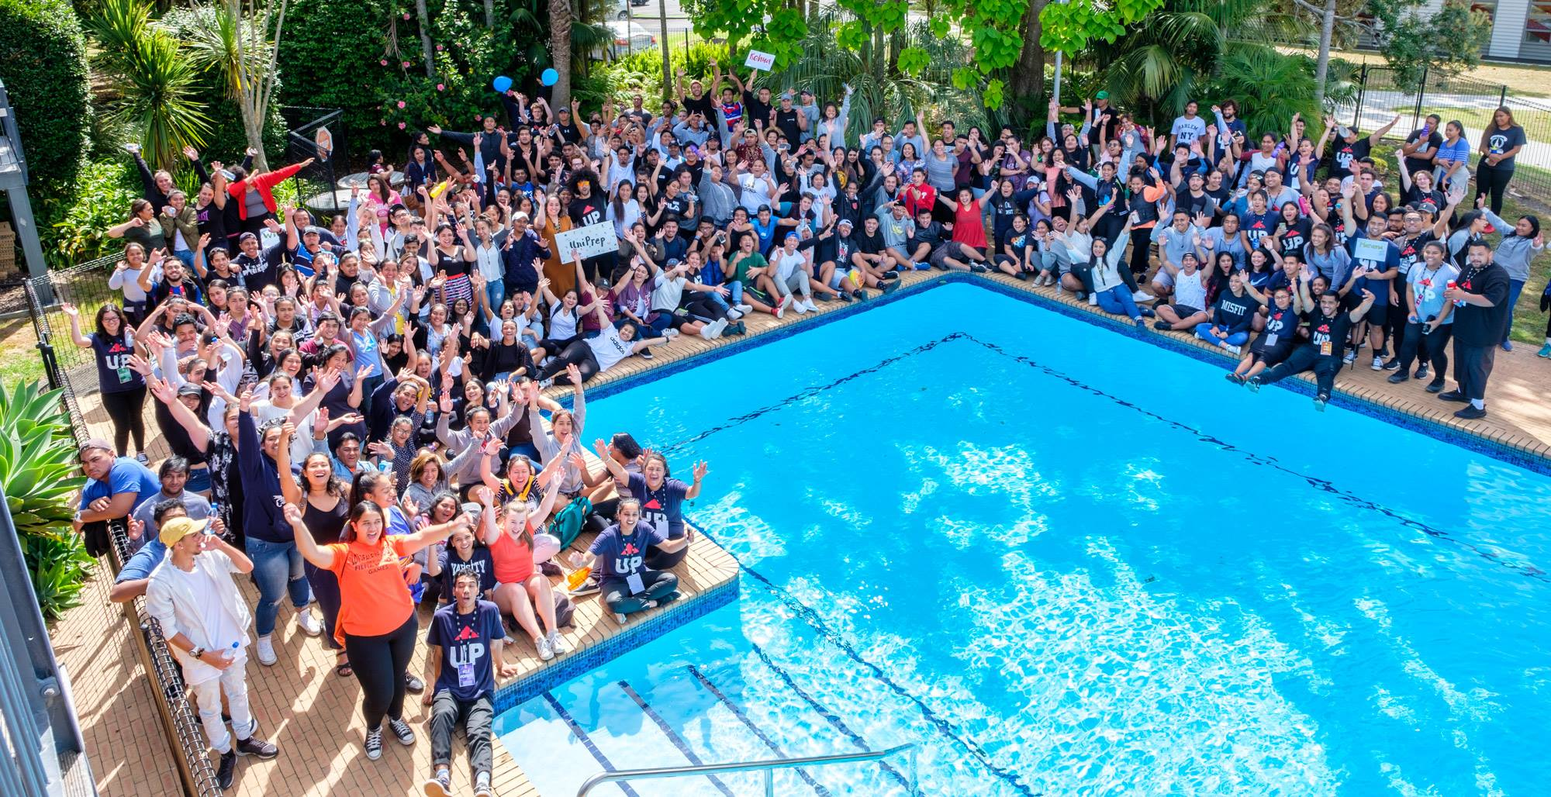
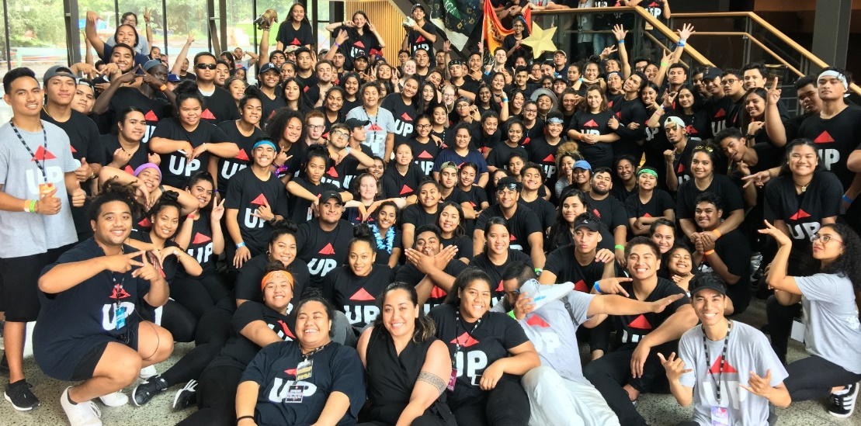
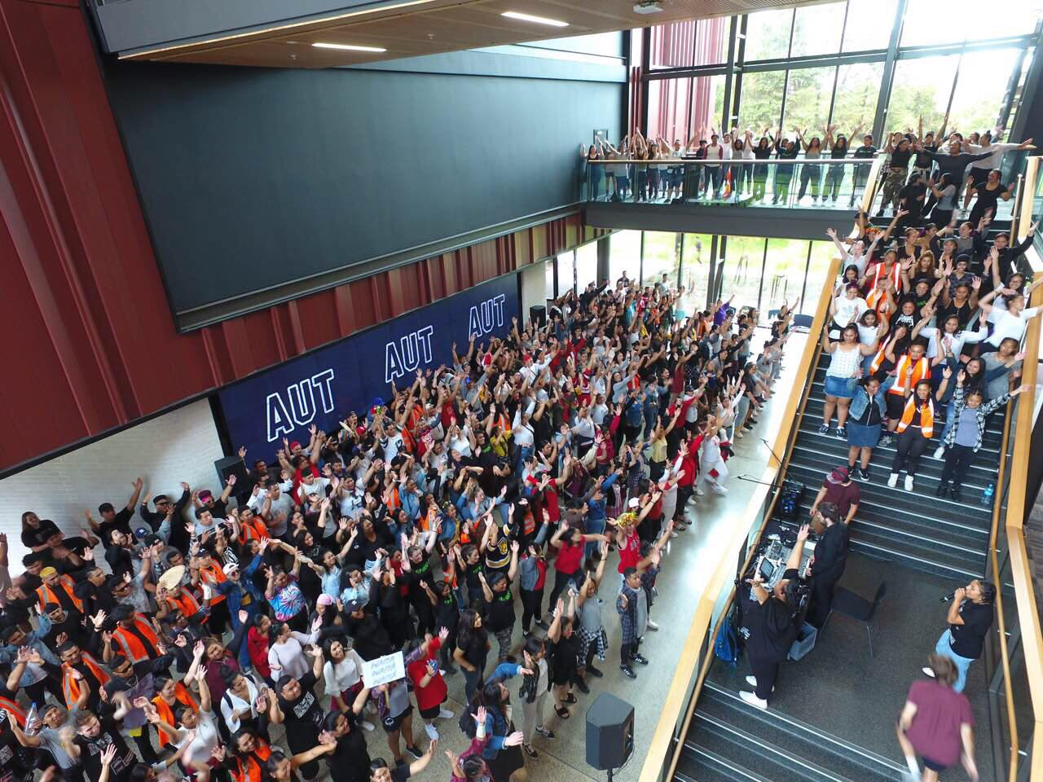

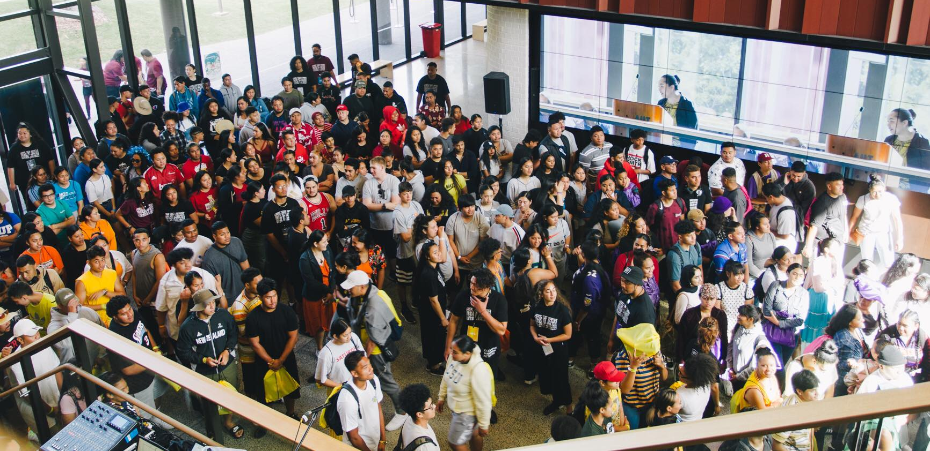
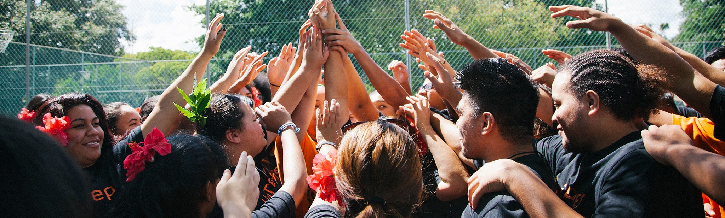

Slide 2
Background
“For students who had less clear goals and were less confident about their readiness for university study, the summer months were more likely to be a time of self-doubt, loss of focus and weakening of resolve. Pacific students in particular were at risk of reacting to peer pressure or other external influences and either delaying attending to enrolment and other procedures or deciding to not enrol. Lack of appropriate guidance and support from academic mentors during this period acted as a stumbling block in their transition experience.” (Madjar, I et al, Stumbling blocks or stepping stones? Students’ experience of transition from low-mid decile schools to university, 2010, p.11)
The “summer learning effect” (SLE) has been observed and described in schools internationally (Borman, 2005). Typically, students from poorer communities and minority students make less growth than other students over summer, which contributes to widening gap in achievement and an achievement barrier that gets larger over time (Alexander, Entwistle & Olsen, 2007). The summer learning effect also has been identified in New Zealand schools and their communities. Three studies in schools serving mainly Maori and Pasifika communities of low socioeconomic status confirmed the extent of the effect.” (McNaughton, S et al, School achievement: Why summer matters, 2010, p.2)

Slide 3
Fast Facts
5 week summer programme
Full time programme from Mon to Fri 9am-5pm
300 places
UniPrep is nil fee
For all high school leavers
Academic programme
Engagement programme

Slide 4
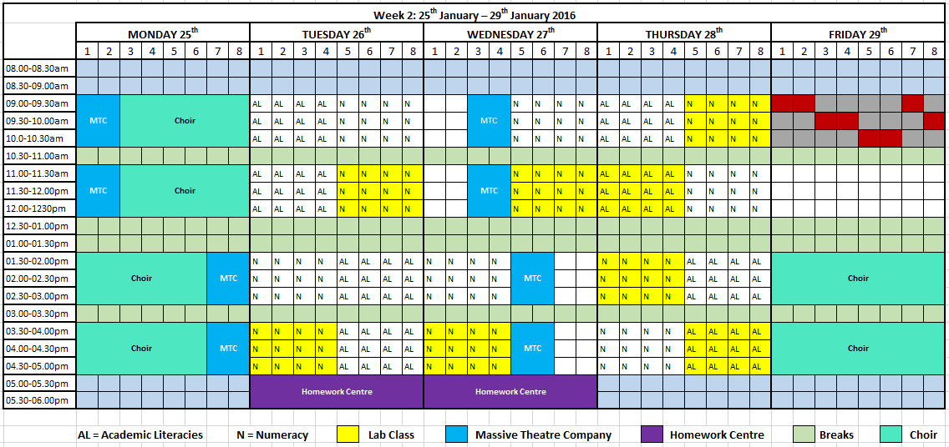

Slide 5
Our Students
UniPrep: Secondary Schools Details:
Secondary School | Decile | Number
McAuley High School | 1 | 117
Aorere College | 2 | 108
De La Salle College | 1 | 103
Otahuhu College | 1 | 81
Tangaroa College | 1 | 79
Southern Cross Campus | 1 | 71
Manurewa High School | 1 | 68
Auckland Girls' Grammar School | 3 | 63
Edgewater College | 2 | 49
Papatoetoe High School | 3 | 49
James Cook High School | 1 | 46
Onehunga High School | 3 | 44
Tamaki College | 1 | 41
Alfriston College | 2 | 35
Mangere College | 1 | 35
One Tree Hill College | 3 | 27
Papakura High School | 1 | 26
Sir Edmund Hillary Collegiate Senior Sch | 1 | 20
Auckland Seventh-Day Adventist H S | 1 | 19
Kia Aroha College | 1 | 7
 | Total | 1088
22 High School Visits in South Auckland
Eligible students are interviewed for places on UniPrep
All students case managed by our team

Slide 6
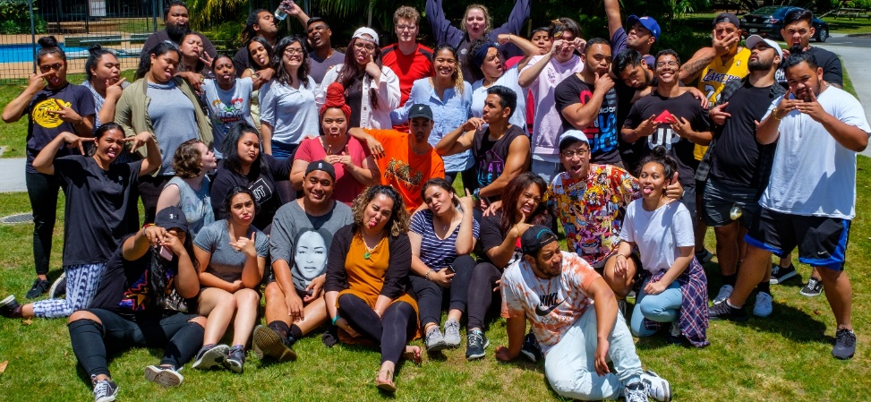
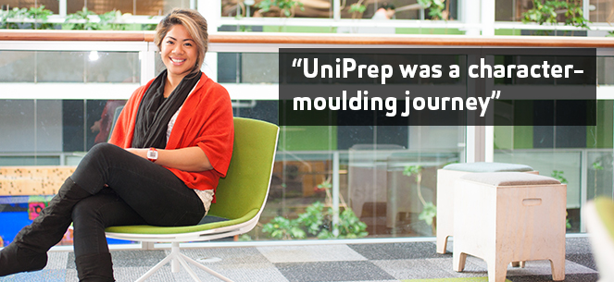
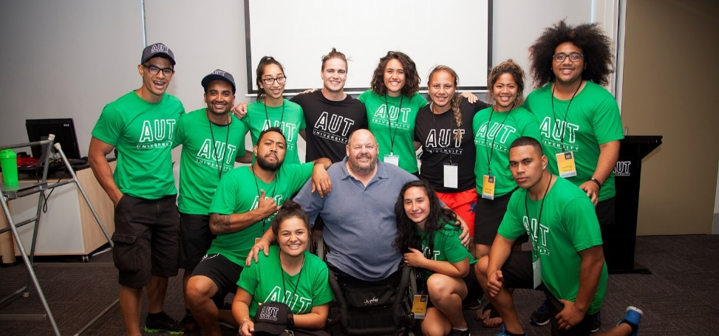
Our Navigators
Highlights:
High regard for Navigators
Stream structure with male-female Navigator effective
Students felt increased levels of confidence in study skills, time management and staying on top of studies for students
Learnings:
Mentor safeguarding and work load
Longitudinal reporting and evaluation

Slide 7
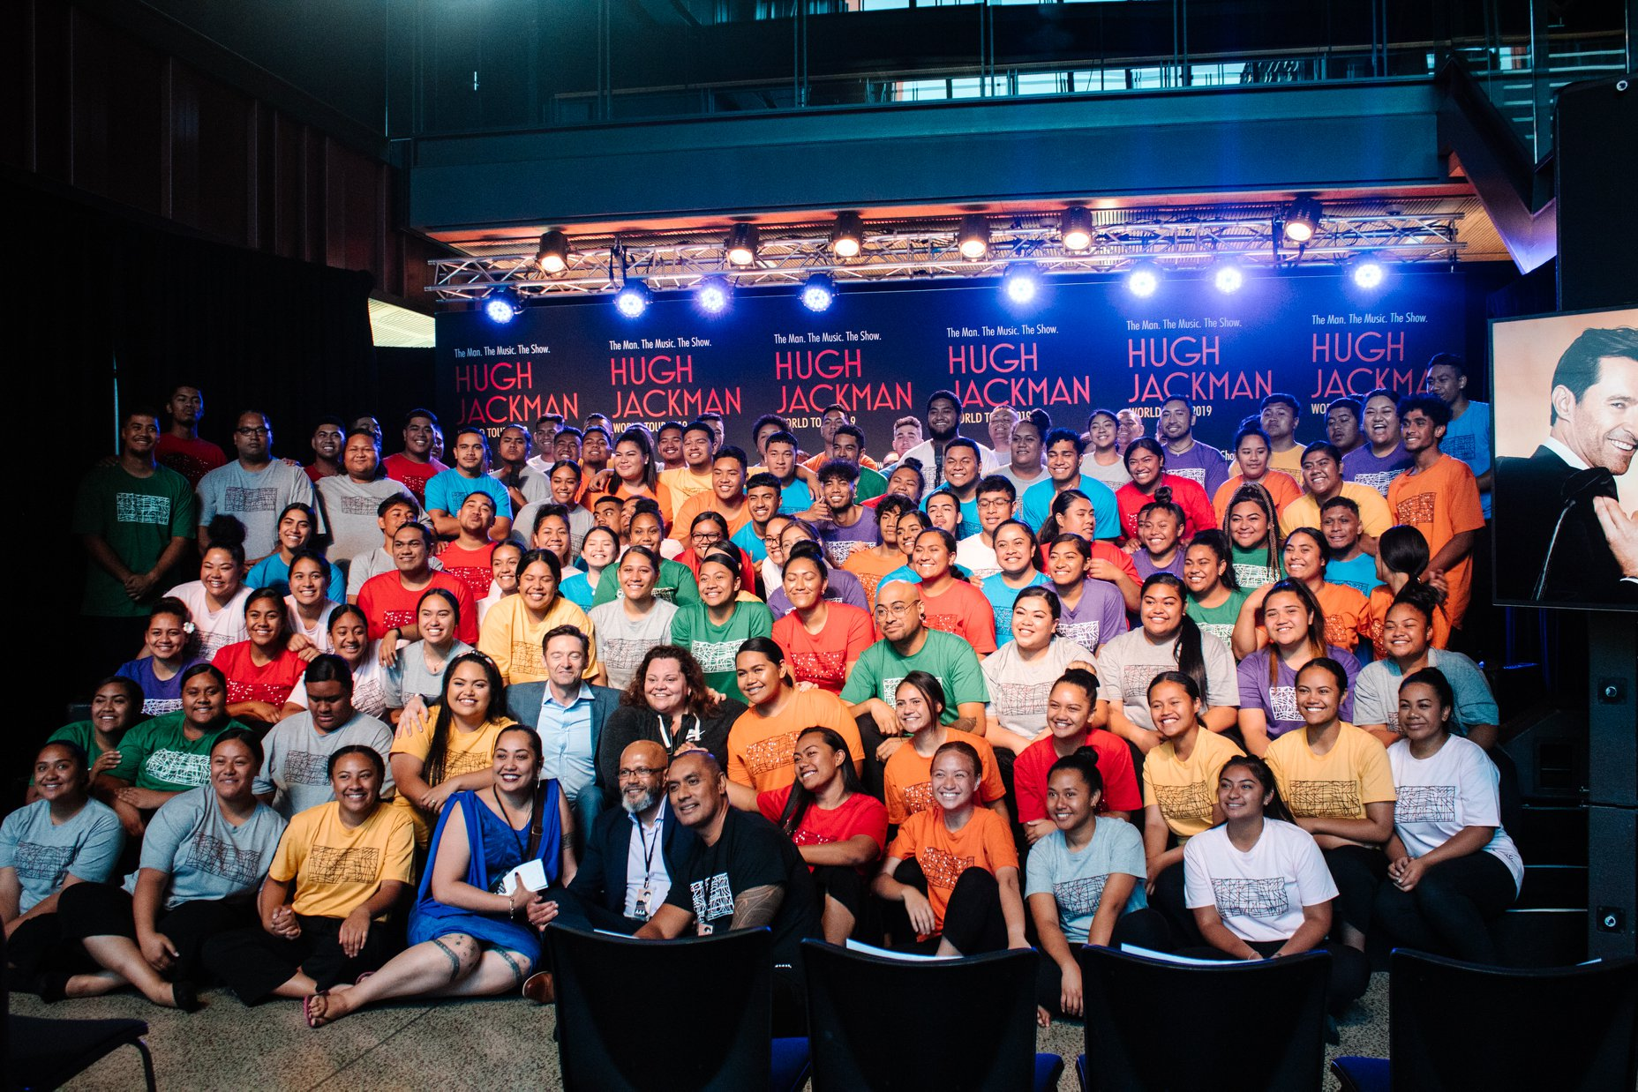
UniPrep:
No one gets left behind

