Slide 1

Data Analytics
and the
Risks around the Corner
Wendy Walker
Project Manager
Data Analytics Ethics
Victoria University of Wellington
Notes:
Tēnā koutou, My name’s Wendy Walker, I’m the Project Manager for Planning and Management of Information at Te Whare Wananga O Te Upoko O Te Ika A Maui, the Victoria University of Wellington.
It’s a pleasure to meet you all and get the chance to hear so many great speakers today.
I’m going to share a little information about the Learning Analytics project I’ve been working on at the Kelburn Campus of Victoria University.
Tertiary institutions are always looking for ways they can maximise the chance of success for their students.
The more students who leave their schools with degrees, the more prestigious the school’s reputation, the happier the shareholders.
And nobody enrolls in third level study or devotes the time, energy, mental health, and money, without aiming to receive that enticing qualification at the end of it all.
During my short time working on this project I’ve met a fantastic collective of people who are dedicated to working with these students to help them reach their goals.

Slide 2
“Learning Analytics is the measurement,
collection, analysis and reporting of data
about learners and their contexts,
for the purposes of understanding
and optimising learning and
the environments in which it occurs”
Siemens and Gaŝeviċ, 2012

Slide 3

“No one achieves anything alone”
Lesley Knope
Notes:
Tēnā koutou, My name’s Wendy Walker, I’m the Project Manager for Planning and Management of Information at Te Whare Wananga O Te Upoko O Te Ika A Maui, the Victoria University of Wellington.
It’s a pleasure to meet you all and get the chance to hear so many great speakers today.
I’m going to share a little information about the Learning Analytics project I’ve been working on at the Kelburn Campus of Victoria University.
Tertiary institutions are always looking for ways they can maximise the chance of success for their students.
The more students who leave their schools with degrees, the more prestigious the school’s reputation, the happier the shareholders.
And nobody enrolls in third level study or devotes the time, energy, mental health, and money, without aiming to receive that enticing qualification at the end of it all.
During my short time working on this project I’ve met a fantastic collective of people who are dedicated to working with these students to help them reach their goals.

Slide 4


Slide 5
“Research has proven that nudging is
effective in steering individuals toward better decisions through choice architecture”
National Bureau of Economic Research (Denmark, December 2013)
Oxford Academic, The Quarterly Journal of Economics (May 2014)
Notes:
Tēnā koutou, My name’s Wendy Walker, I’m the Project Manager for Planning and Management of Information at Te Whare Wananga O Te Upoko O Te Ika A Maui, the Victoria University of Wellington.
It’s a pleasure to meet you all and get the chance to hear so many great speakers today.
I’m going to share a little information about the Learning Analytics project I’ve been working on at the Kelburn Campus of Victoria University.
Tertiary institutions are always looking for ways they can maximise the chance of success for their students.
The more students who leave their schools with degrees, the more prestigious the school’s reputation, the happier the shareholders.
And nobody enrolls in third level study or devotes the time, energy, mental health, and money, without aiming to receive that enticing qualification at the end of it all.
During my short time working on this project I’ve met a fantastic collective of people who are dedicated to working with these students to help them reach their goals.

Slide 6
“All data is potentially taonga in relation to
its utility, through technology or
usefulness to the collective”
Dr Will Edwards, Ngaruahine & Data Iwi Leaders Group.

Slide 7
“The most commonly expressed concerns
were with students’ right to privacy and confidentiality, and their ability to give
informed consent”
Ako Aotearoa (2017)

Slide 8

“The New Sliding Scale of Ethics”

Slide 9
Agencies should be open when collecting information.
They need to make sure that the person will not be surprised about how that information is used later on,
or who it will be given to.
The Privacy Commissioner

Slide 10
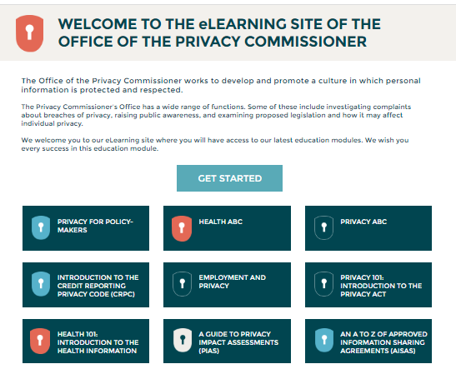
Notes:
Tēnā koutou, My name’s Wendy Walker, I’m the Project Manager for Planning and Management of Information at Te Whare Wananga O Te Upoko O Te Ika A Maui, the Victoria University of Wellington.
It’s a pleasure to meet you all and get the chance to hear so many great speakers today.
I’m going to share a little information about the Learning Analytics project I’ve been working on at the Kelburn Campus of Victoria University.
Tertiary institutions are always looking for ways they can maximise the chance of success for their students.
The more students who leave their schools with degrees, the more prestigious the school’s reputation, the happier the shareholders.
And nobody enrolls in third level study or devotes the time, energy, mental health, and money, without aiming to receive that enticing qualification at the end of it all.
During my short time working on this project I’ve met a fantastic collective of people who are dedicated to working with these students to help them reach their goals.

Slide 11
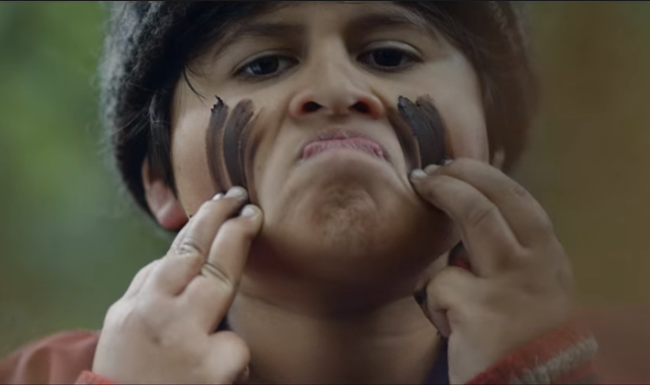
Make it real
Notes:
Tēnā koutou, My name’s Wendy Walker, I’m the Project Manager for Planning and Management of Information at Te Whare Wananga O Te Upoko O Te Ika A Maui, the Victoria University of Wellington.
It’s a pleasure to meet you all and get the chance to hear so many great speakers today.
I’m going to share a little information about the Learning Analytics project I’ve been working on at the Kelburn Campus of Victoria University.
Tertiary institutions are always looking for ways they can maximise the chance of success for their students.
The more students who leave their schools with degrees, the more prestigious the school’s reputation, the happier the shareholders.
And nobody enrolls in third level study or devotes the time, energy, mental health, and money, without aiming to receive that enticing qualification at the end of it all.
During my short time working on this project I’ve met a fantastic collective of people who are dedicated to working with these students to help them reach their goals.

Slide 12


Slide 13

Notes:
Tēnā koutou, My name’s Wendy Walker, I’m the Project Manager for Planning and Management of Information at Te Whare Wananga O Te Upoko O Te Ika A Maui, the Victoria University of Wellington.
It’s a pleasure to meet you all and get the chance to hear so many great speakers today.
I’m going to share a little information about the Learning Analytics project I’ve been working on at the Kelburn Campus of Victoria University.
Tertiary institutions are always looking for ways they can maximise the chance of success for their students.
The more students who leave their schools with degrees, the more prestigious the school’s reputation, the happier the shareholders.
And nobody enrolls in third level study or devotes the time, energy, mental health, and money, without aiming to receive that enticing qualification at the end of it all.
During my short time working on this project I’ve met a fantastic collective of people who are dedicated to working with these students to help them reach their goals.

Slide 14
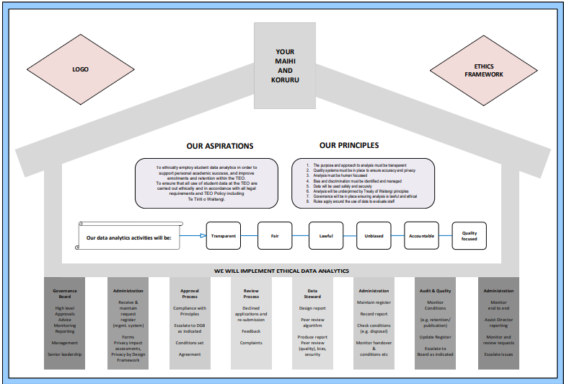
Notes:
Tēnā koutou, My name’s Wendy Walker, I’m the Project Manager for Planning and Management of Information at Te Whare Wananga O Te Upoko O Te Ika A Maui, the Victoria University of Wellington.
It’s a pleasure to meet you all and get the chance to hear so many great speakers today.
I’m going to share a little information about the Learning Analytics project I’ve been working on at the Kelburn Campus of Victoria University.
Tertiary institutions are always looking for ways they can maximise the chance of success for their students.
The more students who leave their schools with degrees, the more prestigious the school’s reputation, the happier the shareholders.
And nobody enrolls in third level study or devotes the time, energy, mental health, and money, without aiming to receive that enticing qualification at the end of it all.
During my short time working on this project I’ve met a fantastic collective of people who are dedicated to working with these students to help them reach their goals.

Slide 15
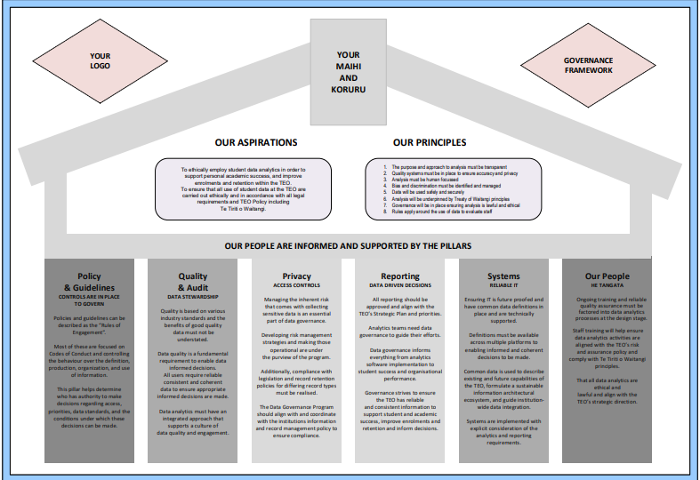

Slide 16
“Its good practice to review what information is being collected, to confirm the information is necessary and connected to the functions of the organisation.
Is the information necessary
or just nice to have?”
Office of the Privacy Commissioner

Slide 17
“Deploying a new system can be expensive; training people to use it and cultivating buy-in take time, as do questions of privacy and ethics”
The Truth About Student Success (2019) (The Chronicle of Higher Education)

Slide 18

Notes:
Tēnā koutou, My name’s Wendy Walker, I’m the Project Manager for Planning and Management of Information at Te Whare Wananga O Te Upoko O Te Ika A Maui, the Victoria University of Wellington.
It’s a pleasure to meet you all and get the chance to hear so many great speakers today.
I’m going to share a little information about the Learning Analytics project I’ve been working on at the Kelburn Campus of Victoria University.
Tertiary institutions are always looking for ways they can maximise the chance of success for their students.
The more students who leave their schools with degrees, the more prestigious the school’s reputation, the happier the shareholders.
And nobody enrolls in third level study or devotes the time, energy, mental health, and money, without aiming to receive that enticing qualification at the end of it all.
During my short time working on this project I’ve met a fantastic collective of people who are dedicated to working with these students to help them reach their goals.

