Slide 1



Welcome!
Onboarding Guidance

Slide 2


Contents
Back to Contents
Introduction
What is Phriendly Phishing? ………………………………………………………………………………………………….……..3
What you need to know………………………………………………………………………………………………..……….………..4
The Phriendly Phishing Learning Method….…………………………………………………………………………..8
Key dates………………………………………………………………..….…………………………………………………………………………..9
Phriendly Phishing Technical Preparation
  Step 1: Account Activation………………………………………………………………………………………………………………11
  Step 2: Add Staff……..……………………………………………………………………………………………………………..……….……12
  Step 3: Whitelisting.…………………………………………………………..………………………………………………..……….……14
  Step 4 (Optional): Phish Reporter Configuration……………………………………..……………….…….……21
  Branded email templates………………………………………………………………………………………………………………24
Phriendly Phishing Platform Setup
  Baseline Emails……………………………………………………………………………………………………………………………….…26
  Communicate to Your Staff ………..…………………………………………………………………………………………….…27
  Phishing Campaigns……………….………………………………………………………………………………………………………28
  Security Awareness Training...……………………..…………………………………………………………………………...…29
  Your recommended Learning Path……………………………………………………………………………..……..……30
Appendix
  Create a custom Learning Path………………………………………………………….………………………………………31
  Schedule a Baseline…………………………………..…………………………………………………………………………….………34
  Set up Your Training Learning Journey…………………………………..………………………………………..…….35
  Schedule Campaign……………………………………………………………………………………………………………………..…36
Additional Info
  Explore Reporting………..………………………………………………………………………………………………………………..…38
  Micro Lesson…………………..………………………………………………………………………………………………………………..…39
  Spear Phishing………..………………………………………………………………………………………………………………….…..…40
  Ongoing Customer Success & Support………………………………………….………………………………..……..41
Notes:
How long will setting up take?
What will I need?
More FAQ questions.
Customers with 400 learners or fewer will have access to our Phriendly Phishing Self-Service Onboarding, please use the in-platform interactive guide to set up your account.

Slide 3
About Phriendly Phishing

Slide 4

What is Phriendly Phishing?
Back to Contents
Phriendly Phishing is an Australian-based company which provides security awareness and phishing simulation training solutions for the Australian and New Zealand market.
We educate and empower your organisation and employees to help mitigate reputational and financial loss from cyber attacks - including common, costly and difficult to detect security threats like:
Phishing
Spear-phishing
Ransomware
Malware and scams
We train not trick through empathetic learning that is customised to each learner's journey.
Our platform is fully automated, digitally delivered and is localised with relevant and engaging content
4

Slide 5
What you need to know....
Back to Contents
What is Phishing?
Phishing is the practice of sending fraudulent emails, often impersonating reputable companies, with the intent to trick you into revealing personal information, such as passwords or credit card numbers.
What does the onboarding process look like?
This document summarises the onboarding process. It can be done all at once or in stages. When you return to the onboarding process, your previous steps will have been saved.
What topics does the training cover?
Our security awareness training covers a comprehensive range of topics designed to equip employees with the knowledge and skills needed to recognise and respond to cybersecurity threats effectively. You can view our course catalogue here.
What is your support process like?
Reach us via phone or email. First response is four business hours from ticket submission. Most technical support issues are resolved on the initial response, however we have multiple escalation levels depending on the nature of the query.
5

Slide 6
What you need to know....
Back to Contents
Is Phriendly Phishing secure and reliable?
Yes, Phriendly Phishing is designed with security and reliability in mind. The service uses industry-standard encryption to protect sensitive data and has multiple layers of redundancy and confidential failover to ensure high availability and uptime. Additionally, Phriendly Phishing undergoes regular security audits and testing to ensure compliance with industry best practices and standards.
Is Phriendly Phishing customisable to my organisation's needs?
Yes, Phriendly Phishing offers a range of customisation options, including the ability to create
your own learning path timeline, custom phishing and training templates, and adjust simulation settings to reflect your organisation's security policies and procedures.
6
Notes:
How long will setting up take?
What will I need?
More FAQ questions.
Customers with 400 learners or fewer will have access to our Phriendly Phishing Self-Service Onboarding, please use the in-platform interactive guide to set up your account.

Slide 7
Important dates

Slide 8





The Phriendly Phishing Learning Method
Phriendly Phishing aims to create long-lasting learning and enhance the performance of employees and organisations. All in the hopes of advancing employee awareness and driving positive behavioural change around cyber security.
Phriendly Phishing provides learning that is continuously practised, tested and measured, all within a zero-touch automation learning path.
Baseline
27 May - 9 June
Communication
10 June – 16 June
Training
17 June – 12 July
Campaigns & Reporting
15 July Ongoing
Phish Reporter
8

Slide 9






Key Dates:
ASAP, BEFORE 17 May 2024
Complete Technical Onboarding Steps
Here are the Key Dates you will need to keep in mind for the successful launch of Phriendly Phishing.
27 May 2024 – 9 June 2024
Baseline Phishing Test - 2 Weeks
10 June 2024 – 16 June 2024
Send All Staff Communication - 1 Week
17 June 2024 – 12 July 2024
SCAM 1 NZ Course – 4 Weeks
Staff communication templates are available on the TEC Phriendly Phishing landing page
15 July 2024 – Ongoing Monthly
Monthly Phishing Campaigns

Slide 10
Technical Steps

Slide 11
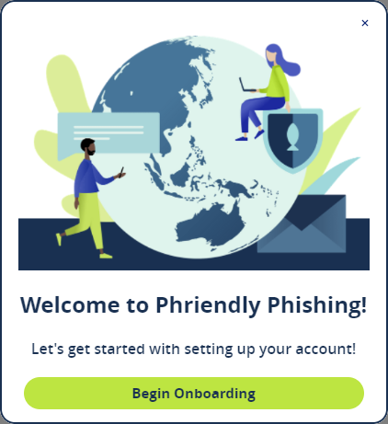


Step 1
Account Activation
Back to Contents
Once you have submitted your Registration Form, we will activate your Phriendly Phishing account and you will receive an activation email. Remember to check your Junk / Spam folder.
Once your account is created, you can add as many additional admins as you would like.
Upon logging in, a welcome popup will guide you through onboarding steps. Click "Begin Onboarding" to proceed and follow the interactive walkthrough. Don't worry, if you need to stop the setup, you can always come back to where you left off by selecting the teractive Gui button in the top right corner of the platform.
Alternatively, you can wait for the next scheduled Instructional Webinar for assistance.
Contact Support
11

Slide 12
Step 2
Add Staff
Back to Contents
The next step is to add staff to the Phriendly Phishing platform. This allows you to send training and simulated phishing emails to your staff. Staff will not receive any notification that they've been added to the platform. Communications will only go out to staff once the learning path has been setup.
We recommend adding staff, by syncing to your directory service. Syncing to your directory service means any update to staff in your directory will automatically be reflected in our platform.
We have four different staff sync options available. Please select the applicable method below for instructions on setting your sync:
Active Directory (on prem)
Azure SCIM
Azure API (recommended for Azure)
Okta
Alternatively, you can Manually Add Learners to the Platform.
(Note: this method means you will need to periodically update the learner list via a CSV)
Unsure about the above options? Read the User Sync FAQ here.
And/or attend the next scheduled Instructional Webinar for assistance.
12
Contact Support

Slide 13
Step 2
Add Staff
Back to Contents
What is a Directory Service?
A directory service functions as a centralised repository for managing a list of people and their account information including names, emails, usernames, department, job location, and potentially additional attributes. Given the dynamic nature of organisational structures, the directory undergoes continuous updates as staff join or depart from the company.
What is the difference between Azure API and Azure SCIM?
Azure API is an interface that Phriendly Phishing has developed to simplify the user synchronisation process. Azure SCIM is an industry standard method of syncing a directory to products and services. Here are the technical differences:
What if I use an active directory other than Azure, AD (on-premise), or Okta?
Currently, Phriendly Phishing can only sync to Azure, AD (on-premise), or Okta active directories. If you use a different active directory, you will need to manually upload users.
 | Azure API | Azure SCIM
How is the data sent? | The Phriendly Phishing platform decides what attributes will be pulled from your Azure AD | The Azure AD portal decides what attributes are pushed to the Phriendly Phishing Platform
What is the setup process like? | Azure API is a simpler process than SCIM, however requires a configuration from Phriendly Phishing’s Support team before you can configure from your Azure portal. | Azure SCIM is the industry standard method of AD synchronisation. Due to the number of steps, it can often cause more mistakes if the implementer is not technically proficient. However, it requires no configuration from Phriendly Phishing and can be set up entirely on your own.
13

Slide 14
Step 3
Whitelisting
Back to Contents
What is Whitelisting?
In the context of emails, whitelisting refers to the practice of allowing emails from specific senders or domains to bypass spam filters and other security measures, ensuring their delivery directly to the recipient's inbox. Essentially, it involves creating a list of trusted email addresses or domains that are deemed safe and authorised to send emails to the recipient. Adding Phriendly Phishing to your whitelisted IP’s and Domains is essential to allow us to reliably send communications to your staff and provide our service.
I use an outsourced IT service – how do we complete this step?
You can send this presentation to your IT provider and ask them to complete the Whitelisting steps outlined in slides 8-16.
Unsure about whitelisting? Read the Whitelisting FAQ here.
And/or attend the next scheduled Instructional Webinar for assistance.
14

Slide 15
Step 3
Whitelisting
Back to Contents
Follow the flow chart to see which option best suits your infrastructure
What office suite are you using?
O365
Option 4: Google Workspace
Are you using a spam filtering application (Secure Email Gateway)?
Yes
No
Option 1: Bypass Filter + Advanced Delivery (recommended option vs Mail Flow Rules)
Option 2: Mail Flow Rules
Option 3: Microsoft Advanced Delivery
15
Contact Support
Unsure about options? Read the Whitelisting FAQ here

Slide 16


Step 3
Note: you only need to complete one whitelisting option.
Whitelisting
O365 Option 1: Bypass Filter & Advanced Delivery
Back to Contents
Bypass the mail filter
Set up Microsoft’s Advanced Delivery feature
Reach out to us to let know you have setup Advanced delivery and provide us with your O365 MX value (example phriendlyphishing-com.mail.protection.outlook.com).
Phriendly Phishing will make a config change and confirm with you once done.
Generate a whitelist test to make sure all our emails can make it through to your environment.
16
Contact Support

Slide 17

Step 3
Note: you only need to complete one whitelisting option.
Whitelisting
O365 Option 2: Mail Flow Rules
Back to Contents
Whitelist our IP’s in your email gateway.
We have currently have guides for:
  Whitelisting in Mail Marshall
  Whitelisting in Proofpoint
  Whitelisting in Mimecast
  Whitelisting in TrendMicro
  Whitelisting in Symantec.cloud
  Alternatively, look up an article in your SEG on how to whitelist IP’s and domains and add Phriendly Phishing’s IP’s
Set up mail flow rules
Generate a whitelist test to make sure all our emails can make it through to your environment.
17
Contact Support

Slide 18

Step 3
Note: you only need to complete one whitelisting option.
Whitelisting
O365 Option 3: Advanced Delivery
Back to Contents
Set up Microsoft’s Advanced Delivery feature
Generate a whitelist test to make sure all our emails can make it through to your environment.
18
Contact Support

Slide 19

Step 3
Note: you only need to complete one whitelisting option.
Whitelisting
Option 4: Google Workspace
Back to Contents
Set up whitelisting in Google Workspace. You MUST complete all four steps dictated in the article.
Generate a whitelist test to make sure all our emails can make it through to your environment.
Contact Support
19

Slide 20
Step 3
Whitelisting
FAQ
Back to Contents
What is the difference between the two options for O365 with a Secure Email Gateway (SEG)?
  Option 1 is recommended as Microsoft has developed a specific feature for third-party phishing email simulations and will only work if your SEG is bypassed. This option is the most reliable way to ensure your staff are receiving all emails and that Phriendly Phishing can accurately track phishing link clicks.
  However, some companies may not be comfortable with allowing Phriendly Phishing to bypass their SEG, and Option 2 is the alternative whitelisting method we provide.
What if I don’t use O365 or Google Workspace?
While we don’t have guides on whitelisting outside of O365 and Google Workspace, you will
still be able to whitelist by adding our IP’s and Domains to your office suite’s administration
console which your office suite should have a guide on. If you are still unsure, you can
contact support@phriendlyphishing.com for help.
20
Contact Support

Slide 21

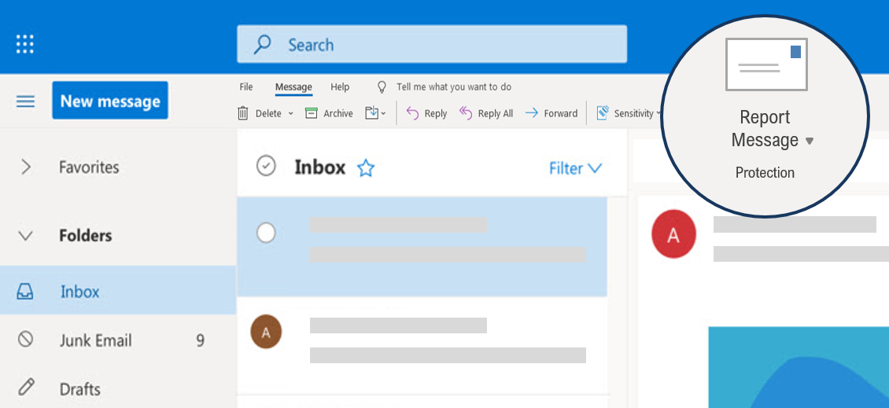

Step 4
Phish Reporter Configuration (Optional)
Back to Contents
Empower your staff to report phishing emails with one click.
The sooner you know about a phishing attack, the sooner you can do something about it. Phriendly Phishing’s Phish Reporter add-in empowers your employees to report suspicious emails with one click for analysis and mitigation.
Phish Reporter Add-in (optional)
Phish Reporter add-in empowers your employees to report suspicious emails with one click for analysis and mitigation. If you'd like to set up this feature, please follow this article to configure your settings.
Install Desktop Phish Reporter
Install O365 Phish Reporter
Install Google Workspace Phish Reporter
Report
Phishing Email
Unsure about Phish Reporter? Read the FAQ here.
And/or attend the next scheduled Instructional Webinar for assistance.
21

Slide 22
Step 4
Phish Reporter
FAQ
Back to Contents
What is the Phish Reporter?
The Phish Reporter is a feature integrated into email clients that empowers staff to easily report suspicious emails to their organisation's security team for further investigation.
How does the Report Phishing Button work?
Staff simply click on the Phish Reporter button within their email client, when they receive a suspicious email. This action sends the email to designated security personnel, helping to identify potential phishing attempts and take appropriate action.
What happens after I report a phishing email using the button?
Once a user clicks the Phish Reporter, the suspicious email is automatically forwarded to the organisation's security team or designated administrators. They will review the reported email to determine its legitimacy and take appropriate action, such as blocking the sender or educating staff about phishing threats.
22

Slide 23
Step 4
Phish Reporter
FAQ
Back to Contents
Is there any training or guidance provided on how to use the Report Phishing Button?
Yes, we have collateral in our help center to assist with providing training and guidance to staff on how to recognise phishing attempts and effectively use the button to report suspicious emails. This education empowers staff to play an active role in protecting the organisation from cyber threats.
What email clients is the phish report compatible with?
Outlook and Gmail
Can I customise the actions taken after a phishing email is reported?
Yes, organisations can customise the response actions taken after a phishing email is reported using the Phriendly Phishing platform. This means staff can automatically be notified if they reported a Phriendly Phishing simulations email vs a potential real life phishing email.
23

Slide 24
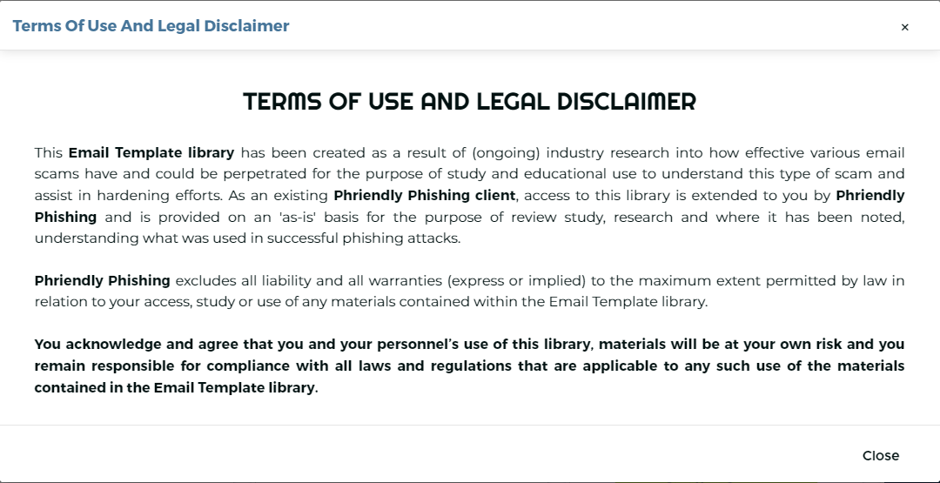
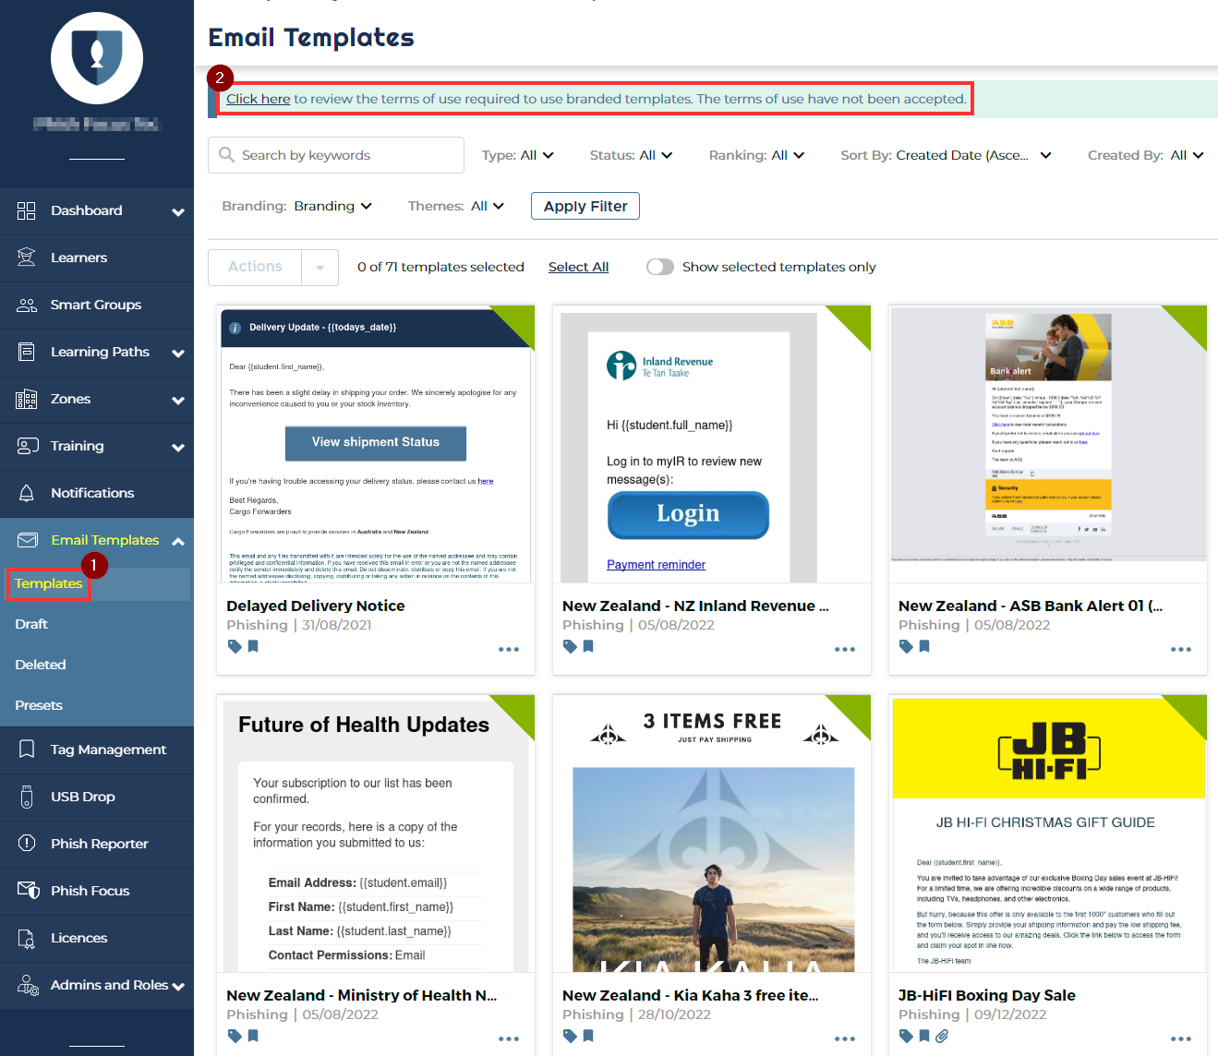
Don’t forget: Branded Templates
Accept the terms and conditions to have our branded templates incorporated into your phishing simulation pool.
It's important to action this prior to the baseline commencing, as these templates make up some of our most sophisticated simulations.
Review and disable any templates you want to exclude from simulations

Slide 25
Your Automated Learning Path
Baseline
Phishing campaigns
Security awareness training

Slide 26


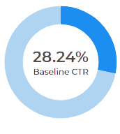
Baseline Emails
Phriendly Phishing subscription begins with a non-invasive baseline audit developed to provide a true snapshot in time of your entire organisation's phishing risk profile.
Anonymous and random to respectfully measure an organisation's risk profile
Incorrect clicks redirects learners to Google.com
Recommended to run annually
Uses our most sophisticated phishing
email templates
Launching:
27 May – 9 June
Notes:
The Baseline is a phishing test where we send 1 anonymous and randomized phishing emails to each of your staff.
This is to respectfully measure the organisations current risk profile.
Anyone that clicks on any of the links in the phishing emails will be redirected to google.
Baseline templates are the most difficult, designed to simulate a real life phishing attack.
Callout – This will be running for your organization from 22 April to 5 May

Slide 27
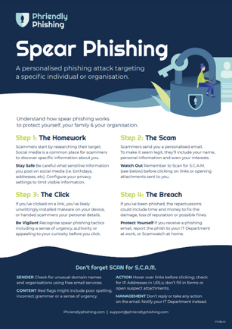
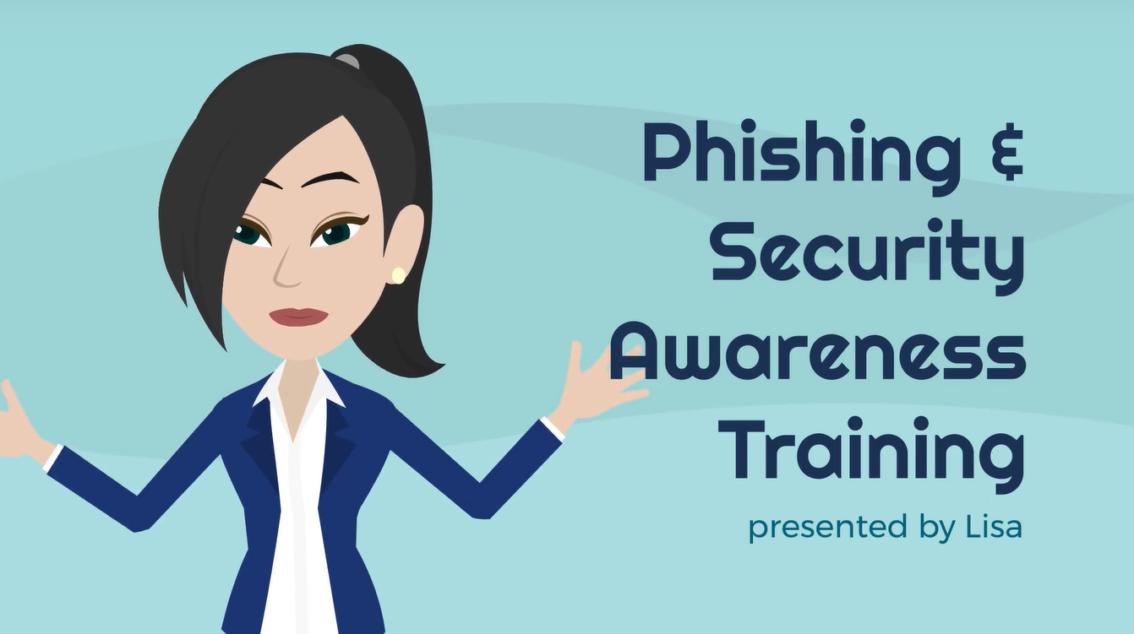
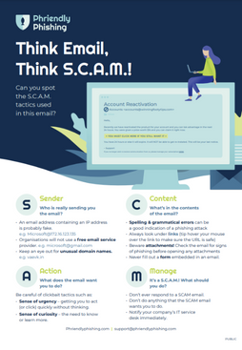
Communicate to Your Staff
Back to Contents
Following the baseline, educate your staff of the Phriendly Phishing program and what to expect throughout.
Share the Communication content available here (video, email templates, posters and desktop images, and more!)
Recommended to share once the baseline completes and before the launch of your initial training course, campaign and Phish reporter.
Communicating your training strategy to staff is important to ensure staff engagement and maximise training
completion.
We recommend doing this annually.
Initial training email communication
Screensavers & educational posters
Employee Onboarding video
27

Slide 28




Phishing
Campaigns
Back to Contents
Campaign randomly assigns a template to the staff from hundreds of email templates
Phriendly Phishing automated monthly email campaigns actively reinforce 'Scan for S.C.A.M.' training concepts through our 'train, not trick' methodology.
Ongoing, zero-touch campaigns ensure your staff are advancing their learning and practicing their new phishing knowledge.
Staff will receive 1 email per month, ongoing
Emails automatically advance to learner's skill
Wrong clicks used as learning experience and directed to a micro lesson landing page
Ongoing monthly
28

Slide 29


Security Awareness Training
Back to Contents
  Short Courses are short & sharp, designed for the time-poor employee.
  Courses are between 2-15 minutes long.
  Courses include interactive games, quizzes, animations and assessments to test employee knowledge.
Mass training email will be sent at 10 am
Unique link in the email
No login or SSO required
Staff receive a completion certificate and survey
Recommended to run quarterly.
29

Slide 30


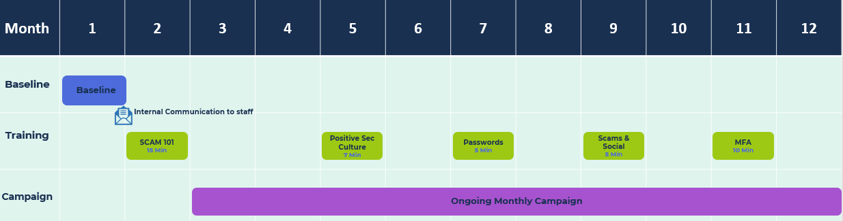
Your Learning Path
Back to Contents
Phriendly Phishing has worked together with TEC and peak bodies to create a recommended 12 month Learning Path. This Learning Path is outlined below. More detailed info can be found on the following slides.
If you would like to customise your own Learning Path, see the instructions in the Appendix of this document.
Activity | Description | Duration
 | Simulated phishing campaign used to determine your organisation’s overall phishing risk and establish a baseline for future measurement. | 2 Weeks
 | Developed Specifically for Australia/New Zealand. Courses include real-life examples of scams & social engineering. Courses can be found in the Course Catalogue | 4 courses over a 12-month period (minimum). Delivered quarterly. Each running for 4 weeks
 | Automated monthly simulated phishing emails sent to your staff. These are designed to improve the detection of your staff for real-life instances of phishing emails. | Ongoing. 1 Phishing email sent per user per month
Baseline
Training
Campaign
30

Slide 31
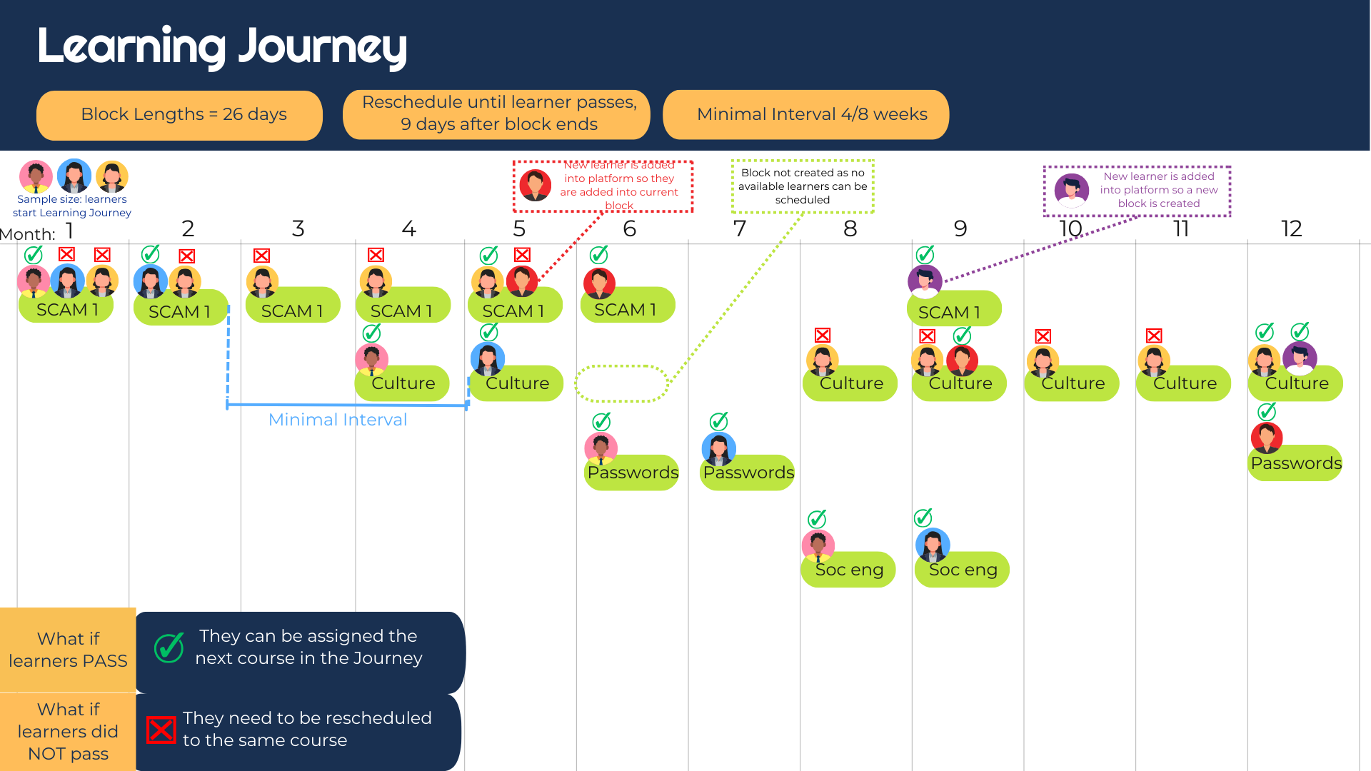

Slide 32
Appendix

Slide 33
Customise Your Learning Path
Back to Contents
The steps in the following slides are only necessary if you want to create a custom learning path for your staff.
Activity | Description | Duration
 | Simulated phishing campaign used to determine your organisation’s overall phishing risk and establish a baseline for future measurement. | 4 Weeks
 | Developed Specifically for Australia/New Zealand. Courses include real-life examples of scams & social engineering. Courses can be found in the Course Catalogue | 4 courses over a 12-month period (minimum). Delivered quarterly. Each running for 4 weeks
 | Automated monthly simulated phishing emails sent to your staff. These are designed to improve the detection of your staff for real-life instances of phishing emails. | Ongoing. 1 Phishing email sent per user per month
Baseline
Training
Campaign
Month | 1 | 2 | 3 | 4 | 5 | 6 | 7 | 8 | 9 | 10 | 11 | 12
Baseline
Training
Campaign
Baseline
SCAM 101
Ksec 1
Ksec 2
Ksec 3
33
Ongoing Campaign

Slide 34
Schedule a Baseline
Back to Contents
Phriendly Phishing subscription begins with a non-invasive baseline audit developed to provide a true snapshot in time of your entire organisation's phishing risk profile.
The Baseline is a simulated phishing campaign used to determine your organisation’s overall phishing risk and establish a baseline for future measurement.
The Baseline assigns each staff member one random phishing email from our pool of highly sophisticated emails. Staff will receive these email during the duration of the exercise. This test also utilises employee anonymisation to ensure a respectful first experience for your employees.
Click here for instructions on how to schedule your Baseline.
Anonymous and random to measure your organisations risk profile
Redirects staff to Google.com
Uses our most sophisticated phishing
email templates
34

Slide 35
Set up Your Training Learning Journey
Back to Contents
All training courses that are available can be found in the Course Catalogue.
We offer a wide range of first-class cyber security training content available for you to schedule for your staff. Starting with the basics, employees learn to identify security threats and build phishing detection skills through engaging and interactive training. Our content is regularly updated to reflect the fast-changing cyber security threat landscape.
We recommend scheduling S.C.A.M. 101 first as this will teach user what a phishing email is and how to identify them.
Click here for instructions on how to schedule your learning journey.
Training delivered via email
Unique link in the email
No login or SSO required
Staff receive a completion certificate and survey
35

Slide 36
Schedule Campaign
Back to Contents
Phriendly Phishing automated monthly email campaign is a continuous chain of monthly phishing email, sent to your staff. These are designed to progressively improve the detection and reporting capabilities of your staff for real-life instances of phishing emails.
These emails are designed to start easy and get progressively harder as staff become more skilled and more confident. The difficulty level of the campaign will increase based on individual interactions with the phishing emails. This means your staff can each learn at their own pace.
​
Click here for instructions on how to schedule a campaign.
Campaign randomly assigns a template to the staff from hundreds of email templates
Emails automatically advance to staff skill
Staff will receive one email per month, ongoing
Wrong clicks used as learning experience and directed to a micro lesson landing page
36

Slide 37
Additional Info

Slide 38
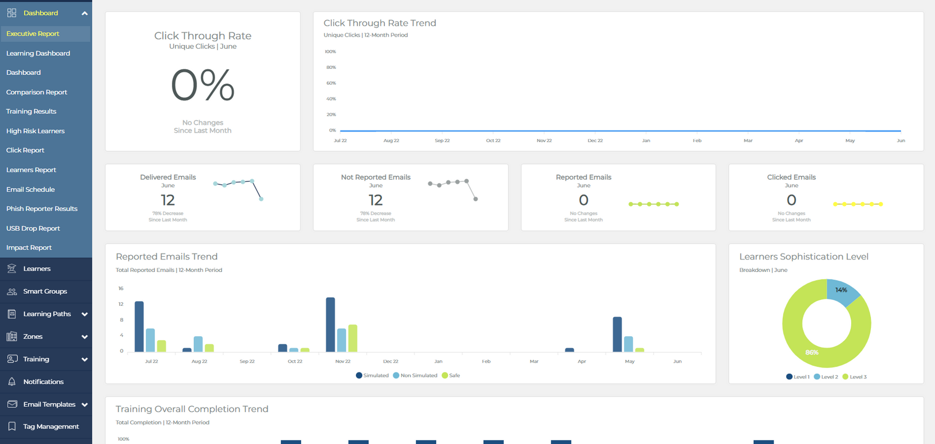
Explore Reporting
Back to Contents
Executive Report
Learning Dashboard
Training Results
Click Report
High-Risk Learners
Learners Report
Email Schedule
Phish Report
38

Slide 39
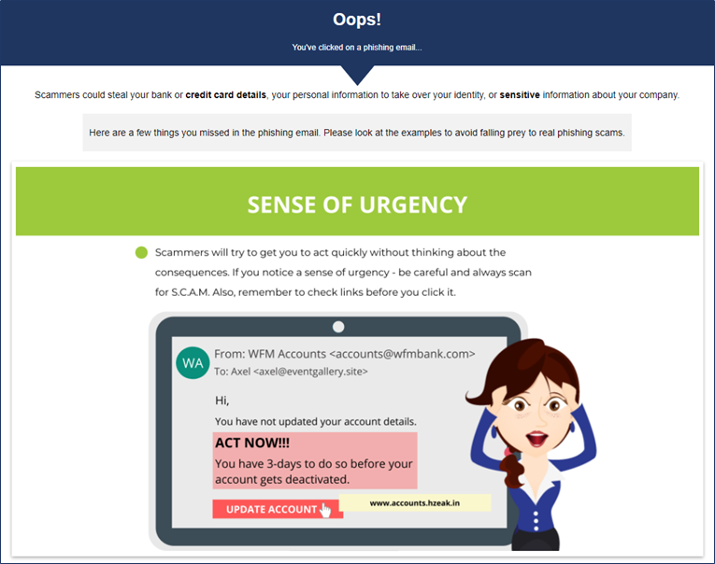
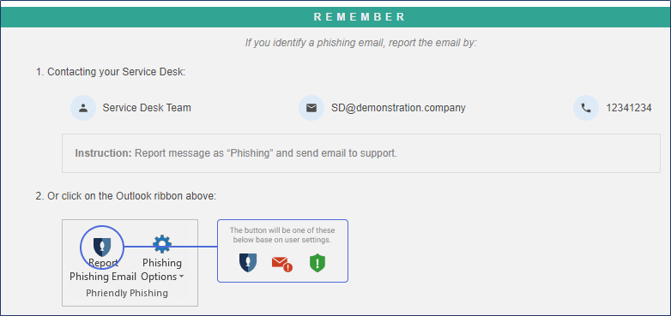
Micro Lesson
Back to Contents
Ongoing learning experience for staff when they click on simulated phishing email campaigns.
Customise the message in your Zone Info tab.
39

Slide 40
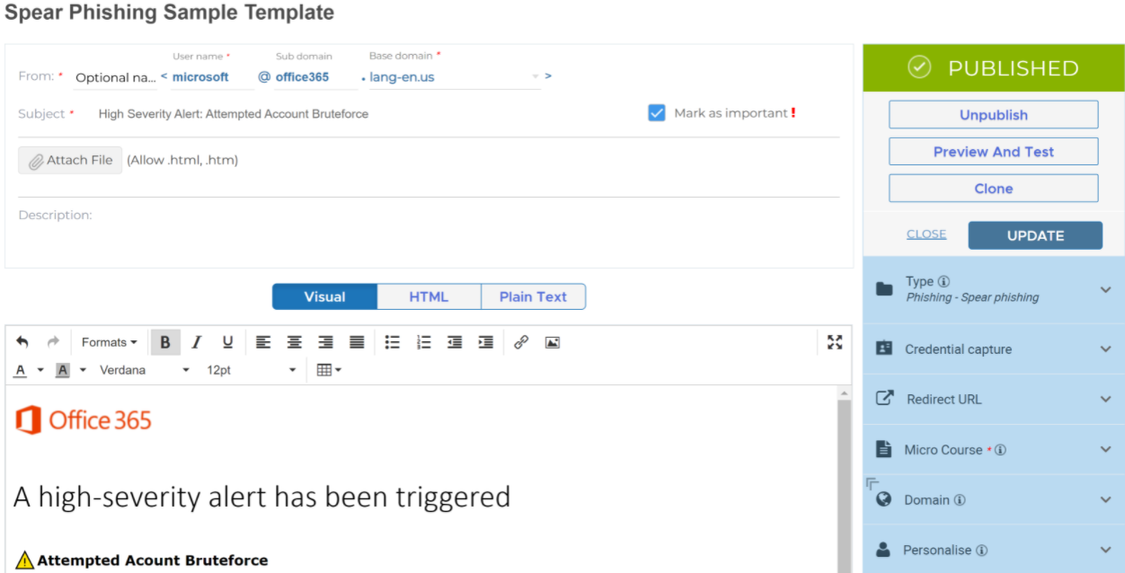
Spear Phishing
Spear phishing is the act of sending a scam email to a specific and well-researched target audience while pretending to be a trusted sender.
Back to Contents
Use the Phishing Creator to customise our existing templates, upload your own or create a template from scratch.
Add a little bit of body text
Report
Phishing Email
Click here for instructions on how to setup some spearphishing campaigns
40

Slide 41

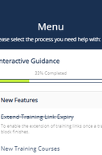

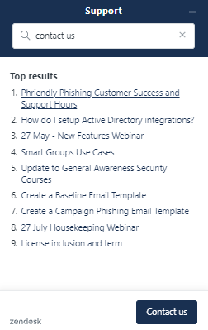
Ongoing Customer Success & Support
Back to Contents
Online Knowledge Base
Monthly Newsletters
Quarterly Webinars
Communication Collateral
Support@phriendlyphishing.com
Submit a support ticket
41

Slide 42


Customer Success and Support team
Contact us at:
support@phriendlyphishing.com
Or visit our online Knowledge base
help.phriendlyphishing.com/hc/en-gb

