Slide 1
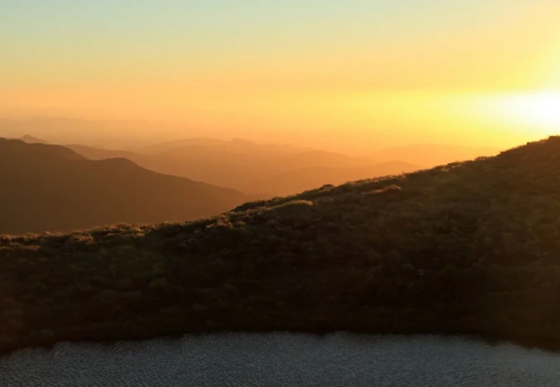
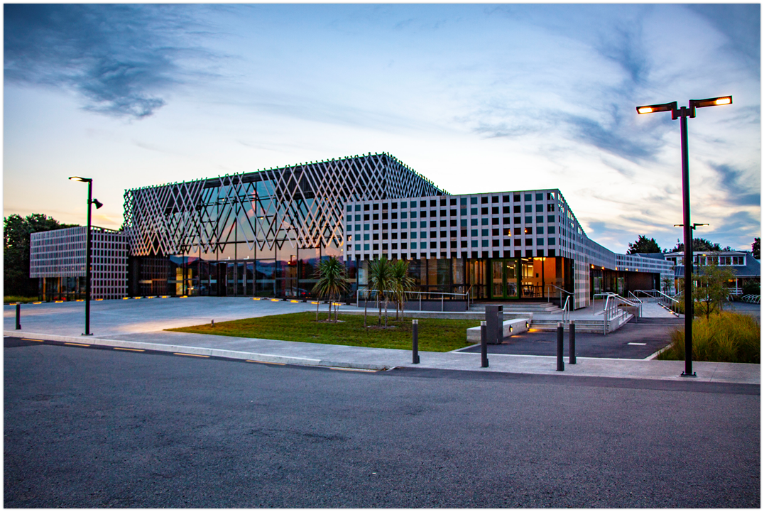
Student Success
E kore au e ngaro he kākano; i ruia mai i Rangiātea.
I will never be lost a seed; sown from Rangiātea

Slide 2
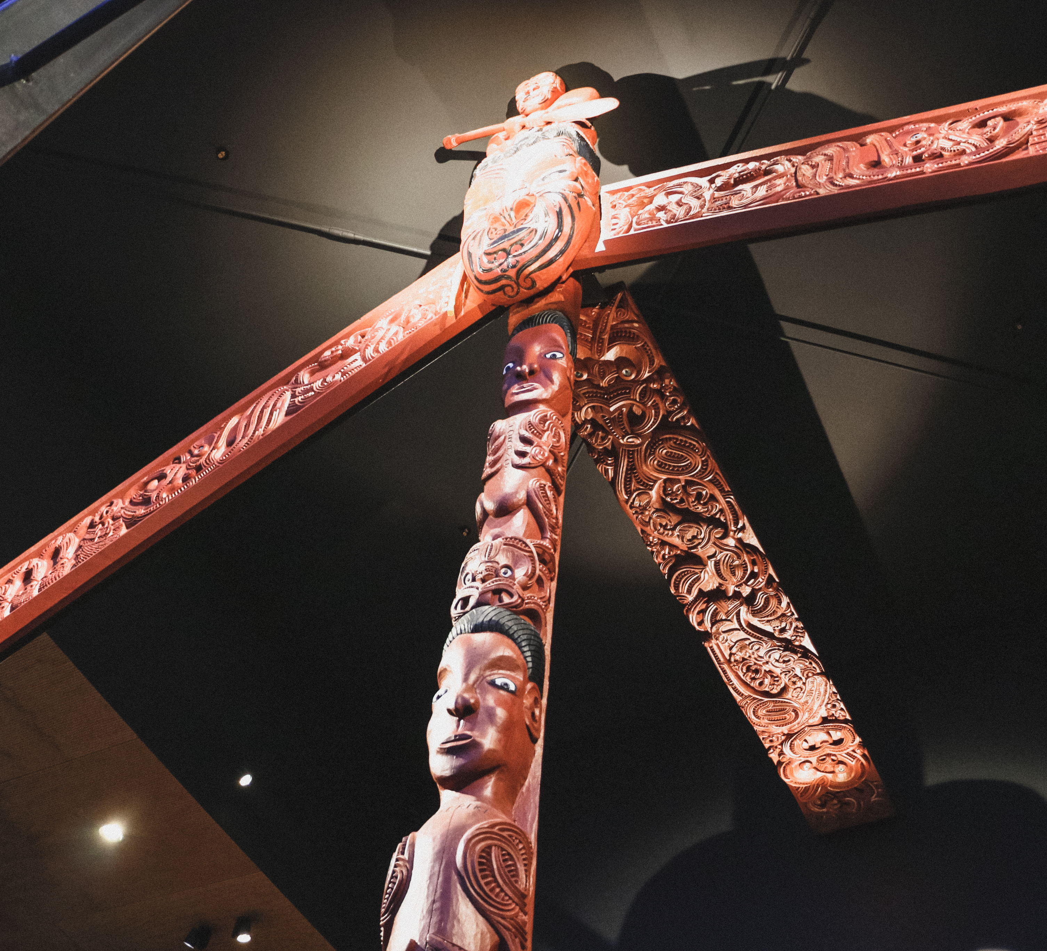
Te Wānanga o Raukawa
Te Āti Awa,
Ngāti Raukawa,
Ngāti Toarangatira
The Confederation of ART

Slide 3
1975 no one under 30 years can speak our language

Slide 4
Whakatupuranga Rua Mano Generation 2000 Tribal Development Plan
Principles:
Our people are our wealth
The marae is our principal home
Our language is a treasure
Self Determination: take control of our destiny

Slide 5
1981 Te Wānanga o Raukawa
To maximise our contribution to the survival of Māori as a people
2 enrollees!
reo, iwi and hapū research: compulsory papers

Slide 6
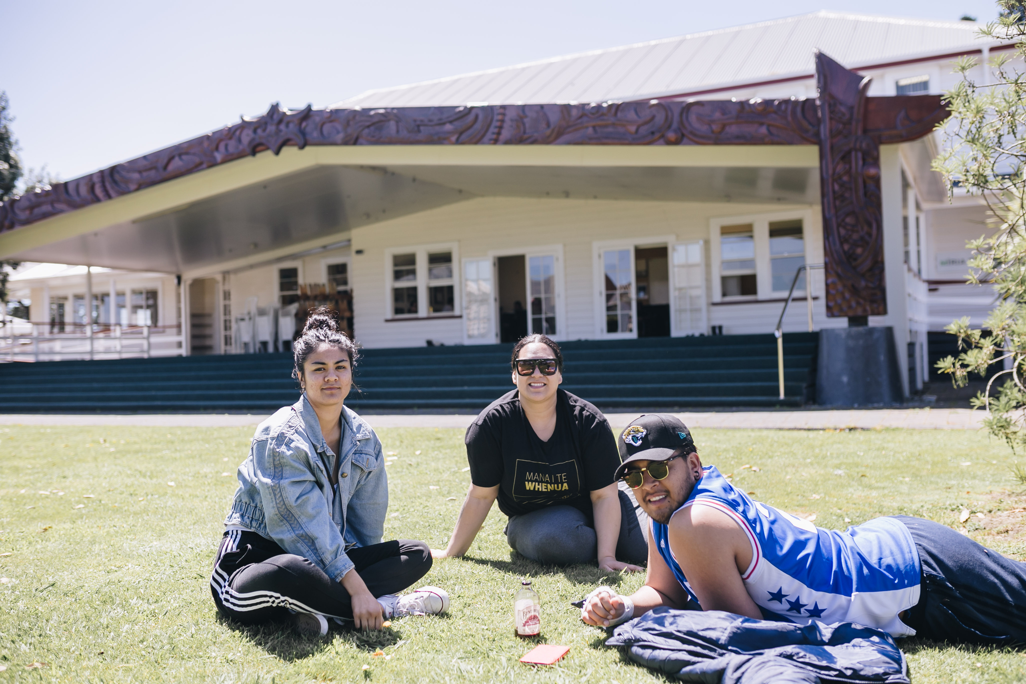
Te Wānanga o Raukawa The survival and wellbeing of Māori as a people
Te Reo,
Whakapapa,
Manaakitanga,
Wairuatanga,
Ūkaipōtanga,
Pūkengatanga,
Kotahitanga,
Rangatiratanga,
Whanaungatanga,
Kaitiakitanga
Notes:
Te Wānanga o Raukawa operates within kaupapa/tikanga framework as proposed by Ngā Kaihautū and endorsed by Te Mana Whakahaere. We find this has placed us in an environment with challenges and opportunities to learn about how the Māori mind (prior to being influenced by the language and culture of later settlers) conceptualised and responded to the world. The kaupapa provide a window to that world. The ongoing accumulation experience represents a contribution to our mātauranga continuum that has served us well and will serve us into the future.

Slide 7
Te Wānanga o Raukawa, then and now
1981
2 students
One programme
100% male
Average age: 20
2019
5000 students
18 UG degrees
5 PG degrees
75% women
Average age: 39
90% part-time

Slide 8
Manaakitanga
Te Wānanga o Raukawa views every enrolment as a mana-enhancing act.
Enrolment:
An act of mana-enhancement
Reciprocity: Manaakitanga
Open entry
Removal of barriers to learning

Slide 9
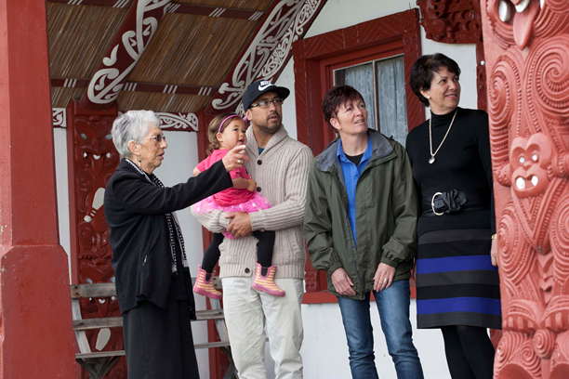
A Changing Demographic
Notes:
Demographic
39yrs, female, often mothers and grandmothers
Mature students who carry burden
First time learners
Part-time (working fulltime)
University structure doesnt accomodate/not suited to this demographic
Our people are victims of the education system
Our dempgraphioc supports our pursuit, vision

Slide 10
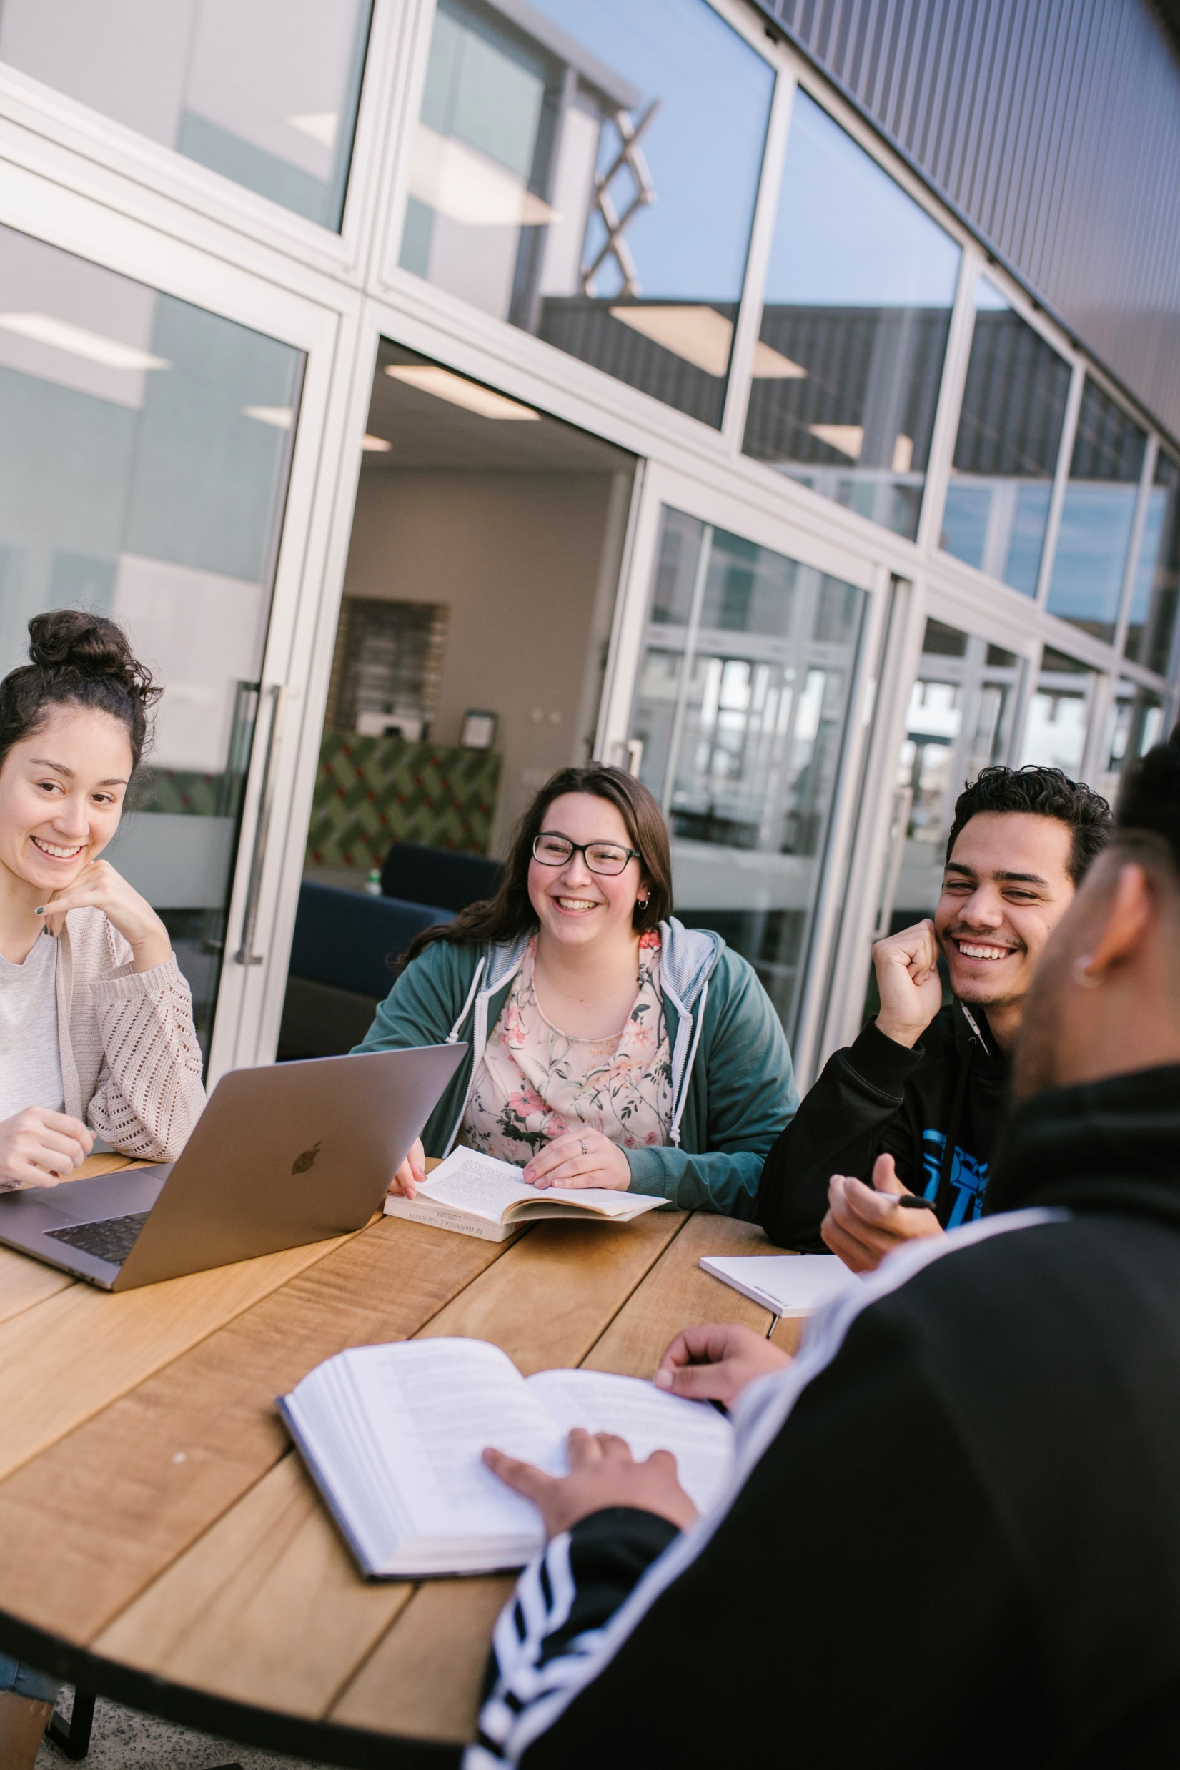
Academic Model
6-week packages
Work at home - Moodle
Learning engagement is interactive
Residential Seminar
Post Seminar work
Assessment completions
Notes:
2015
Financial burden informed academic model
Residential seminars – travel 6-8 times per year
Designed fit for purpose for our people and their circumstances

Slide 11
DRIVERS FOR CHANGE
Self management
Provide visibility across all platforms and remove all manual, repetitive, duplicated and varied processes
The Student Lifecycle
New Academic Model
Blended learning
Recognising an urgent need to improve systems and practices, that is smart, scalable and simple
Notes:
New Academic Model
Blended learning capabilities across the full suite of courses.
Recognising an urgent need to improve systems and practices, that is smart, scalable and simple
The Student Lifecycle
Student managing their journey and controls their information.
Provide visibility across all platforms and remove all manual, repetitive, duplicated and varied processes

Slide 12
The student controlling their journey
Notes:
3 phases
Recruitment
In course
Alumni

Slide 13
Business Transformation
Introduced technology solutions that are easy to use, that support staff & students working anywhere and anytime through innovative and cohesive solutions.
Notes:
Student success focused
Not about having the latest and greatest toys
Internal systems were weak
Too many gaps where we would lose students through systems not talking
We had systems that suited us not the students, came from a package that was designed for administration and not students
More responsive, giving them more control and accountable
Skill capacity level – ability to work in a technology environment
More engagement with students, up the level of engagement due to technology
Individual education plan
Mobility – Anywhere, anytime
Focus not on having the latest and greatest toys but it is all driven by an academic model that is designed fit for purpose for our people and their circumstances and in response to e kore au e ngaro he kakano i ruia mai i Rangiatea.
We found we could not do the best job we wanted to do because our internal systems were weak. We had many sources of truth, different databases spread across the organisation, didnt have visibility to track students; there were too many gaps through systems not talking. We had systems that suited us and was designed for administration and not students.
We aim to be more responsive to our students and to have more control and being accountable.

Slide 14
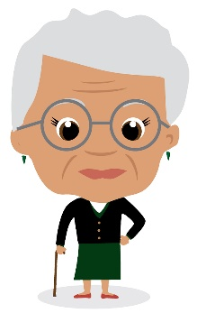
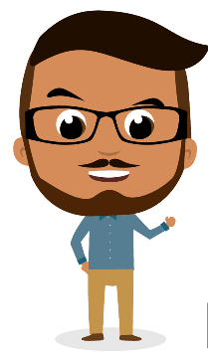
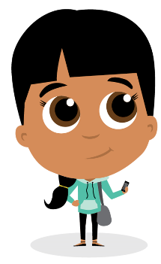
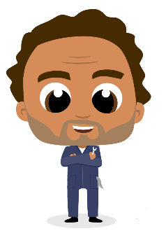
Change Management
Kuikui
Raimona
Staff are our biggest risk but also our biggest opportunity
Increased skill capacity level – ability to work in a technology environment
Change Agent Network established (30+ staff)
Ngāti Riripeti – Building capacity internally
Digital Immigrant
IT
Specialist
Riripeti
Moana
Digital
Native
IT
Technician
Notes:
Kuikui
An individual who was born before the existence of digital technology (digital immigrant) but adopted it to some extent later in life. She understood that the change was critical. She was excited but also very afraid.
Riripeti
Riripeti is our digital native. She is a person born into the age of digital technology.
Raimona
IT specialist - Very knowledgeable person in the world of IT. He knew the ins and outs of all systems.
Moana
IT Technician - Moana was our Mr fix it man. He delivered messages regarding any outages.
Their personas were adapted to fit the scope of the project. Staff could relate to at least one of the avatars. Over time staff were able to identify the purpose of a communication by what ever avatar was used.
Staff along the journey, making sure that when they got across a new line the line then disappeared so they couldn’t get back
Senior management buy in and not sit back and watch – appreciation and empathy for staff
Risk and opportunity
Avatars – classify themselves, gently encouraged,
Staff are our biggest risk but also our biggest opportunity
Change agent network
30 staff spread across the organisation and included the avatars
Facilitators of messages
Ngāti Riripeti
Train the trainer approach
Staff trained to train our own
Built skills within

Slide 15
So what?
Visibility
Controlled content management
No more silos
Standardised, streamlined processes and systems
Unlimited opportunities to express manaakitanga
Stronger, fitter, faster as an organisation
Notes:
Kuikui
An individual who was born before the existence of digital technology (digital immigrant) but adopted it to some extent later in life. She understood that the change was critical. She was excited but also very afraid.
Riripeti
Riripeti is our digital native. She is a person born into the age of digital technology.
Raimona
IT specialist - Very knowledgeable person in the world of IT. He knew the ins and outs of all systems.
Moana
IT Technician - Moana was our Mr fix it man. He delivered messages regarding any outages.
Their personas were adapted to fit the scope of the project. Staff could relate to at least one of the avatars. Over time staff were able to identify the purpose of a communication by what ever avatar was used.
Staff along the journey, making sure that when they got across a new line the line then disappeared so they couldn’t get back
Senior management buy in and not sit back and watch – appreciation and empathy for staff
Risk and opportunity
Avatars – classify themselves, gently encouraged,
Staff are our biggest risk but also our biggest opportunity
Change agent network
30 staff spread across the organisation and included the avatars
Facilitators of messages
Ngāti Riripeti
Train the trainer approach
Staff trained to train our own
Built skills within

Slide 16
Survey Graduands & Pūkenga
Graduands
Work Ready is a good investment
Career pathways are clear
Confident that they can secure positions
Mātauranga Māori is living and case studies are relevant
Academic Staff
Pūkenga undervalue administration
Pūkenga feel administration is below them
Pūkenga don’t like being told HOW to teach the things they teach
Pūkenga do not want to sacrifice their tuition time on other matters (characteristics of GWR&R), it is precious.
Change Management
Focus on student lifecycle
Kaupapa are the foundation of all actions

Slide 17
Business Intelligence (BI) Business intelligence is the convergence of the human mind and artificial intelligence (i.e. software driven).
Understanding brand and reputation
Predictive analytics
Individualised Support Services
Personalised/adaptive learning
Forecasting and planning
Campaigns based on sentiment and campaign effectiveness
Course and programme offerings based on surveys and enrolments
Proactive interventions based on profile, self assessment, literacy , numeracy, etc.
configurable l earning based on student behaviours and needs
at risk indicators triggering interventions
Social learning,
surveys
Course Delivery improvements
Patterns of student behaviours
Assessment patterns

Slide 18
Using BI to support successful outcomes
PRESCIPTIVE
What should I do?
Reports
Interactive Dashboards
Recommendations and Automation
Predictive Models
PREDICTIVE
What will happen?
DIAGNOSTIC
How did it happen?
DESCRIPTIVE
What happened?
PHASE I
PHASE II
PHASE III

Slide 19
Rangatiratanga Graduates who are Work Fit and Work Ready(GWF&R) Characteristics
Notes:
TWOR has always recognised that it’s a much bigger picture than teaching a course. We aim to evolve and identify characteristics that are missing.
Fundamental characteristics of a graduate who is work ready:
Some disciplines you would be introduced to in your home, some at school (if you go), some in other social community groups.
When you enter university or wānanga there is a combination of these things that you grew up with, some haven’t, but there is a piece missing or remaining.
Students study is worthwhile if they know or can be assured and confident that they can get employment when they are complete.
Learner success project we are focussing on producing graduates who are not only Māori in the way they think, behave and act but to produce graduates who are work fit and work ready

